Slide 1
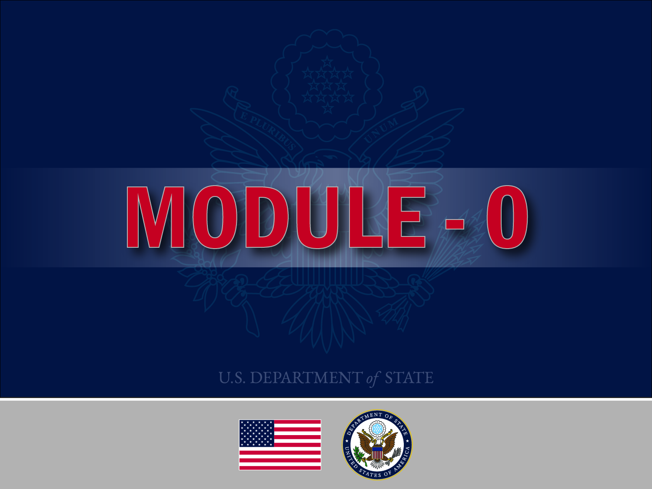
Notes:
SAY TEXT
Welcome everyone. Before we begin the training of our curriculum in ___________, we are going to walk through a few slides that will appear at the opening of all courses funded by the U.S. Department of State’s Bureau of International Narcotics and Law Enforcement Affairs (INL). We call this new opening “Module 0” and it invites all of us to become active participants in a rapidly growing global community of substance use professionals.

Slide 2

Congratulations!
“
As a participant in this training, you are part of a rapidly growing global community of substance use professionals
”
Notes:
SAY TEXT:
Congratulations, as a participant in this training, you are joining a rapidly growing global community of substance use professionals supported by the US. State Department’s Bureau of International Narcotics and Law Enforcement Affairs (INL).
This training, and others like it around the world, are a part of a larger and ongoing process of professionalization of the global prevention and treatment workforce.
Let’s look more closely at the word “professionalization.” What does it actually mean?
Professionalization is the training and development of prevention and treatment knowledge and skills which can be validated through examination and the process of credentialing. We will talk about professionalization in greater detail in later slides.
For now, welcome to the growing global community of substance use professionals!

Slide 3

How is this global community of substance use professionals expanding?
In the last decade, a growing number of people are:
  being trained
  being credentialed
  studying at universities with specialized addiction programs
  operating in the context of a larger drug control system
  adhering to science and research-based approaches
  joining professional substance use associations
  networking through professional associations
Notes:
SAY TEXT:
The growing global community is made up of people like you. As of the beginning of 2020, more than 10,000 individuals worldwide are:
being trained in prevention and treatment knowledge and skills,
being credentialed as prevention and treatment providers,
studying at universities with specialized addiction programs,
operating in the context of a larger drug control system,
adhering to science and research-based approaches, and
joining professional substance use associations and networking through them
We will look more closely at each one of these areas of professional activity in later slides.

Slide 4

Who are the members of this global community of substance use professionals?
Individuals working worldwide in the substance use prevention and treatment fields in government, non-governmental organizations, civil society, and the private sector
Organizations that act as portals or “doorways” for individuals to join the global community
Notes:
SAY TEXT:
Who are the members of this global community? They are both individuals and organizations.
There are thousands of individuals working worldwide in the substance use prevention and treatment fields in government, non-governmental organizations, civil society, and the private sector.
Examples of these substance use professionals are: drug control policymakers, prevention specialists, SUD treatment providers, medical doctors, mental health specialists, other clinicians in related health care and social service, law enforcement and criminal justice personnel who work in drug courts and other diversion programs, peer recovery support specialists, addiction scientists and researchers, and university students studying addiction.
Organizations act as portals for individuals to join the global community of substance use professionals. Three key global substance use professional organizations are:
The International Society of Substance Use Professionals (ISSUP)
The International Consortium of Universities for Drug Demand Reduction (ICUDDR) and
The Global Center for Credentialing and Certification (GCCC)
Now let’s take a brief look at each of these organizations that serve and unify this global community of substance use professionals.

Slide 5

ISSUP stands for the International Society of Substance Use Professionals
  ISSUP was launched by INL in 2015 as a global, not for profit, non-governmental organization to professionalize the global prevention and treatment workforce.
  ISSUP provides members with opportunities to share knowledge, exchange experiences, and stay abreast with current research in the field
Cont.
Notes:
SAY TEXT:
First we will look at ISSUP which was established by INL in 2015 to support the development of a global prevention and treatment workforce. ISSUP’s broader mission is to ground and guide the drug demand reduction field in keeping with evidence-based approaches, quality standards, and sound ethical best practices.
ISSUP provides its members with opportunities and access to share knowledge, exchange experiences, and stay up-to-date with the latest research in the field. Membership at ISSUP can open the door to individuals and networks of professionals who will help you grow and expand your knowledge and skills.
To date there are more than 10,000 ISSUP members worldwide with national chapters in 14 countries and six more national chapters now in the process of being formalized.
You can learn more about ISSUP and join for free at: www.issup.net
We strongly urge you to join this week since this training that you are completing is recognized by ISSUP and credit hours of education will be documented on your private profile. This training record is valuable for purposes of certification or when applying for certain opportunities.

Slide 6

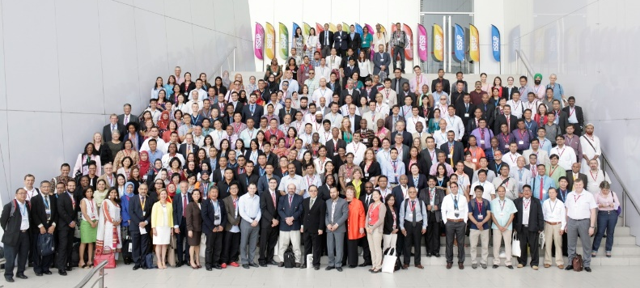
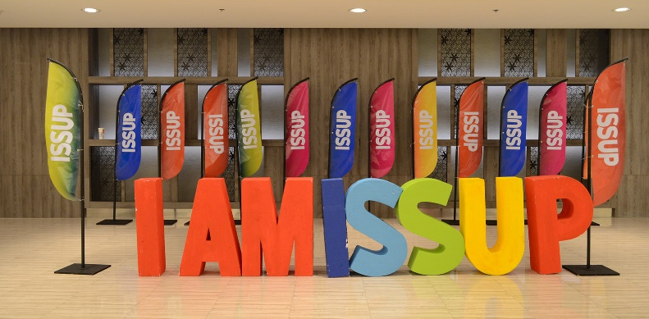
ISSUP stands for the International Society of Substance Use Professionals
  There are more than 10,000 ISSUP members worldwide
  Join one of ISSUPs four levels of membership for free at: www.issup.net
  You can earn credit for this and other courses with ISSUP
Notes:
SAY TEXT:
When you go to the ISSUP website www.issup.net to join for free, note that there are four levels of membership, each with its own criteria and benefits. They are as follows:
Regular Member
Criteria for Regular Membership:
An interested, non-professional applicant (can include volunteers, family members or non-accredited community members)
Acknowledgment and acceptance of ISSUP’s code of ethics
Receives:
Access to relevant online networks
Learning from the Knowledge Share section of the website
Ability to share work and experiences with others
Access to job opportunities from around the world
Professional Member
Criteria for Professional Membership:
This category is for those that are undertaking a role that makes a contribution to the drug demand reduction field, even if not necessarily a specialist or 100% dedicated to that activity. This includes professions such as:
Social workers
Religious leaders
Medical profession
Teachers
Youth workers
Community workers
Academics
Criteria:
An interest and/or contribution to drug demand reduction practice, policy or research
Hold a professional qualification/credential/certification related to their field
A minimum of 3 years’ experience in their role
Receives:
Access to relevant online networks
Information provided to support ongoing professional development
Access to job opportunities
Learning from the Knowledge Share section of the website
The opportunity to publish work to the field via the ISSUP website
Drug Demand Reduction Professional Member
Criteria for Drug Demand Reduction Professional Membership
This level of membership is for those who have specific qualifications, expertise and experience directly linked to the drug demand reduction field.
Criteria:
Applicants should meet one or more of the following criteria:
A minimum of 5 years significant and relevant experience working in the field of drug demand reduction (Prevention, Treatment or Recovery Support)
Demonstrate a specific professional qualification in a field that is directly related to drug demand reduction as one of its fundamental purposes
Demonstrate completion of internationally recognised training relevant to drug demand reduction
Hold relevant qualifications/credentials related to substance use disorder prevention, treatment and recovery support
Receives:
Access to relevant online networks
Information provided to support ongoing professional development
Access to job opportunities
Learning from the Knowledge Share section of the website
The opportunity to publish work to the field via the ISSUP website
Invitation and member discount to the ISSUP international/regional/national conferences
Student Membership
Criteria for Student Membership:
Attending an educational institution (any field) or attending training with drug demand reduction within their field of interest
Acknowledgment and acceptance of ISSUP’s code of ethics
Receives:
Information provided to support ongoing professional development
Access to student networks
Access to early careers network to develop professional standing
Access to job opportunities
Learning from the Knowledge Share section of the website
The opportunity to publish work to the field via the ISSUP website
Invitation to progress to other levels of provision of documentation on completion of studies
All ISSUP members must accept ISSUP's ethical principles

Slide 7

ICUDDR stands for the International Consortium of Universities for Drug Demand Reduction
  Global consortium of universities to promote academic programs that focus on science-based prevention and treatment
  Collaborative forum for individuals and organizations to support and share curricula, particularly this Universal Curriculum series, and experiences in the teaching and training of prevention and treatment knowledge
Cont.
Notes:
SAY TEXT
ICUDDR stands for the International Consortium of Universities for Drug Demand Reduction. It was founded in April of 2016 by the Colombo Plan, the Organization of American States (OAS) and a panel of 20 university experts in addiction.
ICUDDR is a global consortium of universities which offer undergraduate, graduate, and postgraduate study programs specifically focusing on the transfer and adaptation of science-based prevention and treatment.
As of early 2020, there are over 215 ICUDDR member universities from over 65 countries.
ICUDDR functions as a collaborative forum to support and share curricula, particularly this Universal Curriculum series, and experiences in the teaching and training of prevention and treatment knowledge.
ICUDDR aims to promote and encourage the recruitment of persons interested in the research, prevention and treatment of substance use disorders and public health.
You are invited to learn about specialized addiction programs at universities worldwide at www.icuddr.com

Slide 8
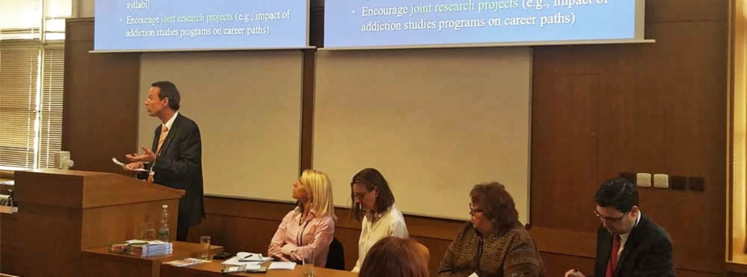
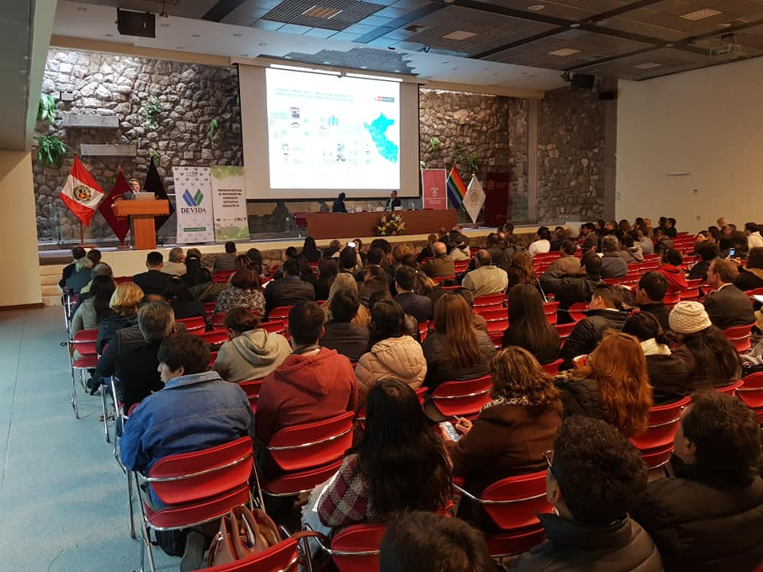
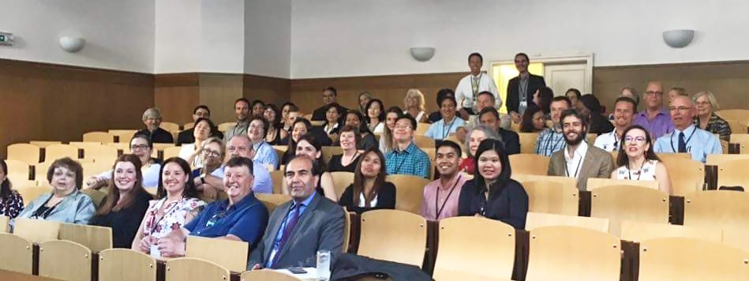
ICUDDR stands for the International Consortium of Universities for Drug Demand Reduction
Learn about specialized addiction programs at universities worldwide at www.icuddr.com
Notes:
SAY TEXT:
These are photos of some of ICUDDR events around the world.

Slide 9

GCCC stands for the Global Centre for Credentialing and Certification of Addiction Professionals
  The hours that you put into this training can be logged at GCCC and qualify you for exams and professional credentials
  GCCC credentials will help accelerate your career by indicating your passion and commitment to high standards
Cont.
Notes:
SAY TEXT
The Global Centre for Credentialing and Certification (GCCC) of Addiction Professionals was established in 2009. It is part of the international organization known as the Colombo Plan and falls under its Drug Advisory Programme (DAP). DAP’s universal curricula and global trainings help prepare trainees to work as qualified professionals who are capable of applying the latest science-based treatment and prevention approaches.
It is GCCC’s mission to provide both experience verification and appropriate exams to ensure that governments and other employers are hiring and utilizing the most qualified professionals.
The hours that you put into this training can be logged at GCCC and qualify you for exams and the opportunity to earn professional credentials.
Throughout the year, GCCC hosts International Certified Addiction Professional (ICAP) examinations around the world. The ICAP exams cover the necessary knowledge and skills needed to be an effective professional.
You are invited to visit the GCCC website at www.globalccc.org for more information about how to accelerate your career with credentials and build evidence of your commitment to the highest professional standards.

Slide 10
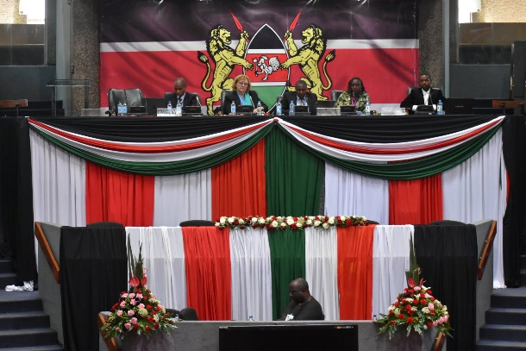
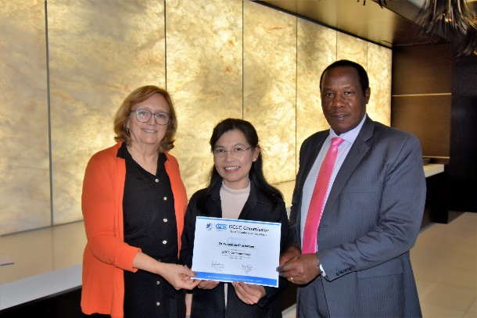
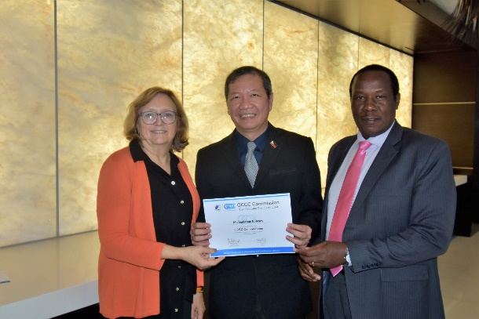
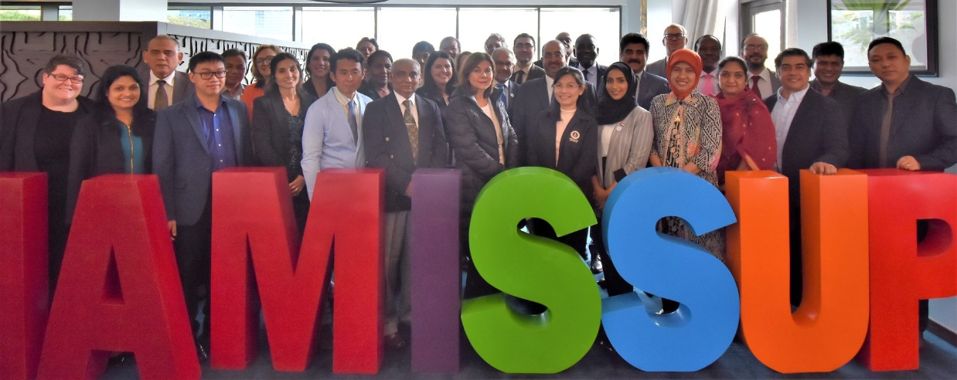
GCCC stands for the Global Centre for Credentialing and Certification of Addiction Professionals
Learn about how to apply the latest in research-based prevention and treatment at: www.globalccc.org
Notes:
SAY TEXT:
These are photos from some of GCCC events around the world

Slide 11

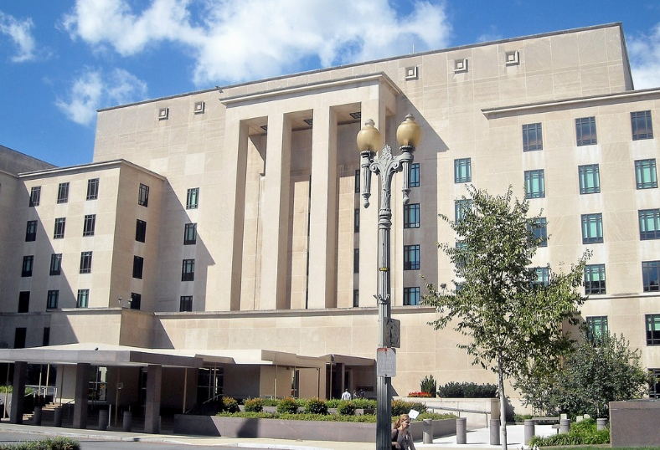

Who funds and supports this global community of substance use professionals?
The U.S. Department of State’s Bureau of International Narcotics and Law Enforcement Affairs (INL) which is funded by the U.S. taxpayer
Notes:
SAY TEXT:
The funder of the global community of substance use professionals is the U.S. State Department’s Bureau of International Narcotics and Law Enforcement Affairs (INL) --which is funded by the U.S. taxpayer.
Not only does INL have a long history of developing and supporting a global prevention and treatment workforce, it has also been the leader for many decades in overall international drug demand reduction efforts.
It is worth noting that the U.S. funds more than 80 percent of the world’s drug research and that the U.S. also champions the right of every person to be free from slavery of any kind, including chemical slavery resulting from drug use.

Slide 12
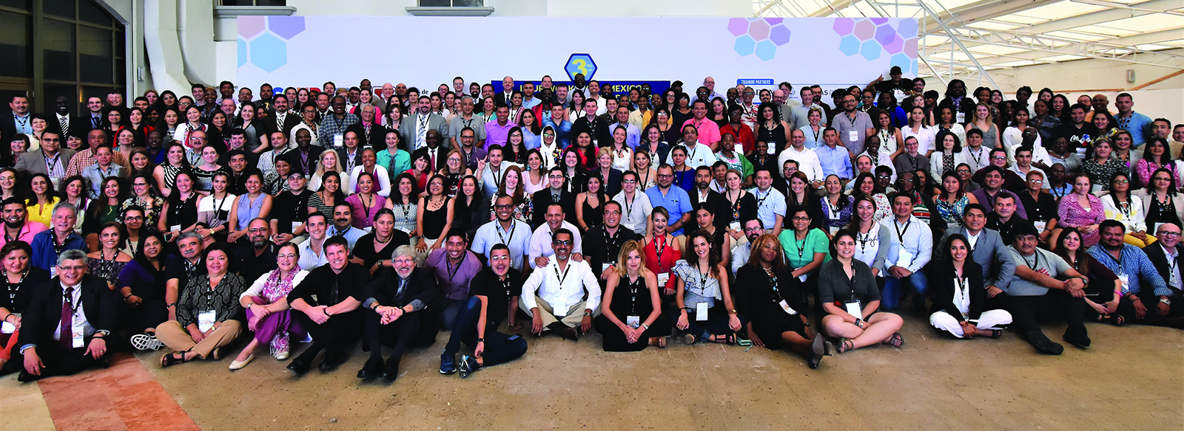
Where does this global community of substance use professionals meet?
  Digitally- through ISSUP and its networks and
  Face to face – through trainings, on university campus settings, and at conferences held at the global, national regional and local levels
Notes:
SAY TEXT:
The members of this community “meet” in two ways. They “meet” digitally through ISSUP and its vast global networks. We will learn more about ISSUP’s networks in later slides.
They also meet face-to face as well as digitally, through various platforms such as ZOOM, for on-line trainings, mentorships, on university campus settings, and at conferences held at the global, national, regional, and local levels.

Slide 13
How does this global community of substance use professionals operate?
In the context of a larger international drug control environment that includes:
  United Nation’s three international Drug Control Treaties or “Conventions”
  Commission on Narcotic Drugs (CND)
  International Narcotics Control Board (INCB)
Notes:
SAY TEXT
The global community of substance use professionals operates in the context of a larger international drug control environment which includes three key parts.
Let’s take a brief look at each of the three elements of the international drug control environment within which the global community of substance use professionals operates.
The first aspect of the international drug control environment is made up of the three major treaties or “conventions” adopted by the United Nations to guide international drug control efforts.
The purpose of these treaties is to ensure that drugs are available for medical and scientific purposes while preventing abuse and diversion of those drugs into illicit channels. The 3 major treaties are:
1) The Single Convention on Narcotic Drugs (adopted in 1961),
2) The Convention on Psychotropic Substances (1971), and
3) Convention Against Illicit Traffic in Narcotic Drugs and Psychotropic Substances (1988)
A second element of the international drug control environment is the Commission on Narcotic Drugs (CND) which was established by the United Nations as a body by which to supervise the application of the three UN international drug control treaties. Every year the world gets together at the annual CND to meet on the global drug issues.
A third element of the international drug control environment is the International Narcotics Control Board (INCB) which is an independent body that monitors the implementation of the United Nations international drug control conventions. The INCB helps member states to achieve the aims of the UN international drug control conventions by providing technical assistance and guidance to member states, and by monitoring the worldwide production, trade, and consumption of narcotic drugs and psychotropic substances. The INCB is made up of thirteen experts who are each elected in their personal capacity.
There are also five international drug demand reduction organizations with whom INL partners, that also operate within the context of this larger international drug control environment. We will now take a brief look at each of them in the next slide.

Slide 14

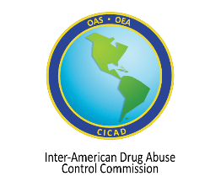



What are the key international organizations which operate in the context of this larger drug control environment?
  The Colombo Plan Drug Advisory Program (DAP)
  The Inter-American Drug Abuse Control Commission (CICAD) of the Organization of American States (OAS)
  The African Union Commission (AUC)
  The United Nations Office on Drugs and Crime (UNODC)
  The World Health Organization (WHO)
Notes:
There are also five international organizations which operate in the context of this larger international drug control environment. INL works with them as partners in drug control efforts around the world. They are: the Colombo Plan, the OAS-CICAD, UNODC, WHO, and the AUC.
Now let’s take a brief look at the mission of each of these five organizations.
The Colombo Plan Drug Advisory Programme (DAP) spearheads drug demand and supply reduction solutions, mainly in the Asia-Pacific region, Africa, and Latin America.. It also provides technical assistance, training, and programming across five continents. Since 2009, the Global Centre for Credentialing and Certification (GCCC) has operated as the credentialing division of DAP. Colombo Plan opened offices in Kabul, Afghanistan and Santiago, Chile in 2010 and 2017 respectively.
The Inter-American Drug Abuse Control Commission (CICAD) of the Organization of American States (OAS) is the Western Hemisphere’s policy forum for dealing with the drug problem. The Demand Reduction Section of CICAD works with member states to build institutional and human resource capacity through training and certification programs.
The African Union Commission (AUC) is the policy making organ of the African Union - an inter-Governmental organization of 55 African countries and is responsible for formulating continental policies and frameworks. It promotes the adoption of comprehensive, balanced and integrated polices to counter the world drug problem including scaling up evidence-based services to address health and social impact of drug use. AUC promotes minimum quality standards for drug treatment and seeks to strengthen epidemiological networks and research and data collection capacity.
The United Nations Office on Drugs and Crime (UNODC) operates in all regions of the world through an extensive network of field offices to assist Member States in responding to the world drug problem. UNODC encourages a balanced approach between drug supply and drug demand reduction activities, with a fundamental emphasis on respect for human rights.
The World Health Organization (WHO) is the directing and coordinating authority on international health within the United Nations system. It provides leadership on matters critical to health by shaping the research agenda, disseminating knowledge, implementing norms and standards, and articulating policy options that are based in both science and ethics.

Slide 15
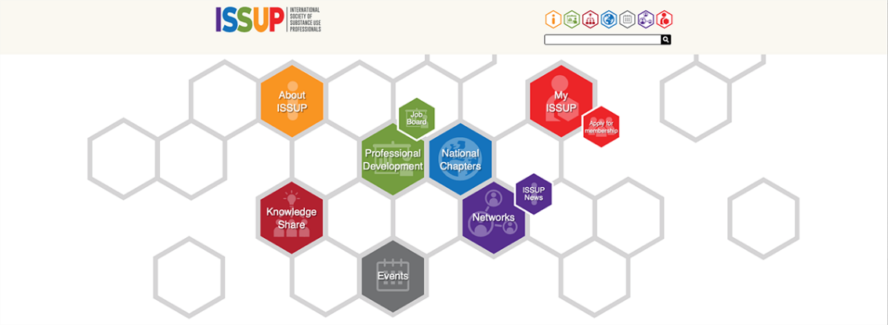


How can I participate in this global community of substance use professionals?
The easiest way is to become an active member of ISSUP!
  Register for free on the ISSUP website at www.issup.net
  Click on the “Apply for Membership” icon
  Select one of four levels of membership -all are free!
  Begin networking with others on an ongoing basis
It takes only a few minutes to register and you can immediately connect with over 10,000 ISSUP members worldwide!
Notes:
SAY TEXT:
The easiest way to participate in this global community of substance use professionals is by joining and becoming an active member of ISSUP.
First of all, you can register on the ISSUP website at www.issup.net.
Registering takes only a few minutes and membership is free. All you need to do is click on this membership icon on the homepage. You can select one of four levels of membership-- and all are free.
Membership allows you to immediately connect with over 10,000 members worldwide.
As an ISSUP member, you can instantly access the latest information and news, scientific research, and training opportunities.
ISSUP is the fastest and easiest way to network both digitally and face-to-face with other members of the global community of substance use professionals.

Slide 16
What are the benefits of being an active member of this global community of substance use professionals?
You can:
  Stay informed
  Implement best practices
  Access training and mentoring
  Turn training into credentials
  Access job postings
  Access up-to-date research
  Join a professional network
  Interact with other professional networks
Notes:
Being an active member of the global community of substance use professionals offers many substantial benefits including:
Staying informed as to SUD events around the world
Learning how to implement evidence-bases practices/programs
Access training and mentoring opportunities
Taking advantage of credentialing opportunities
Access postings for internships and employment opportunities
Accessing the latest SUD research
Joining a network in your area of specialization and
Interacting with a broad set of professional networks
As a member of ISSUP, the doors of ICUDDR and GCCC are also opened to you. On the ISSUP website, for example, you will be immediately informed on upcoming conferences and trainings being held around the world.
When you join ISSUP and interact in the ISSUP community, you will become more aware of the larger international drug control framework which unifies efforts in the field.
With access to research, training, mentoring, credentialing and networking, you will find yourself on a path towards enhancing your status as a professional with more opportunity for advancement.
Most importantly, you will possess a greater ability to make a contribution to addressing the drug problem, both in your community and globally.

Slide 17
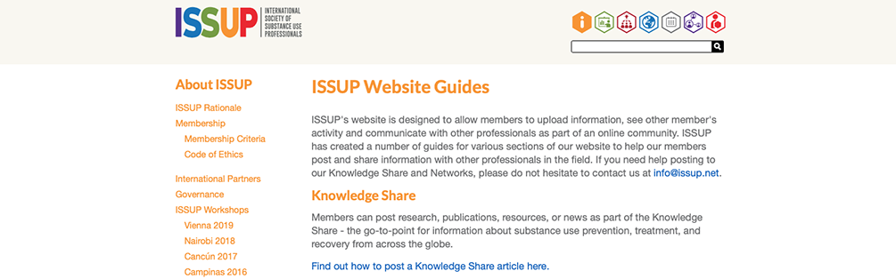

CALL TO ACTION
Next Steps
Join ISSUP at www.issup.net
Complete this training to earn credit
Send your credit hours to GCCC at www.globalccc.org
Participate in ISSUP
Post on ISSUP: Find easy instructions for how to post on the ISSUP website
Engage ISSUP’s Networks: Connect with colleagues and broaden your impact
Notes:
INL invites all members of this training to respond to a formal CALL TO ACTION.
INL encourages you to invest in yourself, your colleagues, and the field by taking three simple steps. First, join ISSUP. Second, complete this training. Third, send your credit hours to GCCC.
Participate as an active member of the global community of substance use professionals by learning to post on the ISSUP website and engage in one or more of ISSUP’s networks. Enjoy connecting to the world of prevention and treatment professionals.
“Module 0” has hopefully provided you with a heightened awareness of the nature of the rapidly growing global community of substance use professionals to which you now belong by virtue of attending this training.
INL and your colleagues around the world warmly welcome you!

