Slide 1


The Potential Harm of Electronic Cigarette
Hari Nugroho, MD, MSc
Addiction Medicine Physician
harinugroho@gmail.com
Green Crescent Indonesia
Institute of Mental Health Addiction and Neuroscience Jakarta
National Narcotics Board the Republic of Indonesia

Slide 2
Disclosure
I do not receive any sponsorships / grant / fund / salary from any pharmaceutical or tobacco and electronic cigarette company.
I am a staff and get salary from Indonesia government agency : National Narcotics Board the Republic of Indonesia.

Slide 3
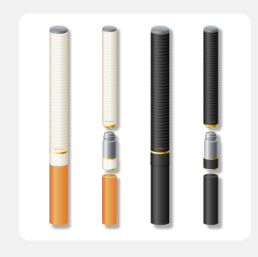
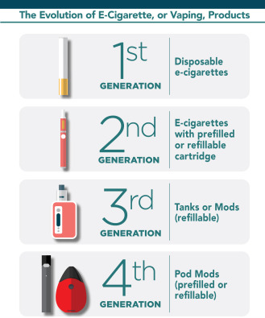
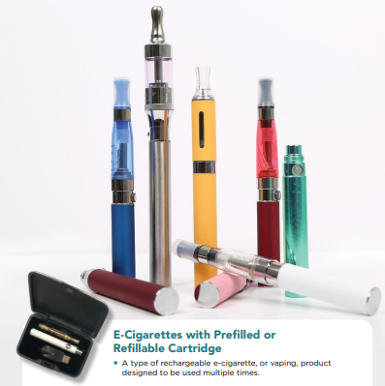
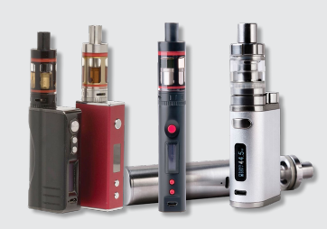
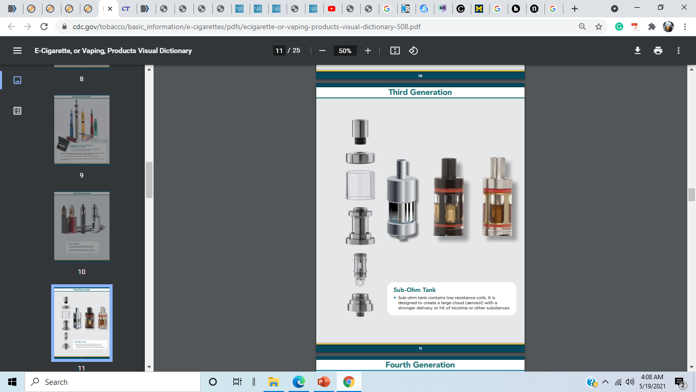
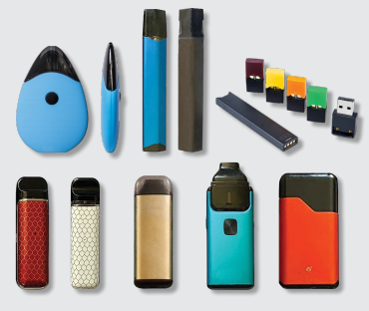
The Evolution of E-Cigarette https://www.cdc.gov/tobacco/basic_information/e-cigarettes/pdfs/ecigarette-or-vaping-products-visual-dictionary-508.pdf

Slide 4
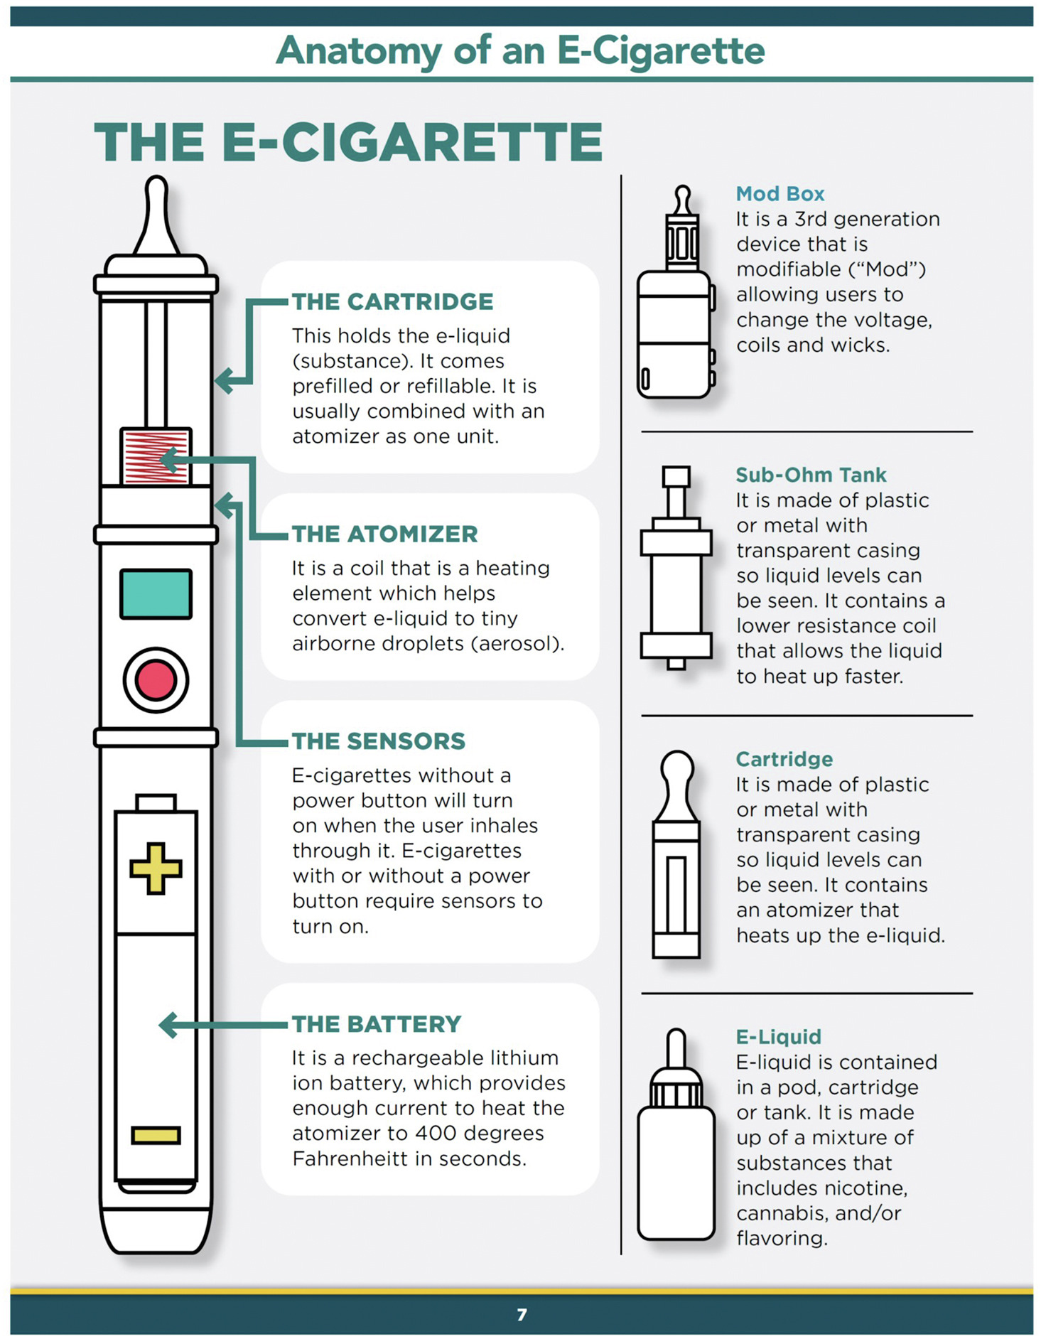
Anatomy of E-Cigarette
https://www.cdc.gov/tobacco/basic_information/e-cigarettes/pdfs/ecigarette-or-vaping-products-visual-dictionary-508.pdf

Slide 5
Modification of E-Cigarette
Coils : Various cloud thickness and densities;
Cotton Wicks : safety, taste, and quality reasons
Batteries : safety
E-Liquid : nicotine strength, cheaper product, to mixed with different substances such as flavors liquid, THC, CBD, or other drugs
Yachao Li , Robert T. Fairman , Victoria Churchill , et al. Users’ Modifications to Electronic Nicotine Delivery Systems (ENDS): Interviews with ENDS Enthusiasts. Int. J. Environ. Res. Public Health 2020, 17, 918

Slide 6
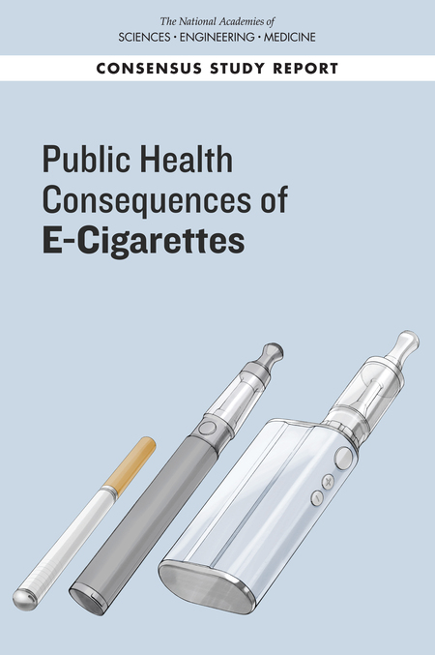
Potential Harm
Conclusion 5-1. There is conclusive evidence that in addition to nicotine, most e-cigarette products contain and emit numerous potentially toxic substances.
Conclusion 5-2.There is conclusive evidence that other than nicotine, the number, quantity, and characteristics of potentially toxic substances emitted from e-cigarettes are highly variable and depend on product characteristics (including device and e-liquid characteristics) and how the device is operated
Conclusion 14-1. There is conclusive evidence that e-cigarette devices can explode and cause burns and projectile injuries. Such risk is significantly increased when batteries are of poor quality, stored improperly, or modified by users.

Slide 7
Vaping Drugs?
Increase : Inhalation as a route to use drugs
Possibility to use e-cigs as an alternative to use drugs
Dissolved in e-liquids
Crushed plant materials → thick waxes or oils
Breithbarth, 2018 DOI https://doi.org/10.1016/j.drugalcdep.2018.07.031

Slide 8
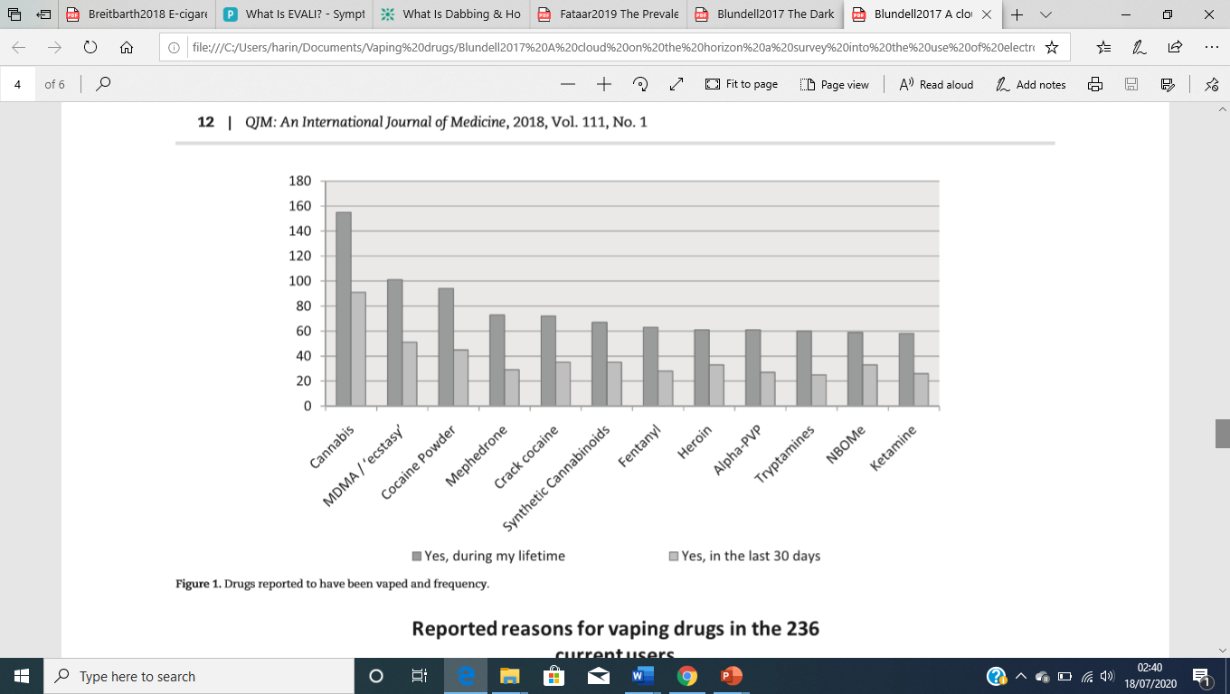
Vaping Drugs (2)
Blundell, M; Dargan, P; & Wood, D, 2017 doi: 10.1093/qjmed/hcx178

Slide 9
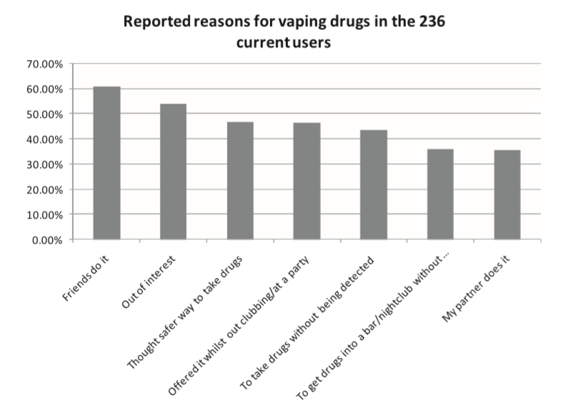
Vaping Drugs (3)
Blundell, M; Dargan, P; & Wood, D, 2017 doi: 10.1093/qjmed/hcx178

Slide 10
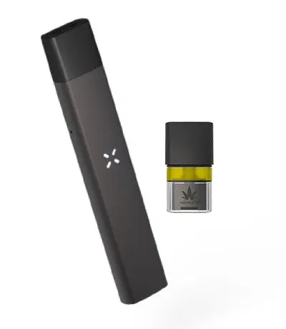
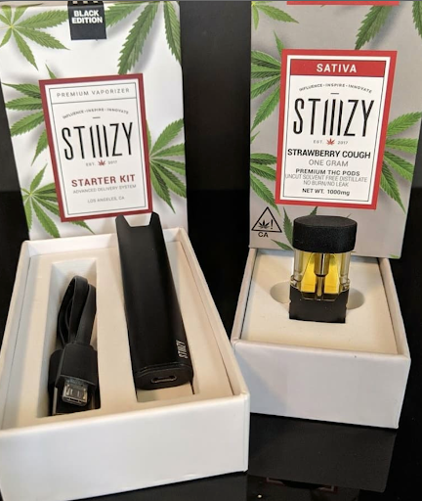
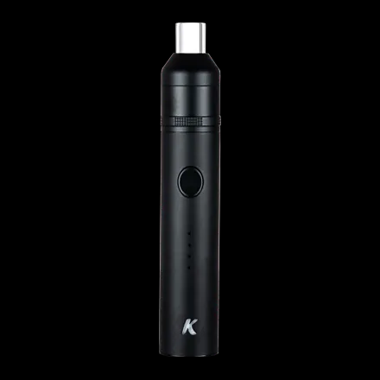
E-Cigs to consume THC/CBD
Smaller clouds
Smells like weed, with some fruity aromas mixed in

Slide 11
EVALI : SIDE EFFECT OF VAPING DRUGS
EVALI : Electronic cigarette , or Vaping product use Associated Lung Injury
Bronchoalveolar lavage (BAL) fluid :
Vitamin E acetate (48 of 51 cases [94%])
THC detected or reported vaping THC product (47 of 51 cases [94%])
Vitamin E acetate as additive substance for THC liquid
Another concern : liquid CBD analysis contains 5 Fluoro MDMB-PINACA (5F-ADB) dan Dextrometorphan
Benjamin C. Blount et al (2020) N Engl J Med 2020; 382:697-705 DOI: 10.1056/NEJMoa1916433
Poklis, J.L.; Mulder. H.A.; & Peace, M.R., 2019 https://doi.org/10.1016/j.forsciint.2018.10.019

Slide 12
Indonesia situation of electronic cigarette
There is no certain regulations about electronic cigarette
Vaping drugs become popular, SINTE is the street name
Some drugs particularly NPS are detected in the e-cigarette liquid
Bought from online markeplace or social media
Common reason : to avoid detection, odorless, difficult to get cannabis, friends also use sinte.
Side effect : Strong hallucination, headeache, nausea, black out

Slide 13
Liquid E-Cigarette containing drugs in Indonesia
Synthetic Cathinone : 4-metklorokatinona (4-CMC) / Blue Safir
Synthetic Cannabinoid: 5-fluoro-ADB; 5-fluoro-MDMB-PICA; FUB-AMB
Cannabis: THC; CBD
Amphetamine Type Stimulant: MDMA / Liquid Illusion; Methamphetamine
NPS Alert System -BNN

Slide 14
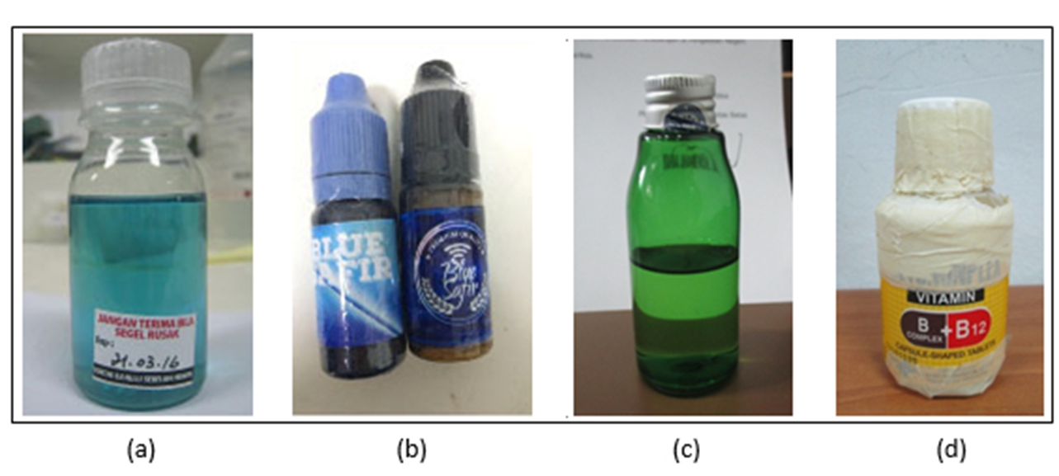
4-CHLOROMETHCATHINONE (Clephedrone) / Blue Safir
Synthetic Cathinone
NPS Alert System -BNN

Slide 15
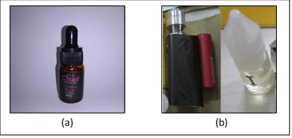
Synthetic Cannabinoid
5-Fluoro-ADB
5-Fluoro-MDMB-PICA

Slide 16
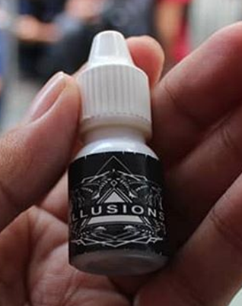
Synthetic Cannabinoid:
FUB-AMB
NPS Alert System -BNN

Slide 17
Conclusion
Modification of e-cigarette device can be dangerous
EVALI can be the dangerous effect of using liquid e-cigs which contained vitamin E asetate as additive substance for THC
The need specific regulation about e-cigarette
The need to educate people about the potential harm of using e-cigs to consume drugs

