Slide 1
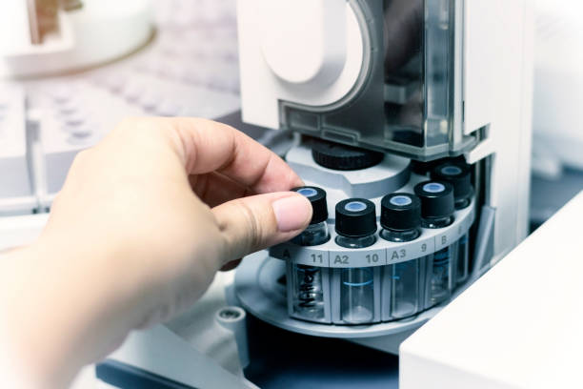

Forensic testing for alcohol and drugs in relation to substance abuse detection and validation
Dr. Tim Laurens
Ms. Maraliese Jordaan
BSc(Ed); BSc(Hons); MSc(Chem); MSc(Appl Tox); MPhil (Med Law), PhD(Chem); PhD(Med Law)
Forensic Toxicologist | Director
Tel: +27 (0) 82 673 9338
E-mail: tim.laurens@fortoxlab.co.za
BSc(Phys); BSc(Hons)(Chem Path); MSc(Chem Path)
Laboratory Manager | Director
Tel: +27 (0) 83 324 6472
E-mail: maraliese.jordaan@fortoxlab.co.za

Slide 2

INTRODUCTION
Substance abuse detection of prime importance in modern-day life
Schools
DIAGNOSTIC TESTING
Civil matters and Family Law
  Family and Matrimonial law
  Personal injury
  Disability
Criminal law environment and sentencing recommendations,
  Correctional addiction psychiatry
  Treatment and rehabilitation
  Non-incarceration correctional settings
Administrative Law environments
  Administrative refers to expectations, due process procedures and practices of various regulatory bodies
  Regulatory bodies:
    World anti doping association
    Professions
    Aviation industry
    Jokey clubs
Workplace
COMPLIANCE TESTING

Slide 3
COMPLIANCE VS DIAGNOSTIC APPROACH
COMPLIANCE TESTING
Threshold concentration or administrative cut-off levels
In the interest of Health and Safety and “risk minimisation” (Occupational Health and Safety Act, Act 85 of 1993)
No diagnostic approach, rather “strict liability”
Medical Review Officer: No “doctor-patient” relationship of trust
DIAGNOSTIC TESTING
No threshold concentration or administrative cut-off levels
Sometimes a “Limit-of-Detection” approach
Diagnostic approach: Drug test results a part of the diagnostic/assessment paradigm
In the best interest of the patient or the child (Children’s Act; Act 38 of 2005, Section 9)
Substance abuse professional may have a “doctor-patient” relationship of trust in a clinical treatment setting (Altruistic approach)
Independent consultant or friend of the court have less ethical constraints regarding
the “doctor-patient” relationship of trust

Slide 4
DIAGNOSTIC APPROACH
No illegal substances in their system
Schools
LEARNERS ARE TESTED
No “legal” substances such as Cannabis and Alcohol in their system
Civil matters and Family Law
  Family and Matrimonial law
  Personal injury
  Disability
Divorce disputes
Custody
Guardianship
Adoption
Child Safety
Illegal substance use indicate risky behaviour
Inappropriate Alcohol and Cannabis use problematic
Criminal law environment and sentencing recommendations,
  Correctional addiction psychiatry
  Treatment and rehabilitation
  Non-incarceration correctional settings

Slide 5
CONSTITUTIONAL & ETHICAL REQUIREMENTS
CSA Section14: “Everyone has the right to privacy”.
CSA Section10: “Everyone has inherent dignity and the right to have their dignity respected and protected”.
CSA Section12(2) (b & c): “Everyone has the right to bodily and psychological integrity, which includes the right: to security in and control over their body and not to be subjected to medical or scientific experiments without their informed consent.”
CSA Section15: “Everyone has the right to freedom of religion, belief and opinion”.
CSA Section28(2): “A child’s best interests are of paramount importance in every matter concerning the child”.

Slide 6
CLINICAL ASSESSMENTS FOR LEGAL PURPOSES
Forensic assessment of a substances abuser must include a review of all history:
Medical information
Psychiatric information
Social function
Standardised instruments:
Michigan Alcoholism Screening Test provides normalised data which is useful for comparison
Laboratory Tests:
Essential to know what tests to order and what the significance of the tests are
Elevated levels or presence does not imply addiction
Ex:
  Urine alcohol tests provides different information vs a serum carbohydrate-deficient transferrin (CDT) test
  Knowledge of the False-positive-rate (FP) and False-negative rates (FN) important
  A high FP and FN rate for a test result will require an additional test to improve the probability of detection
  Abnormal CDT, Liver enzymes (GGT) and macrocytic anaemia (Red blood cell MCV)
  does not imply addiction or dependence
  Ignorance to these probabilities not in the interest of justice, the individual or the profession

Slide 7
DRUG TESTING IN GENERAL
Testing identifies recent use and can help to :
Obtain information on drug use in a “drug-free standard” environment
Differentiate chronic (repetitive) use from single (low frequency) uses
Two characteristics about drug use and addictive disorders are that:
Continued use despite the problems caused by the use
DISHONESTY to others and themselves regarding their alcohol and drug use
Many of the users with positive test results claim that the use was an isolated/first time event.
Rare or occasional USE ARE UNLIKELY TO BE DETECTED BY DRUG TESTING
Vast majority of positive drug tests reflect continuous use

Slide 8
DRUG TESTING IN GENERAL
Route of administration are chosen to achieve the “brain rewarding effect”.
The route that delivers the most rapid increase in blood concentrations are the most intensely rewarding.
- Injecting, Oral, Intranasal, Smoking
Once absorbed into the blood stream, distributed to all parts of the body, metabolised in the liver and excreted
Drugs can be detected in all parts of the body, body fluids and tissues

Slide 9
INGESTION
Oral
Liver
Intravenous
Bloodstream
BBB
Brain
Inhallation
Lungs

Slide 10

Matrix
Years
Hair
Nails
Urine
Sweat
Weeks
Indicator of Intoxication
Invasiveness
6 h
Saliva
Breath
0 h

Slide 11
Detection time
Matrix | Detection time | Comments
Blood and oral fluid | 1 – 3 days
Breath alcohol | Immediately | Similar to blood for ethanol detection
Urine (most drugs)-single dose | 1 - 3 days | Initial time-lag of typically 4 hours
Urine (most drugs)-multiple dose | 1 - 5 days | Initial time-lag of typically 4 hours
Urine (cannabis)-multiple dose | Up to 27 days | Initial time-lag of typically 4 hours
Sweat | Up to 7 days | Initial time-lag of typically 2-8 hours
Hair | Up to years | Initial time-lag of typically 3-5 days

Slide 12
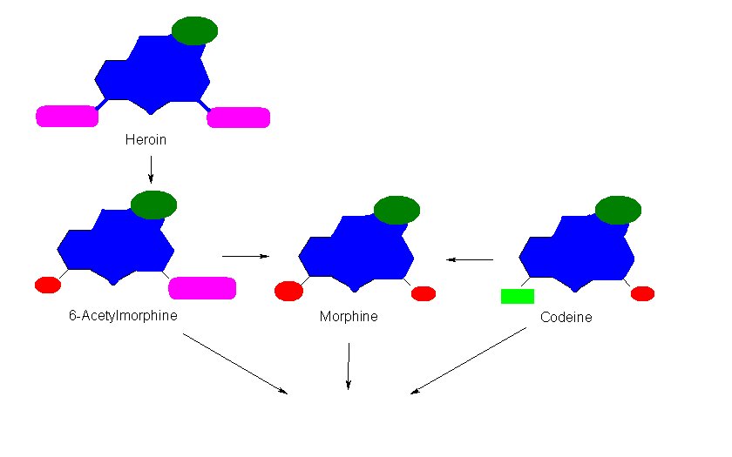
Metabolism of Opiates
ILLEGAL
LEGAL
Codus, Myprodol, Syndol etc
Opiate Class

Slide 13
Metabolism of Cocaine

Slide 14
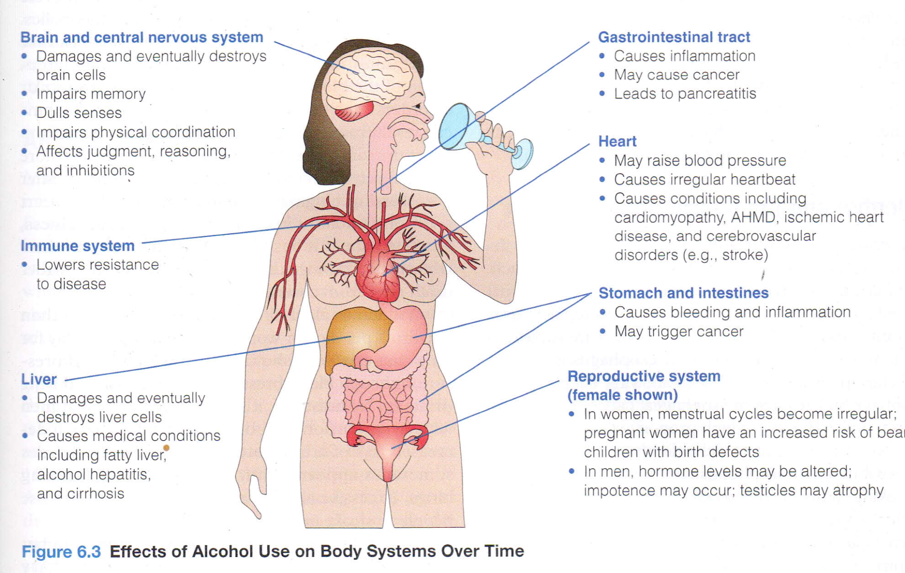
Alcohol

Slide 15
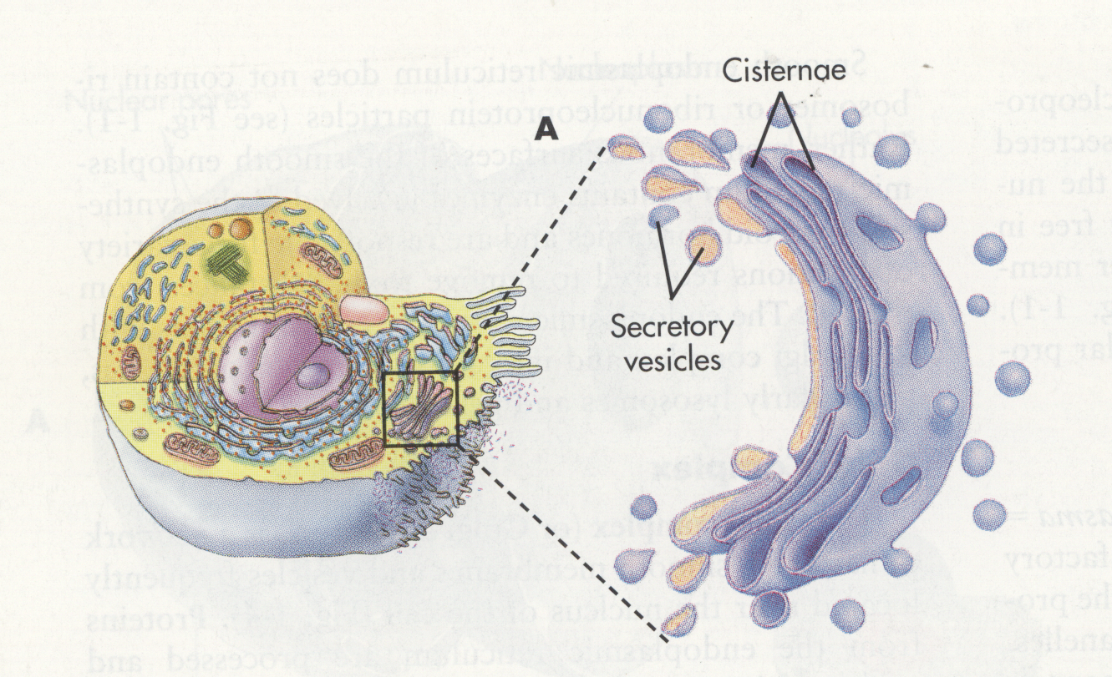
Metabolism of Drugs
Metabolism
increase water solubility
Hepatocyte
Cytochrome P450 Enzymes CYP3A4, CYP2A6

Slide 16
Testing strategy
Screening / preliminary test
ALL “non-negative results”
Confirmation
Specialized laboratory (GC-MS) Forensic Toxicology Laboratory Pty Ltd
Competent to provide evidence in a disciplinary hearing or a Court of Law

Slide 17
Sensitivity vs Specificity of a test
$Sensitivity= \frac{TP}{TP+FP}$ = Rate of successful identification of true positives
$Specificity= \frac{TN}{TN+FP}$ = Rate of successful identification of true negatives

Slide 18
Testing Techniques
Testing starts with the least expensive detection techniques – immunoassay screening tests with high sensitivity but not necessarily high specificity
    Low specificity can cause false positive test results by non-drugs
    Used routinely in settings where the test result is used as additional information to complement the diagnostic regime
    Preliminary test results MUST BE CONFIRMED before decisive action in the criminal justice system
    Limited immune assay tests available – lab tests required for drugs, which cannot be tested for by immunoassay.
  Confirmation testing – no subject to cross reactivity

Slide 19
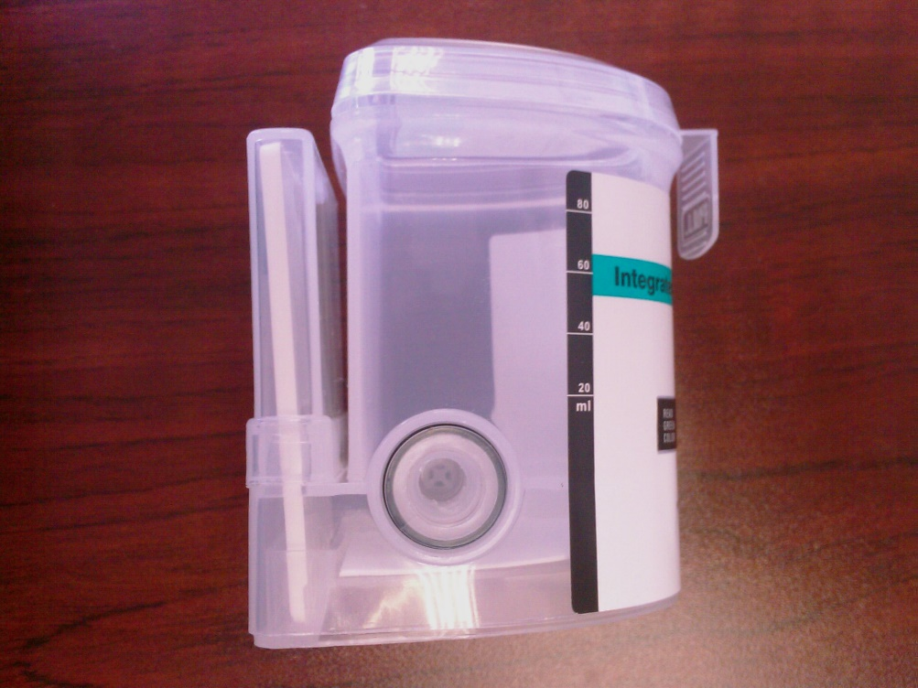
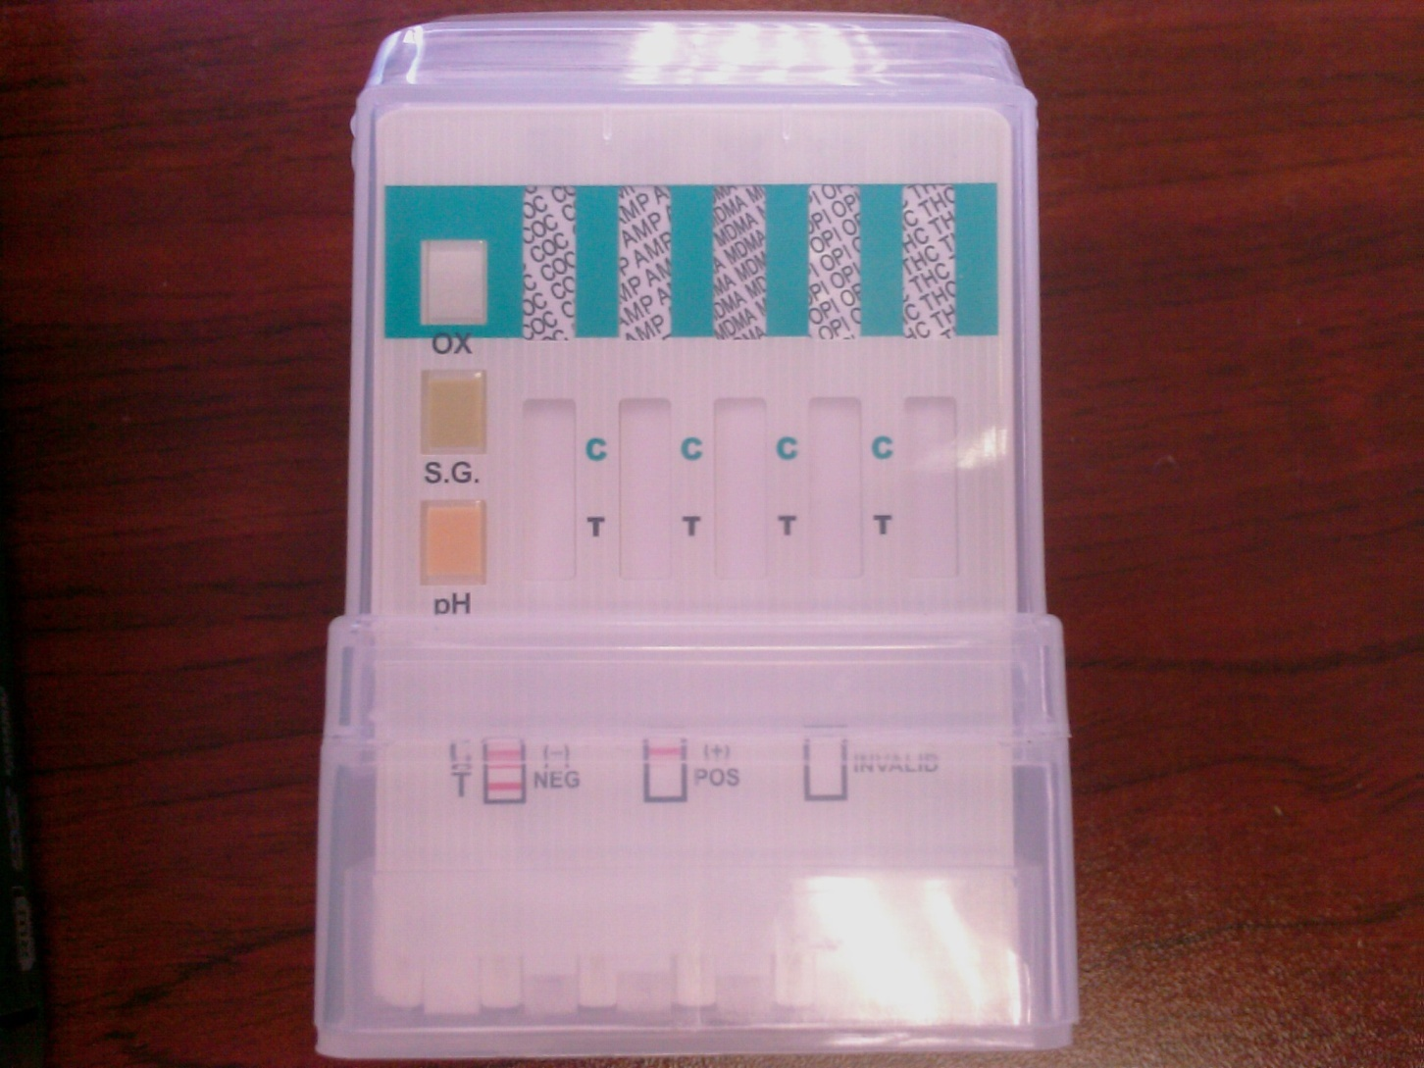
SCREENING TEST
Sensitivity and Specificity ca 60-70%

Slide 20
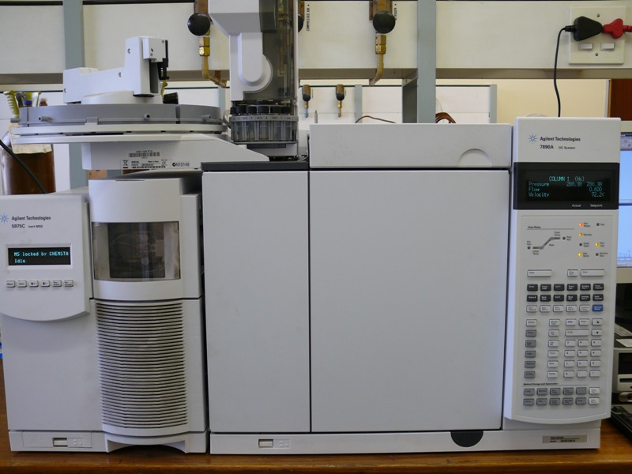
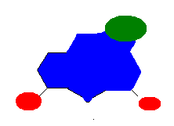
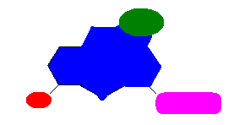
CONFIRMATION TESTS
Morphine
6-Acytelmorphine
Sensitivity and Specificity ca 99,9%

Slide 21
MARKERS FOR DRUG USE
MARKERS OF EXPOSURE
Drug parent compounds (Blood, Oral fluid, Hair, Nails)
Drug metabolites (Urine)
MARKERS OF EFFECT
Chronic exposure (long-term exposure)
Liver enzyme induction
  Gamma-glutamyl transferase (GGT)
  Aspartate aminotransferase (AST)
  Alanine amino transferase (ALT)
  Carbohydrate-deficient transferrin (CDT)
Haematology changes
  Macrocytic Anaemia: Mean red blood cell volume (MCV)

Slide 22
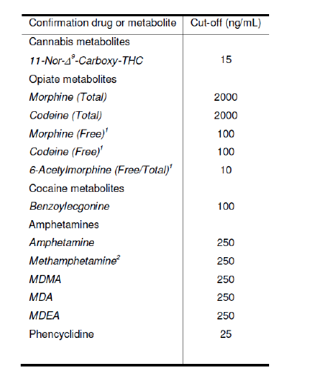
MARKERS OF EXPOSURE (URINE)
URINE
URINE

Slide 23
MARKERS OF EXPOSURE (ORAL FLUID)
ORAL FLUID
ORAL FLUID
Drug class | Preliminary cut-off concentration limit (ng/mL)
THC | 2
Cocaine/ | 8
Benzoylecgonine | 8
Codeine | 15
Morphine | 15
Hydrocodone | 15
Hydromorphone | 15
Oxycodone | 15
Oxymorphone | 15
6-Acetylmorphine | 2
Phencyclidine | 2
Amphetamines | 15
MDMA | 15
MDA | 15
MDEA | 15
Drug class | Preliminary Cut-off concentration limit (ng/mL)
Marijuana THC | 4
Cocaine/Benzoylecgonine | 30
Hydrocodone/Hydromorphone | 30
Oxycodone/Oxymorphone | 30
6-Acetylmorphine | 3
Phencyclidine | 3
Amphetamines | 25
MDMA/MDA/MDEA | 25

Slide 24
Markers of effect for Alcohol
Marker | Sensitivity | Specificity | Amount drunk
CDT | 46-90% | 70-100% | Chronic excessive drinking
GGT | 37-95% | 18-93% | Chronic excessive drinking
AST | 25-60% | 47-68% | Chronic excessive drinking
ALT | 15-40% | 50-57% | Chronic excessive drinking
MCV | 40-50% | 80-90% | Chronic excessive drinking
CDT+MCV+GGT (combined) | 88% | 95% | Chronic excessive drinking
EtG (Hair) | 75% | 96% | Chronic excessive drinking Cut-off = 30 pg/mg
[Ref] H Andressen-Streichert et al, Dtsch Artztebl Int 2018, 115, 309.

Slide 25
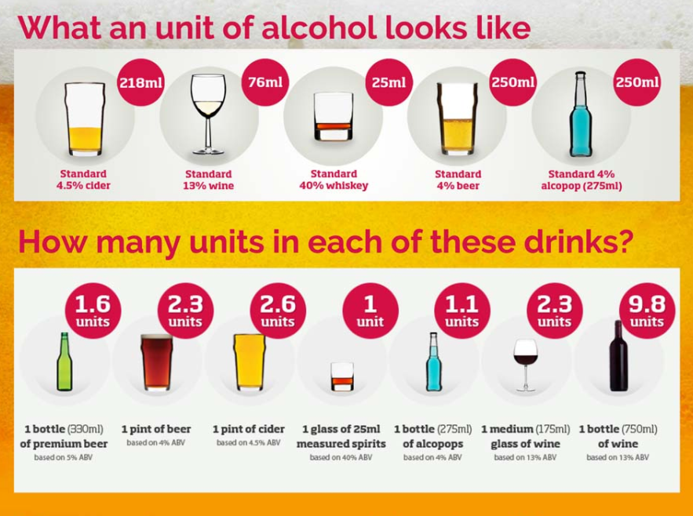
World Health Organisation
Low –risk Alcohol consumption < 12 g ethanol per day (1.5 units)
Harmful Alcohol consumption : 12 – 24 g ethanol per day (1.5-4 units)
Chronic excessive Alcohol consumption > 60 g ethanol per day (7.5 units)

Slide 26
CLINICAL CHEMISTRY
CDT:
Excessive alcohol intake over a period of 1-2 weeks elevates the CDT
CDT not sensitive but specific
Moderate alcohol consumption or episode drinking – normal CDT range
FP may occur due to genetic variations
Increase in MCV, AST, ALT (AST:ALT>2) and GGT→ may be signs of harmful alcohol consumption and alcohol hepatic induced injury
After termination or reduction of alcohol use it takes some time to become normal
  CDT – 2-3 weeks
  GGT – 2-6 weeks
  AST/ALT – 2-4 weeks
  MCV – 8-16 weeks

Slide 27
CLINICAL CHEMISTRY
Generally low specificity:
  Non-alcohol-induced hepatic conditions may contribute
  Medications may also contribute
The biomarkers able to identify harmful/excessive alcohol consumption however,
Not suitable for abstinence monitoring
Regular intake of small amounts, also binge drinking do not lead to increases in these parameters
MCV:
  Hypothyroidism, Vit B12 and Folate deficiency, myeloma, anaemia and other drugs may also increase MCV

Slide 28
NEXT….
Ms Jordaan: Testing for drugs in hair

Slide 29
Thank You
Dr. Tim Laurens
Ms. Maraliese Jordaan
BSc(Ed); BSc(Hons); MSc(Chem); MSc(Appl Tox); MPhil (Med Law, PhD(Chem); PhD(Med Law)
Forensic Toxicologist | Director
Tel: +27 (0) 82 673 9338
E-mail: tim.laurens@fortoxlab.co.za
BSc(Phys); BSc(Hons)(Chem Path); MSc(Chem Path)
Laboratory Manager | Director
Tel: +27 (0) 83 324 6472
E-mail: maraliese.jordaan@fortoxlab.co.za

Slide 30
HISTORY OF HAIR ANALYSIS
From 1960-1970 : Used to evaluate exposure to toxic metals such as Arsenic, Lead and Mercury
  - ng concentration level
1979 – Werner Baumgartner decided to apply immunoassays to detect opiates in hair
- Caused many to be interested in the unknown territory of hair analysis
Today, gas or liquid chromatography with mass spectrometry (GC-MS; GC-MS/MS; LC-MS; LC-MS/MS) is the method of choice.
December 1995 the Society of Hair Testing (SOHT) was founded:
Promote the research in hair testing technologies in forensic, clinical and occupational sciences
Develop international proficiency tests
Organize meetings and workshops
Encourage the scientific cooperation and exchanges among members.

Slide 31
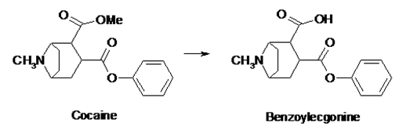
STABILITY OF DRUGS IN HAIR
Drugs can survive in hair for thousands of years under favorable conditions:
  - Ambient temperature
  - Dry atmosphere
The presence of opiates detected in five hair shafts (7.5 cm in length) from a Victorian poet “John Keats” 167 years after his death…
  - taken to control the pain of Tuberculosis
The scalps of eight Chilean mummies dating from 2000 BC tested positive for benzoylecgonine (a metabolite from cocaine)

Slide 32
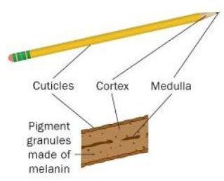
BIOLOGY OF HAIR
Hair is a product of differentiated organs in the skin of mammals
It differs in individuals only in color, quantity and texture
Composition:
  - Protein (65% – 95% keratien)
  - Water (15% - 35%)
  - Lipids (1% - 9%)
  - Mineral content (0.25% - 0.95%)

Slide 33
INCORPORATION OF DRUGS INTO THE HAIR MATRIX
Drug incorporation
  Lipophilicity
  pH
  Melanin (color of hair)
Analysis
  Metabolites
  Matrix effects
Total number of hair follicles in adults ≈ 5 000 000
On the head ≈ 1000 000

Slide 34
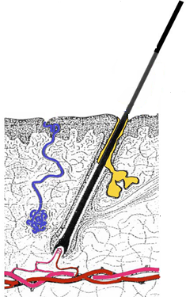
INCORPORATION OF DRUGS INTO THE HAIR MATRIX
Hair growth phases
  Anagen / Growing phase – 3 to 7 years (90% of follicles on the scalp)
  Catagen / Intermediate phase – 2 to 4 weeks (1% of follicles on the scalp)
  Telogen / Resting phase – 3 to 4 months (10 – 15% of follicles on the scalp)
  Exogen / Shedding phase
  Non-head hair - similar growth rate
  - 40 – 60% of follicles are in the telogen phase
  - No segmentation
  - Advantageous when head hair unavailable
  Hair growth rate
  Head hair - 0.7 to 1.5 cm per month
  - Segmentation possible
  - Growth rate is influenced by therapeutic drugs
  - Depends on age, sex, race and seasonal fluctuation

Slide 35
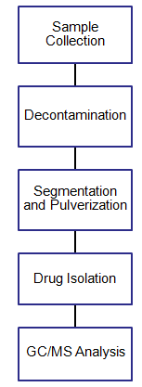
SPECIMEN COLLECTION AND PROCEDURES
Informed Consent!!
Chain of custody!!
Drugs and interferences
Crack cocaine, cannabis, heroin smoke
Evidentiary false positives due to passive exposure
Pulverised with ball-mill
Cut into segments
Dissolved as a whole
Solubilisation of the drug
Drugs must not be altered or lost
Identification of drugs and metabolites
Quantification

Slide 36
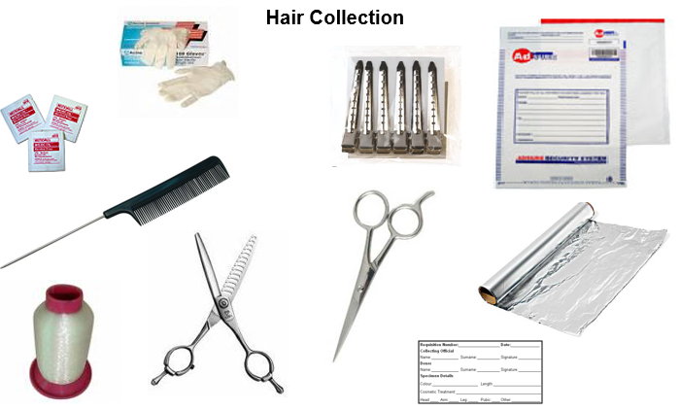
SPECIMEN COLLECTION AND PROCEDURES

Slide 37
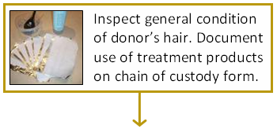


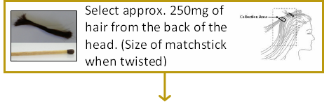
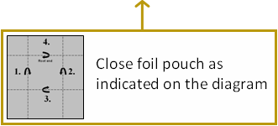
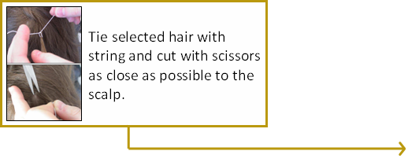
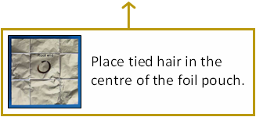
SPECIMEN COLLECTION AND PROCEDURES

Slide 38
SPECIMEN COLLECTION AND PROCEDURES
The most critical issue facing hair analysis is to avoid
  Technical false positives
    Caused by errors in the collection, processing and analysis of specimens
  Evidentiary false positives
    Caused by passive exposure to the drug
A wash step (decontamination) is executed before laboratory analysis.
Detection of drug metabolites cannot be explained by external environmental exposure
➔ Internal drug exposure has occurred

Slide 39
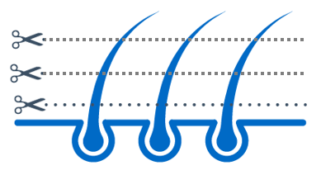
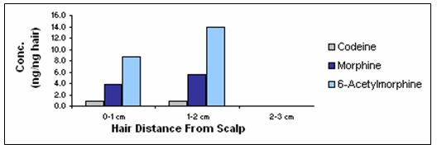
SEGMENTATION OF THE HAIR SHAFT
Segmental analysis :
  - Hair cut into segments
  - 1 cm segment represents approx. 1 month’s growth
  - This allows for accessing the trend of drug abuse by the donor

Slide 40
EFFECT OF COSMETIC TREATMENTS
All strong chemical, physical and mechanical influences have harmful effects on the cuticula
Hair is continuously exposed to natural factors that damages the cuticle:
  Sunlight, Weather, Water, Pollution
  Repeated shampooing-no significant impact
Cosmetic treatment enhance the damage:
  Permanent waving
  Straightening
  Dyeing/Bleaching (alter physical properties i.e. oxidation and increased porosity)
  50% - 80% decrease in drug concentrations
Allow for one month’s growth before tested?

Slide 41
RESULT INTERPRETATION
Is there a relationship between the drug intake and the concentration in the hair?
A poor dose-concentration relationship may be explained by the following points:
    Drug dose of the abuser is uncertain
    Exact time of exposure in uncertain
    Purity of the illicit compound is unknown
    Uptake of the drug from blood to hair varies between individuals

Slide 42
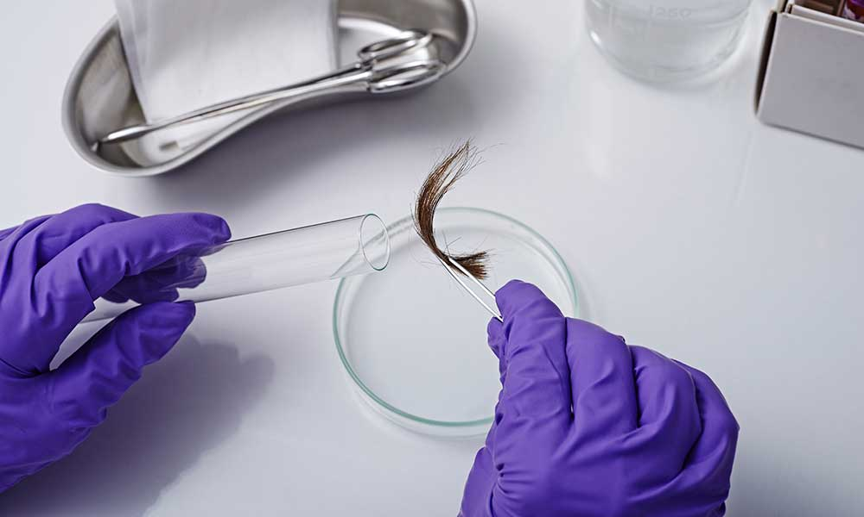
CASE STUDY: HAIR TESTING
Context
A patient was admitted to a rehabilitation centre for treatment after a self-admitted history of heroin abuse.
Initial urine drug screening tests (immunoassay), performed at the rehabilitation centre, came out “non-negative” for opiates and negative for cocaine.
Urine and hair specimens were submitted to the Forensic Toxicology Laboratory for confirmation testing.
Testing Strategy
Urine screening test
Urine confirmation test
Hair test

Slide 43
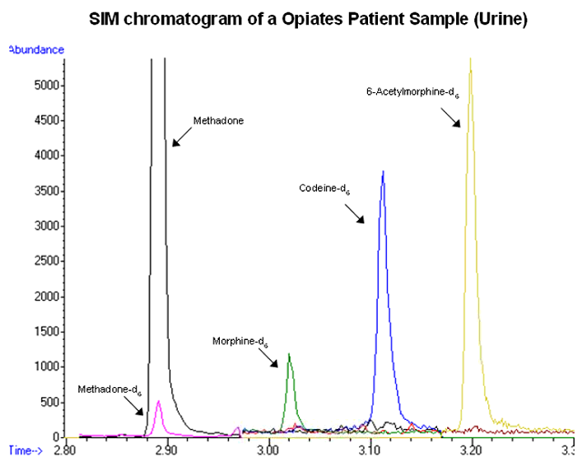
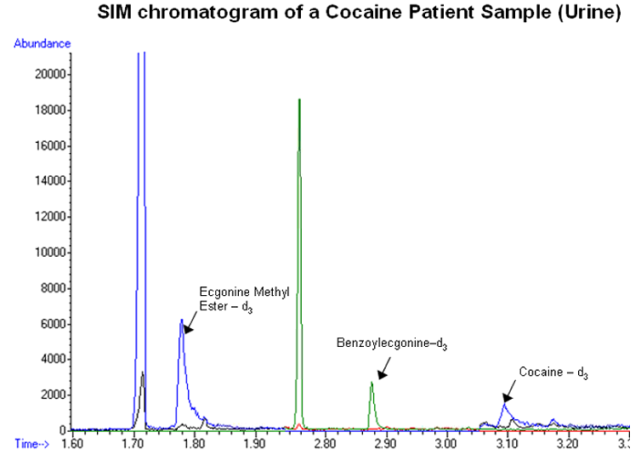
CASE STUDY: HAIR TESTING
Urine confirmation test result
TEST RESULT UNIT CUT-OFF VALUE
URINE OPIATES
Free Morphine ND μg/L 100
Free Codeine ND μg/L 100
6-Acetylmorphine¹ ND μg/L 10
Meperidine ND μg/L
Methadone 100 μg/L
¹6-Acetylmorphine is the principle metabolite of Heroin
URINE COCAINE
Free Cocaine ND μg/L
Benzoylecgonine¹ ND μg/L 150
Ecgonine Methyl Ester ND μg/L
¹Principle metabolite for positive confirmation of cocaine use

Slide 44
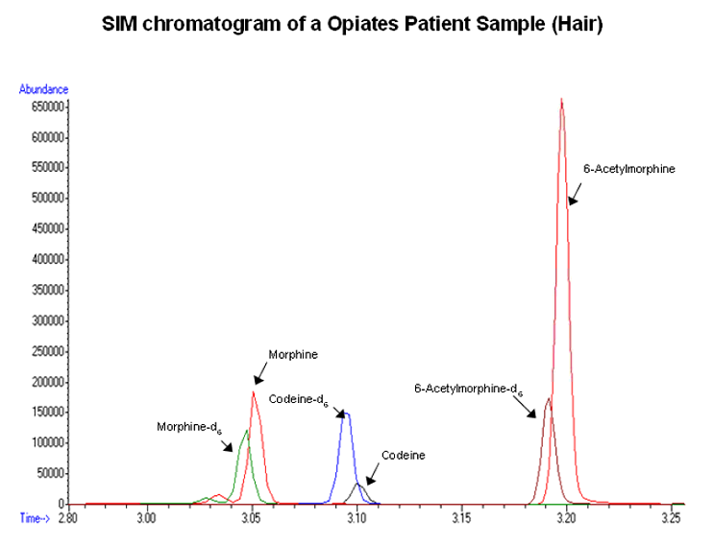
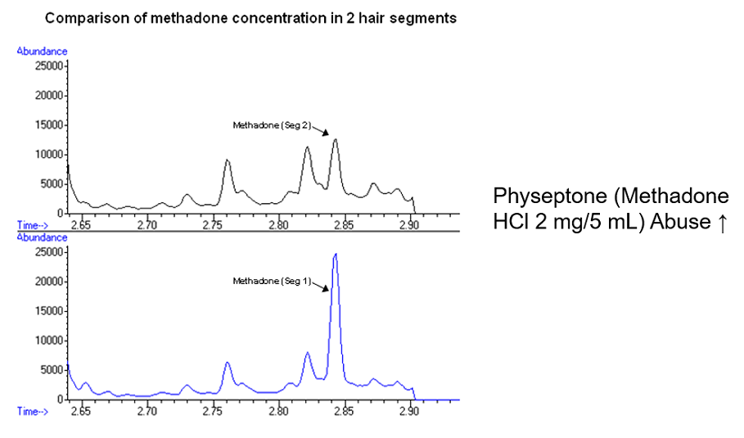
CASE STUDY: HAIR TESTING
Hair confirmation test result - Opiates
TEST RESULT UNIT CUT-OFF VALUE
HAIR OPIATES 0-1 cm 1-2 cm
Morphine 3.82 5.54 ng/mg 0.2
Codeine 0.91 0.95 ng/mg 0.2
6-Acetylmorphine¹ 8.61 13.93 ng/mg 0.2
¹ Heroin consumption is differentiated from codeine or morphine use by the presence of
6-acetylmorphine

Slide 45
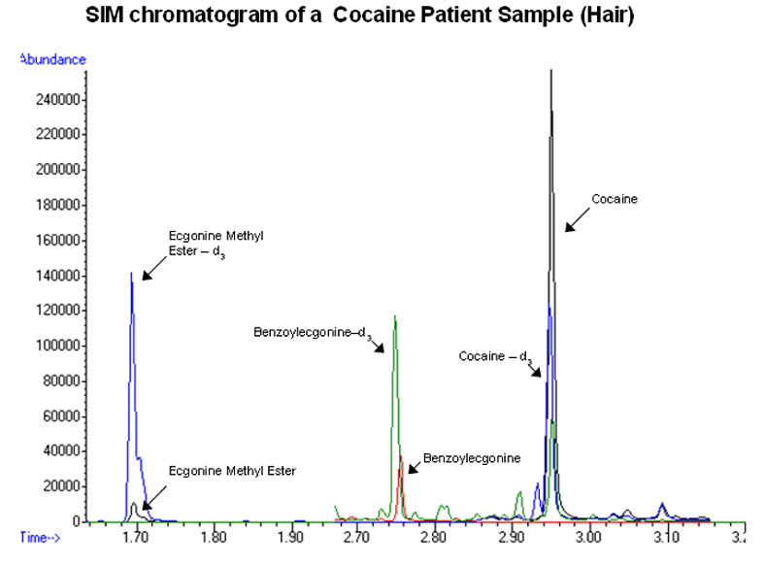
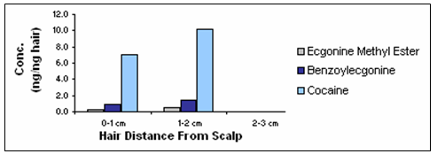
CASE STUDY: HAIR TESTING
Hair confirmation test result - Cocaine
TEST RESULT UNIT CUT-OFF
HAIR COCAINE 0-1 cm 1-2 cm
Cocaine 7.05 10.19 ng/mg 0.5
Benzoylecgonine¹ 0.97 1.45 ng/mg 0.5
Ecgonine Methyl Ester 0.21 0.47 ng/mg 0.05
¹ Cocaine AND either benzoylecgonine, cocaethylene, norcocaine or ecgonine methyl ester should be present above the cut-off level to indicate cocaine use

Slide 46
CASE STUDY: HAIR TESTING
3. Interpretation
From the results of the hair analysis, the Forensic Drug Testing Laboratory could advise the rehabilitation centre that not only did this patient have a heroin addiction, but that he was also abusing cocaine in the months prior to his admission.
It was evident from the hair analysis that the patients’ heroin and cocaine consumption decreased over the two months prior to his admission into rehab. However, there was an increased consumption of methadone during the same period.
After consulting with the patient, he admitted to the rehabilitation centre’s psychologist that he was indeed using both heroin and cocaine.
He also admitted that a local pharmaceutical distributor illegally provided him with bulk quantities of Physeptone, which he used as a substitute for heroin.
Physeptone (Methadone HCl 2 mg/5 mL) is an opioid analgesic used for anesthesia and it is also commonly used as a substitute narcotic in the treatment of heroin addiction.

Slide 47
APPLICATION FOR HAIR ANALYSIS
Application of hair analysis for illegal and therapeutic drugs fall into the following categories:
  Criminal court proceedings:
  Confirmation of chronic abuse to order a medical and physiological examination
  Examination of the reliability of the accused or of the victim
  Testing a supposed victim’s sample (intoxication over a long period?)
  Detox control in addicts
  General and special workplace drug testing:
  Pre-employment and workplace testing
  Additional scopes of application are:
  Drug related fatalities
  Child custody / adoption cases;
  Prenatal and neonatal hair analysis

Slide 48
LIMITATIONS OF ALTERNATIVE MEDIA
The laboratory procedures for drug analyses are more difficult and time consuming, therefore costs more.
Unable to give indication of dose and time

Slide 49
ADVANTAGES OF HAIR TESTING
Hair has a much larger surveillance window
  weeks → months (depending on the length of the hair shaft)
  Complementary use of urine and hair testing
Long term history use become accessible through hair analysis
Hair analysis can distinguish between chronic use and single exposure - segmentation
Close observation possible without being invasive
Possible to obtain a fresh sample
Save money in the long term
Identification of “urine false-negatives”
Can not abstain or cheat the test

Slide 50
Thank You
Dr. Tim Laurens
Ms. Maraliese Jordaan
BSc(Ed); BSc(Hons); MSc(Chem); MSc(Appl Tox); MPhil (Med Law, PhD(Chem); PhD(Med Law)
Forensic Toxicologist | Director
Tel: +27 (0) 82 673 9338
E-mail: tim.laurens@fortoxlab.co.za
BSc(Phys); BSc(Hons)(Chem Path); MSc(Chem Path)
Laboratory Manager | Director
Tel: +27 (0) 83 324 6472
E-mail: maraliese.jordaan@fortoxlab.co.za

