Slide 1


ISSUP Philippines Pre-Conference Event
Emerging Issues and Realities on Addiction and
Behavioral Health Amidst the Pandemic:
Silver Linings of the Lockdown
Eric Siervo, M.Ed.
Vice President, International
GLOBAL | COLLABORATIVE | INNOVATIVE | PASSIONATE | LEADER

Slide 2
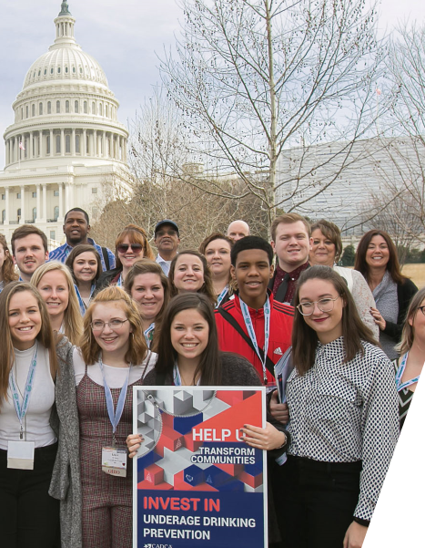
CADCA History and Overview
CADCA’s Vision:
A world of safe, healthy and drug-free communities
CADCA’s Mission:
To strengthen the capacity of community coalitions to create and maintain safe, healthy and drug-free communities globally
Founded in 1992 as a recommendation from the President’s Drug Advisory Council
CADCA represents more than 5,000 community coalitions
Notes:
Established in 1992 as an outcome of a Presidential Drug Advisory Council, Community Anti- Drug Coalitions of America (CADCA) is a leading U.S. based substance use prevention organization, representing over 5,000 community-based coalitions across the United States and in 28 countries that work to create safe, healthy, and drug-free communities.
CADCA accomplishes this by assisting local communities through training and technical support to develop effective multi-sector community coalitions capable of achieving and sustaining population-level reductions in illicit drug use rates and related problems.

Slide 3
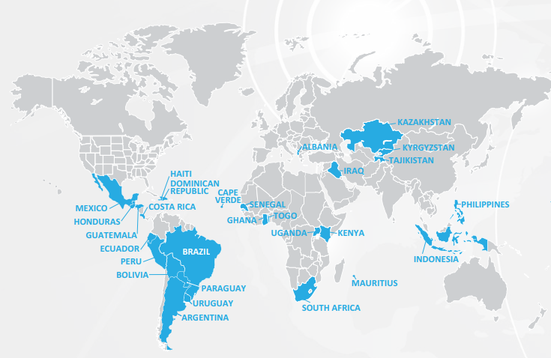
CADCA has developed a global network of 305 community coalition in 28 countries around the world​
Notes:
CADCA’s efforts through out the world mirror its domestic work by offers training, technical assistance and other resources on the strategy of community coalitions to government institutions, non - governmental organizations and community groups in numerous countries affected by the cultivation, trafficking and use of illicit drugs.
Train communities have determined local actionable data to assess problems, develop, implement and evaluate strategic plans, build capacity and mobilize communities through civic engagement. In short, they have formed multi-sector community coalitions by recruiting and organizing local youth; speaking publicly about local drug and alcohol misuse; working with local authorities; and assumed responsibility in taking action to be agents of change in their respective communities.

Slide 4
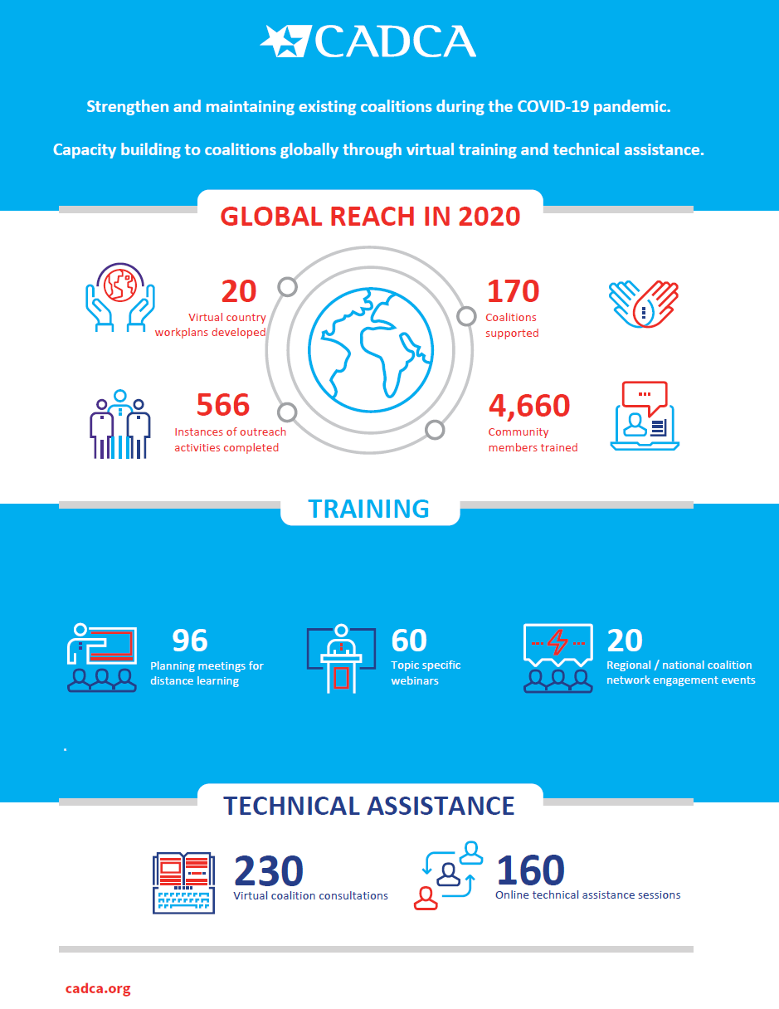
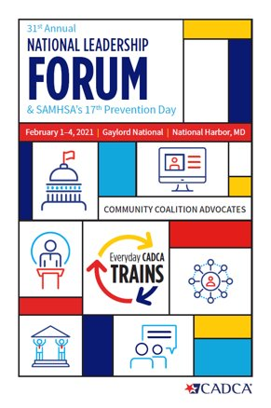

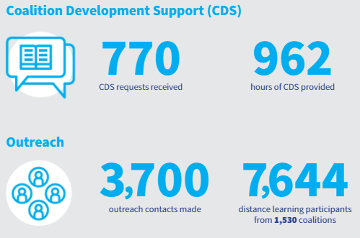
CADCA Expanding Virtual Outreach to Coalitions
Domestic Reach
Notes:
As a result of the pandemic and lockdowns CADCA found other ways to provide support to coalitions around the world. Virtual Outreach made it possible for CADCA to establish new ways to provide support through virtual meetings, webinar trainings, Online training and technical assistance session, one on one Consultations with coalitions and regional and national coalition network engagement activities to share best practices and lessons learned during the pandemic

Slide 5
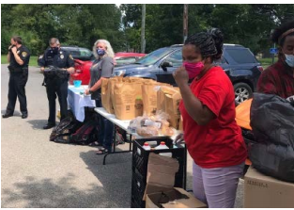
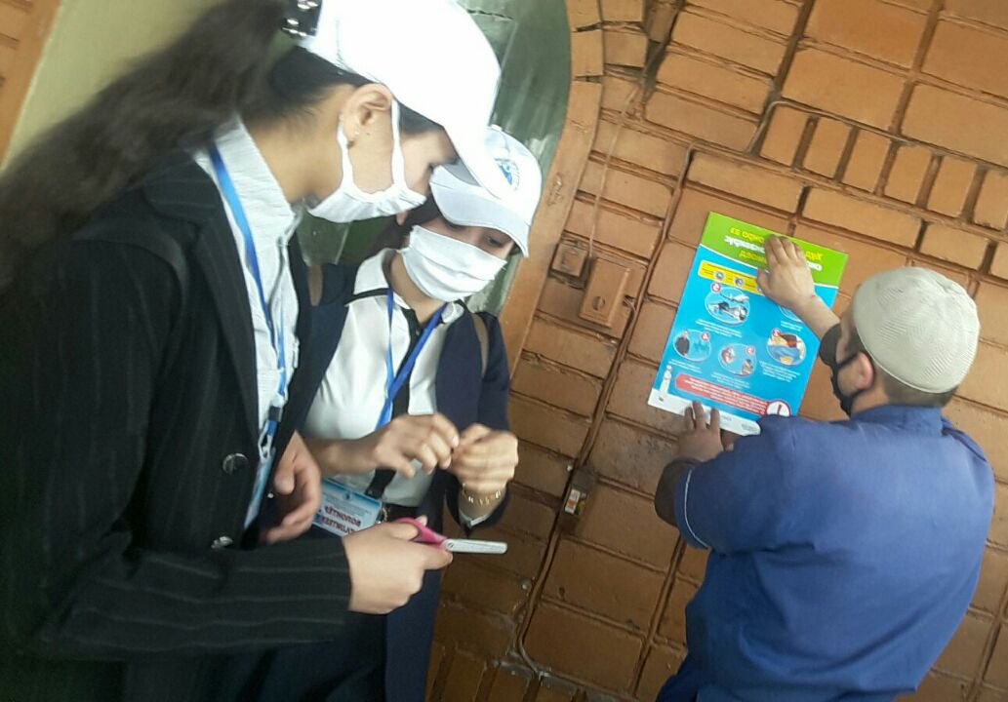
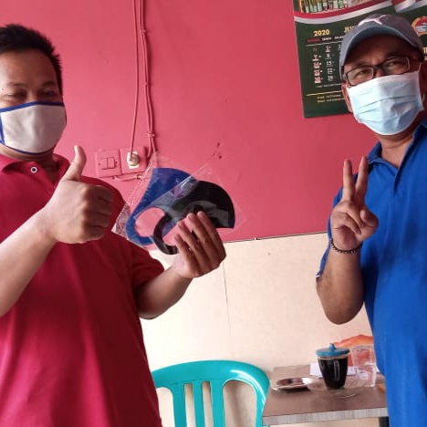
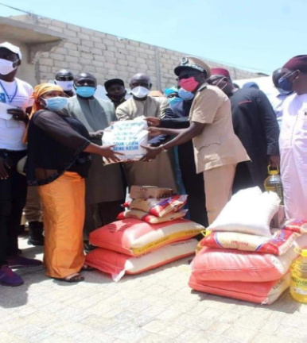
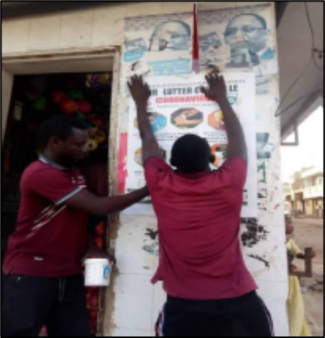
Emerging issues and realities on the ground in communities globally?
Coalitions shifting priorities to fill gaps in infrastructure for vital services
Coalitions in Tajikistan and Senegal disseminating National COVID Guidelines
Coalitions organizing food drives in the United States and Senegal
Coalition in Indonesia collecting and distributing PPE.
Notes:
Right here in the Philippines, Dr. Raquel Tolention, Chairman of the Association of Antidrug Abuse Coalitions in the Philippines reported that may coalitions have coordinated their efforts and partnered with local medical and COVID – 19 task forces and other government agencies to contribute to drafting COVID-19 guidelines and local drug prevention action plans.

Slide 6

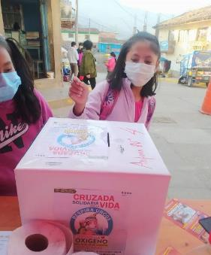
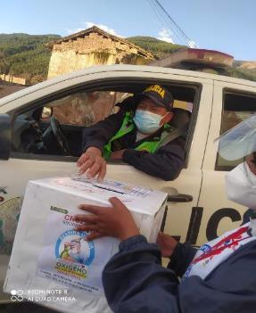
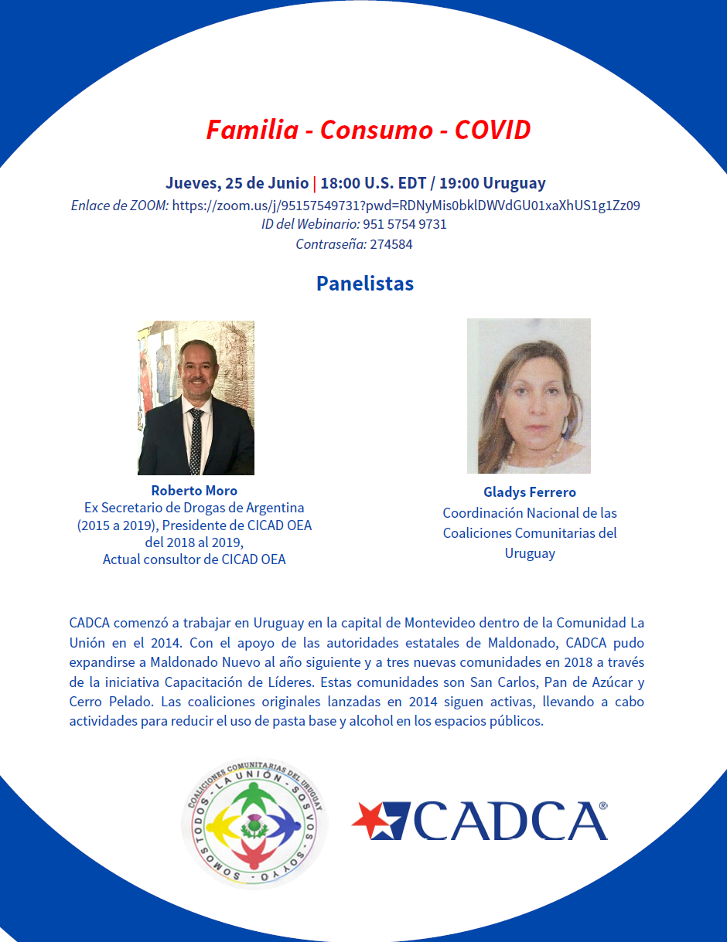
Emerging issues and realities on the ground in communities globally
The scope of prevention has expanded for coalitions during COVID
Prevention now encompasses:
- Substance use,
- Mental health,
- Suicide,
- COVID – 19,
- Hunger / loss of employment,
- and other public health issues.
Coalitions have worked to reexamine and enhance their capacity in response to the changing conditions in their communities.
Campaign “Respira Urcos” in Peru to raise money for oxygen tanks for local health centers
Webinar in Brazil on Prevention and Social Change during the Pandemic
Webinar in Uruguay on the Impact of Substance Use, COVID and Families
Notes:
New Realities on the Ground and examples of changing conditions.
In Argentina and Uruguay coalitions report increase in Marijuana Cultivation as a means of supplementing loss income.
In Kenya, coalitions reported increase of substance use, domestic violence and teen-age pregnancy and the impact on youth due to school closures

Slide 7
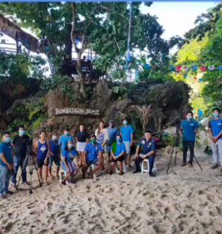
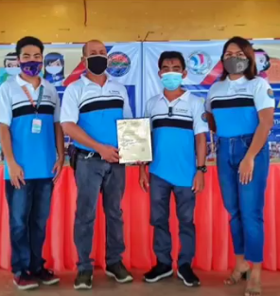


Coalitions in Action During COVID-19 (Philippines)
Aklan Community Coalition on Drug Abuse Prevention (AKON-DA): During the pandemic, the coalition has reinvented itself to have a strong presence online and through social media. During Drug Abuse Prevention Week 2020, they managed several online events including spoken word poetry competition and drug prevention graphic design contest. They also launched a TV show in partnership with local media and the local municipality, which covered topics from local ordinances around safety and security to COVID policies and local response to the pandemic. The coalition also coauthored, lobbied and passed a local ordinance for workplace drug testing, which includes public officials, government employees, public and private organizations, NGOs, cooperatives and associations. The coalition also worked to establish a Substance Use Committee for the Province of Aklan.

Slide 8

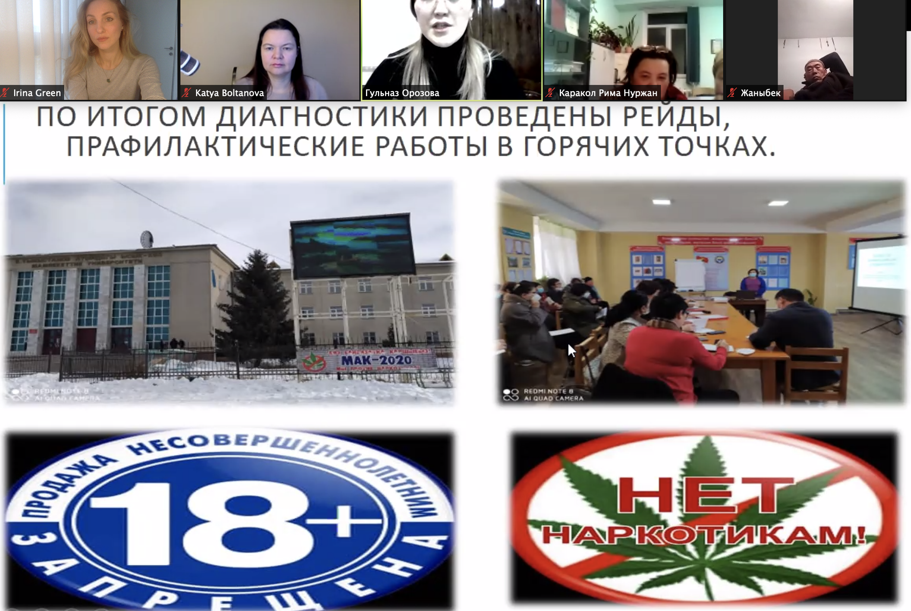
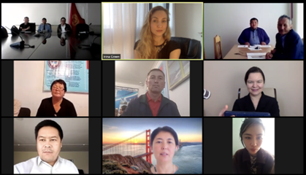


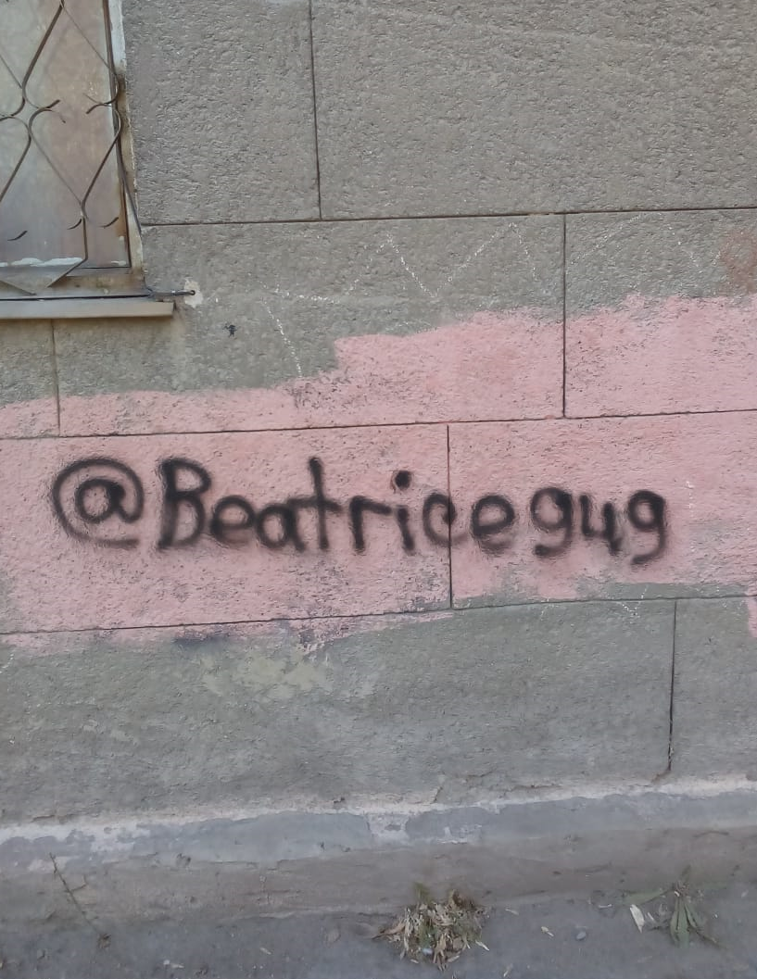
Coalitions in Action During COVID-19 (Central Asia)
Karaganda coalition (Kazakhstan): Before the pandemic, the coalition conducted environmental scans in groups on a regular basis. In their community, graffiti with the web addresses to buy synthetic drugs had been painted on different buildings all over the city. During the pandemic, the social distancing measures precluded the coalition to conduct these scans in groups. The coalition decided as an alternative to conduct an environmental scan challenge, which was announced via all relevant social media channels. Karaganda residents were asked to send photos of illicit graffiti that they discovered and send to the WhatsApp hotline number. The coalition received approximately 70 photos that were reviewed and verified and then sent to the local government partners that took measures to remove the graffiti.
Karakol coalition (Kyrgyzstan): During the pandemic, the coalition community assessment committee in collaboration with the local government conducted an online youth survey to find out the types of drug use, access to drugs, and perceptions of drug use among youth, as part of the community assessment efforts. The survey was administered through WhatsApp and other social media channels with 1,544 respondents. The findings of the survey will be used to shape the coalition's engagement strategy with the community and interventions. Among the surprising findings, 16.8 per cent of youth indicated marijuana use was prevalent, in contradiction to official data that marijuana use among youth was almost non-existent.

Slide 9
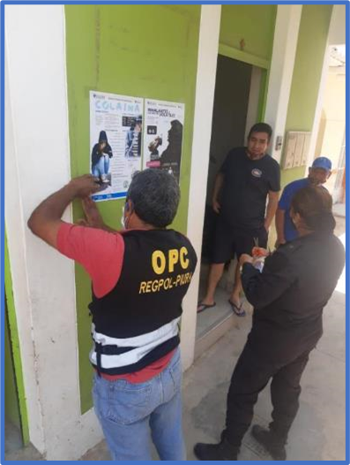
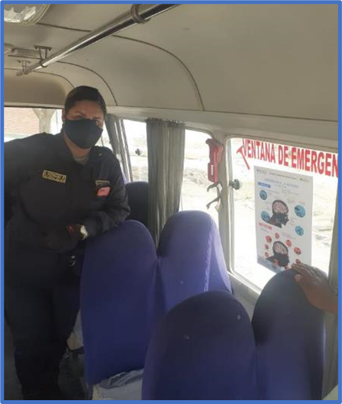
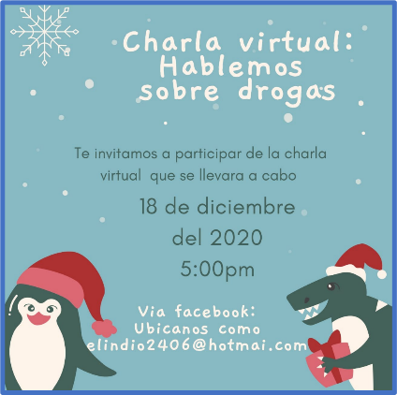
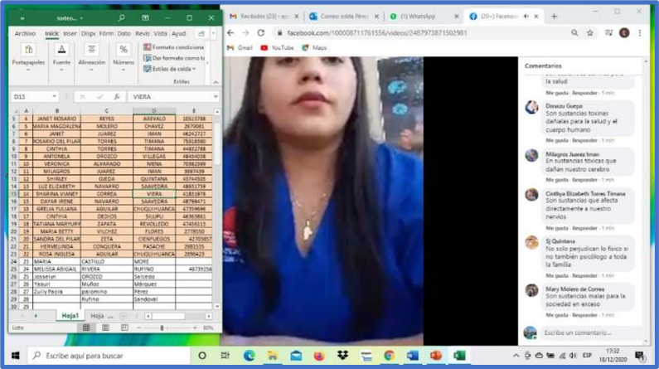
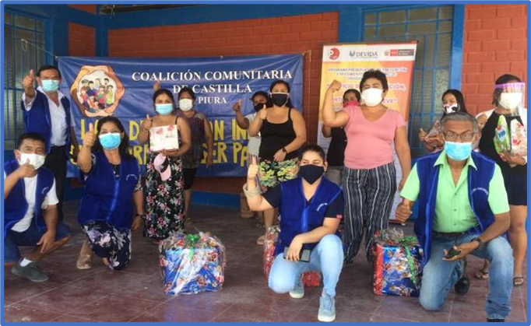

Coalitions in Action During COVID-19 (Peru)
El Indio Community Coalition, from the Castilla district, Piura
Before COVID-19:
During COVID-19
Use of Basic Cocaine Paste (PBC)
“Use of PBC in the Pachacútec park”
Alcohol use (Chicha)
“Use of alcoholic beverages on the sidewalks in front of houses and chicheríos".
During the pandemic the park is closed
During COVID-19: A behavior change occurred where residents started drinking alcohol in public, on the doorsteps, on sidewalks of their homes, and in stores or chicheríos (Illicit alcohol business), which led to assaults and delinquent behavior as well as greater spread of COVID-19. Castilla was one of the districts with the highest rates of infection and death from COVID-19 in Peru. It was also a victim of disinformation that alcohol will protect from COVID.
The coalition carried out various activities such as: putting up posters on alcohol consumption risks in the busiest and most crowded places of the community with the help of the National Police. They also broadcasted preventive audios on community radio stations (loudspeakers) on the stages of alcohol consumption and a held a live talk on Facebook, with a raffle of food baskets among the participants.

Slide 10


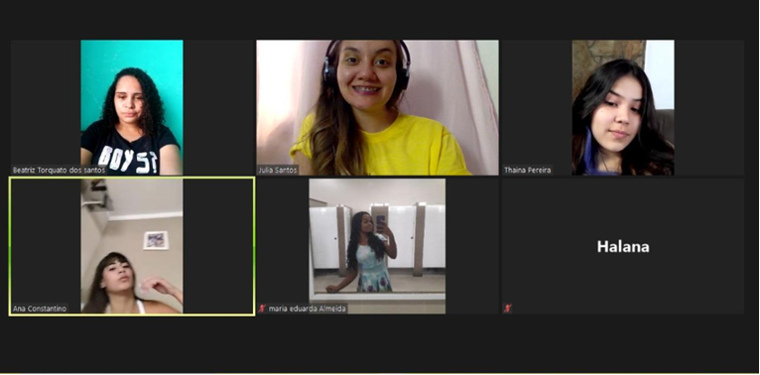
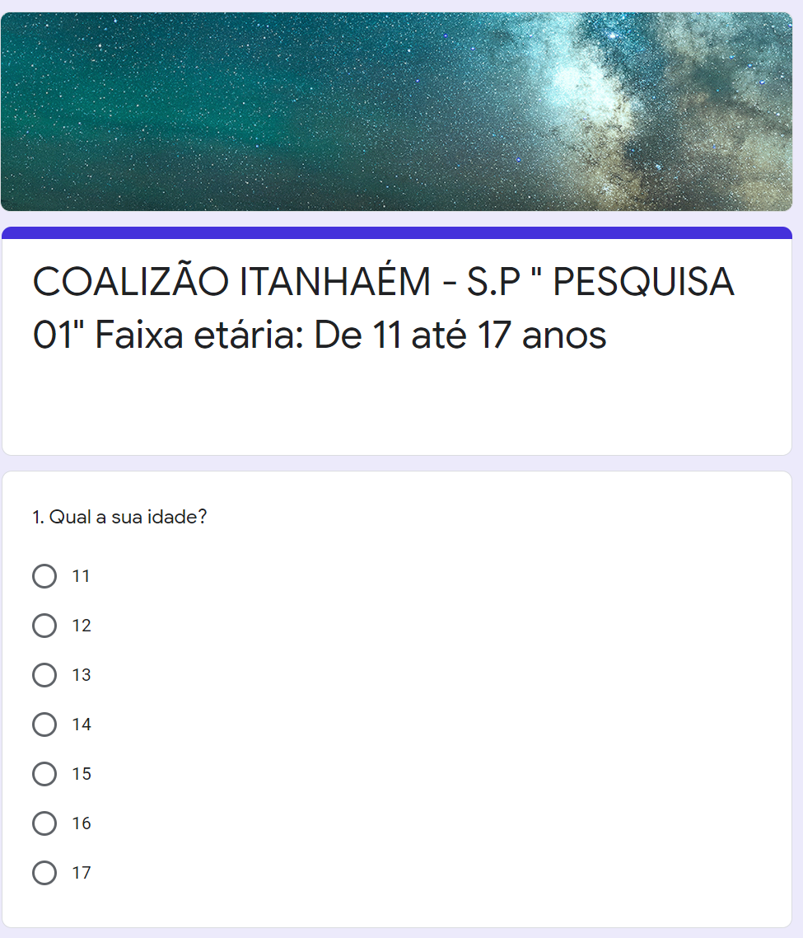
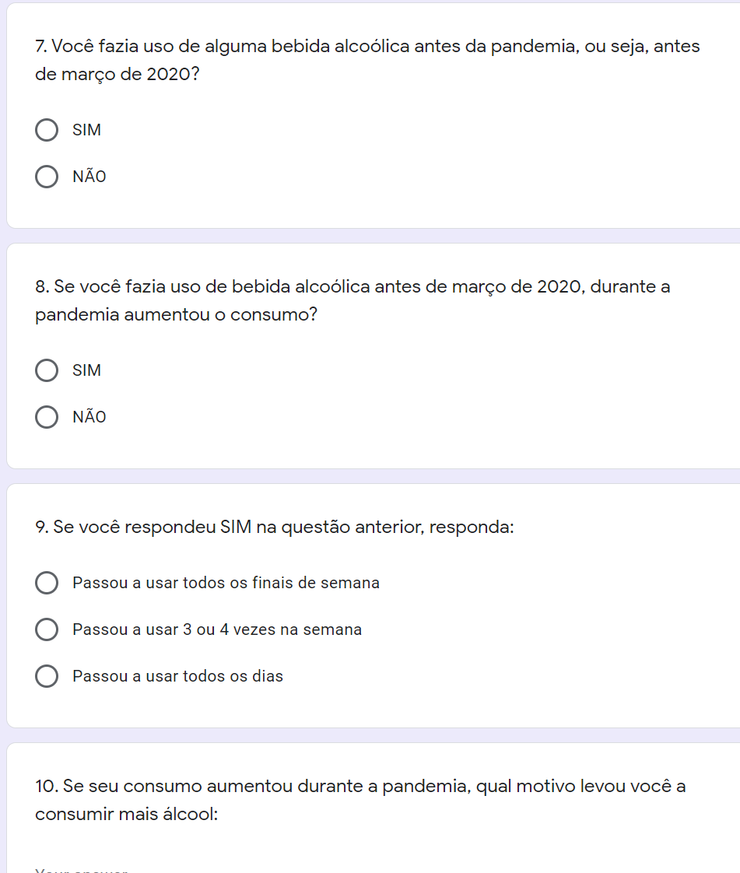
Coalitions in Action During COVID-19 (Brazil)
Before the pandemic, some coalitions used to hold youth leadership workshops to train youth to be advocates for substance use prevention among teenagers. In the past these youth leadership trainings were reaching youth from only 7 schools. Due to the pandemic, they had to adapt to virtual means of delivery and are now reaching more schools and a larger adolescent audience through online platforms.
Coalitions prior to the pandemic administered school surveys in person, as part of their community assessment. They have now converted them to online questionnaire using Google forms. Together with the support of local universities they are standardizing the instrument to collect substance use data on adolescents during the pandemic. They plan to have this data tabulated in April this year and will use the data to make changes to their strategic plans and prevention strategies.
Online Youth Leadership Training
Questions from Coalizão Itanhaém research.

Slide 11
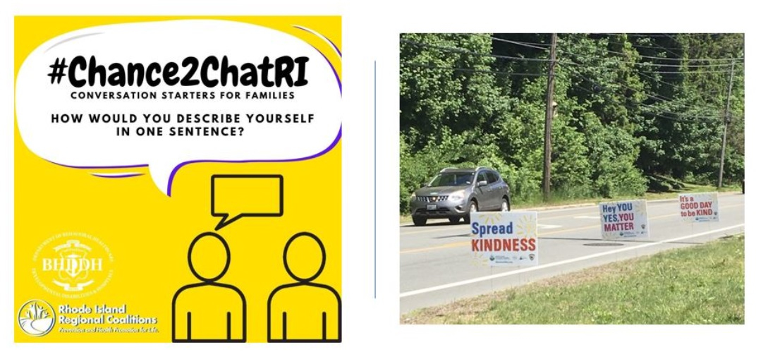
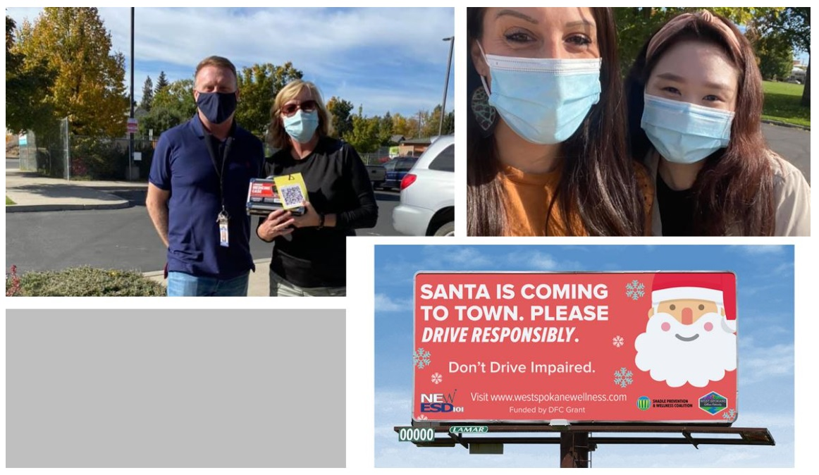

Coalitions in Action During COVID-19 (United States of America)
The Madison Chatham Coalition offered remote podcasts that engaged different sectors and focused on topics related to primary prevention for each episode. At the end of each podcast, the Youth Coalition recorded their thoughts on the interview. They have an RSS feed on their website and linked directly to that, where they shared the podcasts with their members and community.
Rhode Island Regional Coalition created a virtual ‘Hidden in Plain Sight’ resource, which offers parents and caregivers an easy opportunity to learn about the substances a youth might misuse and the ways those substances can be easily concealed in a bedroom. “This program is something we normally set up at our coalitions’ open houses, but with COVID-19 we knew that was not going to be possible this year. Instead, we decided to create a virtual bedroom that parents could explore on their own. To date, more than 2,200 people have visited and used the tool.”
The Nashua Prevention Coalition launched a Virtual Video Project, which they used to encourage families with youth to create short videos about what they were doing to stay resilient during COVID-19. The coalition shared these videos on their social media outlets and reached out to many of coalition members (SAPs, law enforcement, mental health professionals, etc.) and asked them to make positive videos with ideas for coping strategies or just to say hello, so youth knew they still had community support during COVID-19.

Slide 12
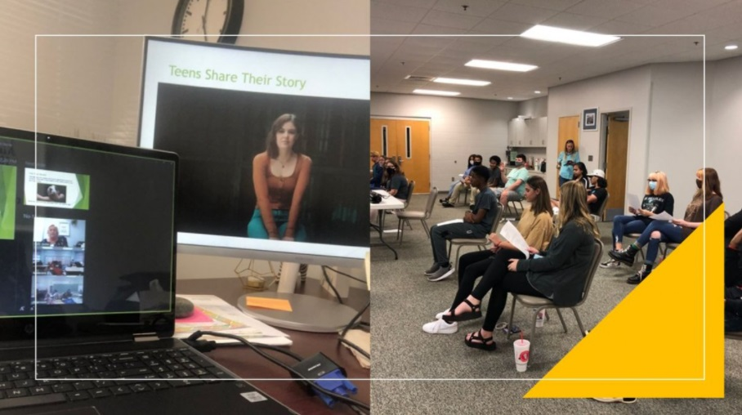
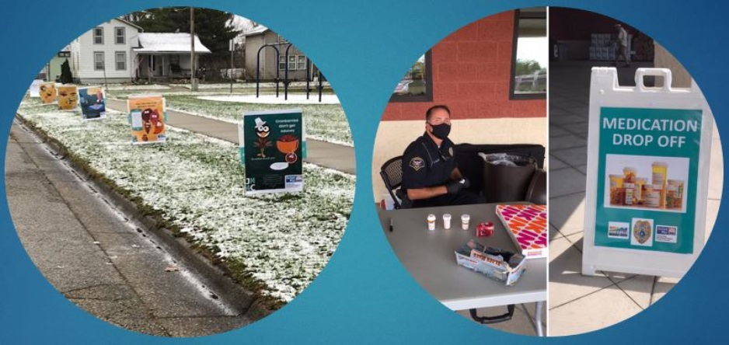

Coalitions in Action During COVID-19 (United States of America)
Partnership for Health engaged students using virtual Kahoot games through Zoom. The questions were a mix of pop culture questions, as well as questions about drug and alcohol. Their students greatly enjoyed Kahoot!
The Community Action Commission of Fayette County partnered with Meals on Wheels to distribute at-home medication safe disposal pouches through their program.
Over the past six months Impact Spartanburg has focused on developing COVID-specific resource guides, identifying ways to remotely engage youth and exploring ways to keep prospective policy change moving forward. On National Overdose Awareness Day they partnered with a dozen community partners to disseminate information about the importance of safe disposal and distributed over 1,400 Deterra bags to all corners of our community. Given the transportation barriers in the community, the ability to collaborate with partners who travel to residents was a huge success.
Decatur Prevention Initiative disseminated postcard mailers about permanent dropbox locations to 12,300 residents, had billboards on safe disposal reach more than 250,000 people, distributed resource guides to 1,250 families and participated in a local adolescent health conference.

Slide 13

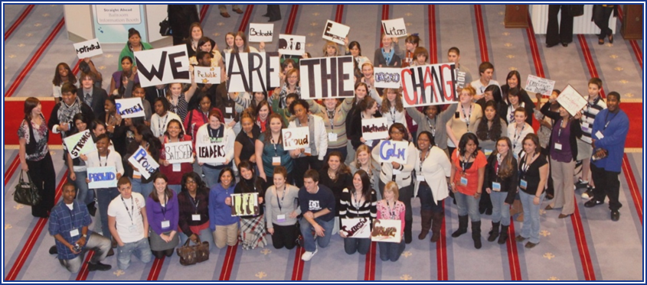
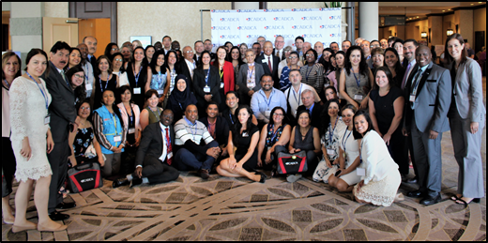
For more information & Technical Assistance
Online Resources:
CADCA
Community Anti-Drug Coalitions of America
www.cadca.org
1-800-54CADCA
International@cadca.org
Point of Contact:
Eric Siervo
Vice president, International Programs
Tel: 001 (703) 706-0560 ext. 248
esiervo@cadca.org
Youth Coalition members participating in
CADCA’s National Forum
International guests participating in the Mid-Year Training Institute" – July 2018

