Slide 1


INL Drug Demand Reduction
Update
January 2021
Bureau of International Narcotics and Law Enforcement Affairs
U.S. Department of State

Slide 2

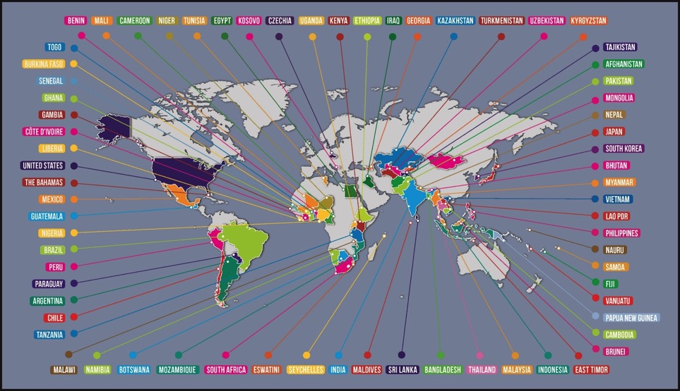
INL’s Universal Curriculum (2010-2020)
3 UC Series
121 Courses
2660 Total Training Hours
4 Editions
24 Languages
69 Countries
177 Training Providers
2021 Plans on ISSUP
Update Courses on ISSUP
Update Global Master Trainer Directory
Update List of Training Providers
Notes:
Bruno –
Past 10 years success
TEAG updating
Renumbering courses – a course catalog
3 areas to focus on in the next year
Courses update on ISSUP website

Slide 3


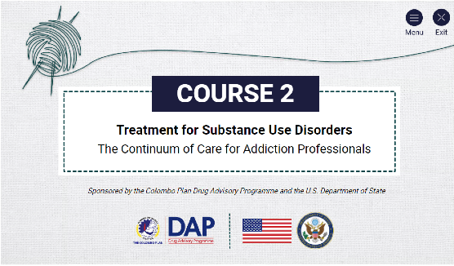
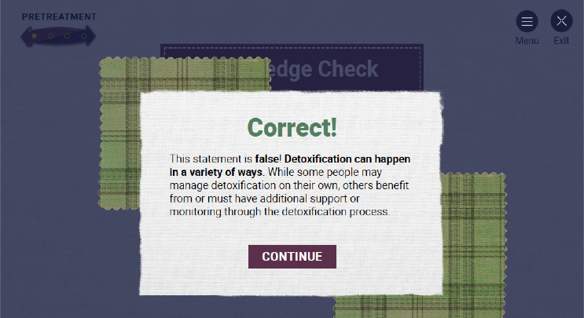
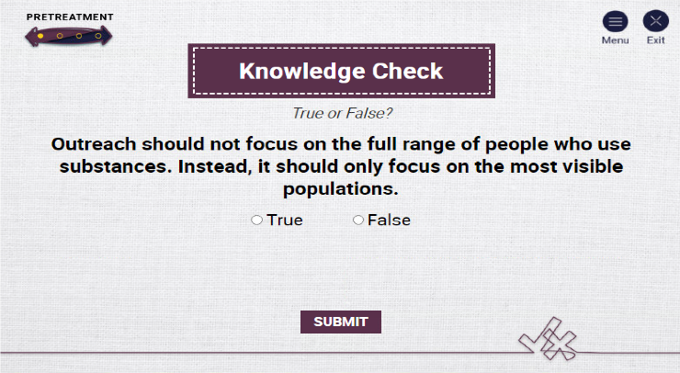
Online Training: Self-Guided
Notes:
Bruno –
New training hub on HEK patform – next few months
Invite them to this

Slide 4
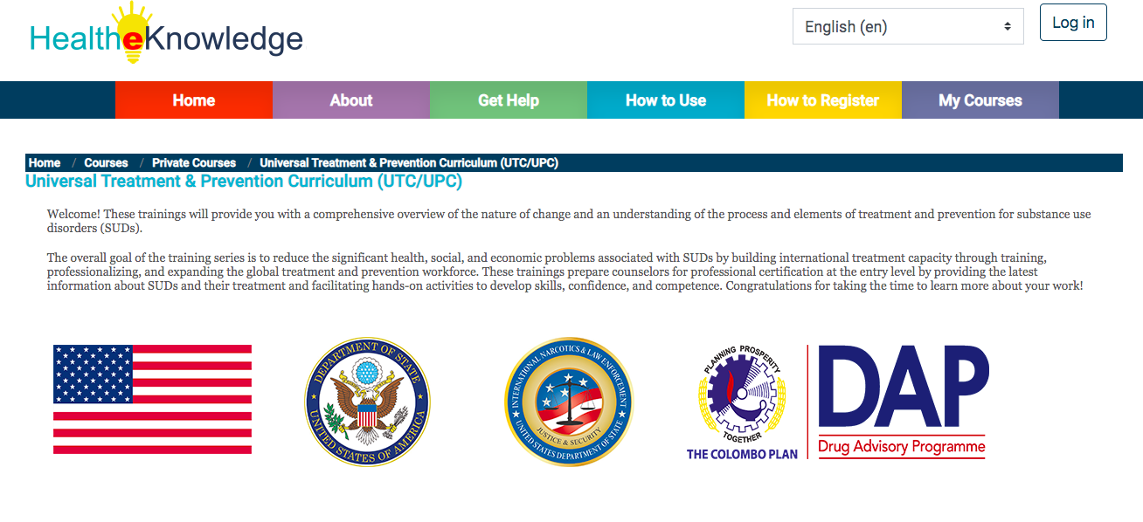
Online Training: Trainer Led
ISSUP Training Hub
In partnership with Health-e-Knowledge
Transforming UC Courses
Courses later this year
International Organizations will contract trainers to disseminate
In future, training providers may develop their own courses
Notes:
Bruno –
New training hub on HEK patform – next few months
Invite them to this

Slide 5
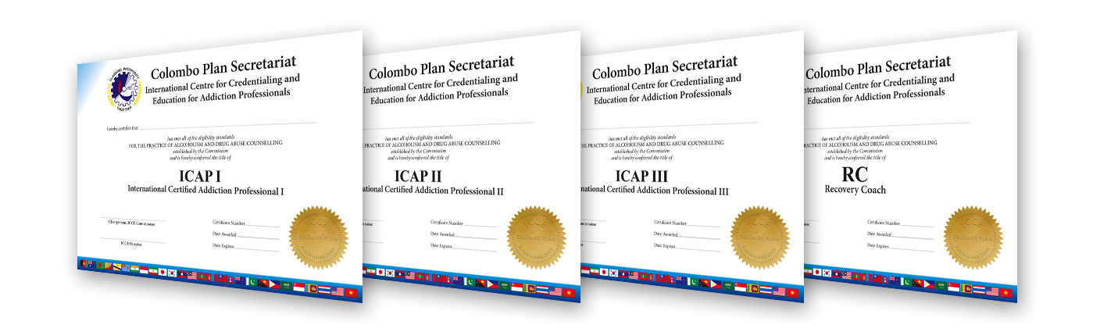

Examination and Credentialing
Online Proctoring
Launching Prevention Exam & certificate
Expansion of GCCC Commission & Power of Reciprocity
Importance in having the Government of the Philippines adopting GCCC credentials
Notes:
Charlotte
Online proctoring
New exams -- - reach the other workforce
Expanding GCCC Commission from Latin America
Regoconice ICAP credential - - process of
(NADAC merging of the exam)

Slide 6

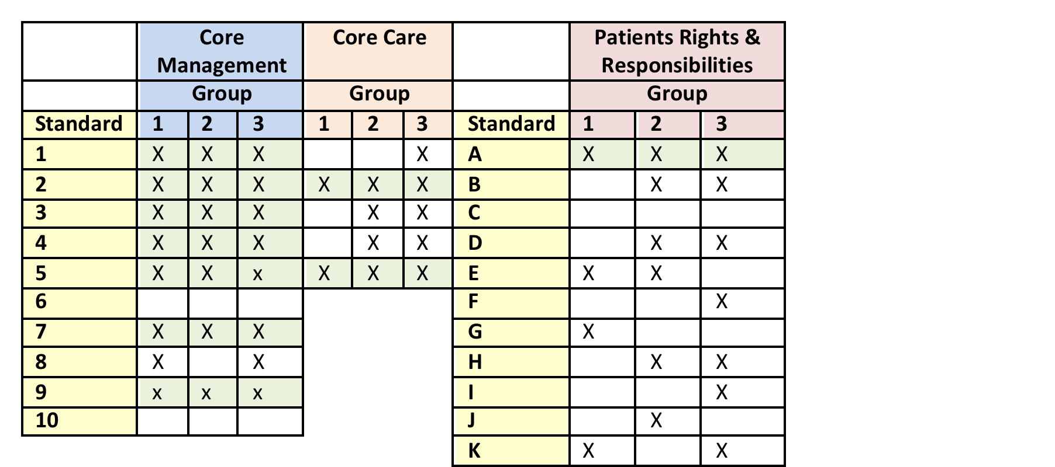
Quality Assurance
Mid-2021: UNODC global meeting of quality assurance agencies
Late-2021: Colombo Plan launches International Consortium of Quality Assurance Agencies
International Standards for Substance Use Treatment
Quality Standard
Consortium of Quality Assurance Agencies
Notes:
Alan –
Many programs will be included on DOMES

Slide 7




International Technology Transfer Centers (ITTCs)
Vietnam ITTC
Ukraine ITTC
South Africa ITTC
Colombia ITTC
Peru ITTC
Other ITTCs: Mexico, UAE
Network of International Universities
Universities provide analysis for national governments
Systems Approach:
  Mapping Tool,
  Analysis of Drug Use & Crime Drivers
  Integration of Services
Recurring data collection systems
Outcome evaluations

Slide 8
2021 Program Development
Five-year in-depth program and evaluation in the city of Pereira, Colombia
Create Alternatives to Incarceration Programs
Youth Forum / Youth Congress Curriculum
Law Enforcement & School Prevention Dialogue
Mainstream CADCA Community Coalition Program
Notes:
Charlotte
Online proctoring
New exams -- - reach the other workforce
Expanding GCCC Commission from Latin America
Regoconice ICAP credential - - process of
(NADAC merging of the exam)

Slide 9
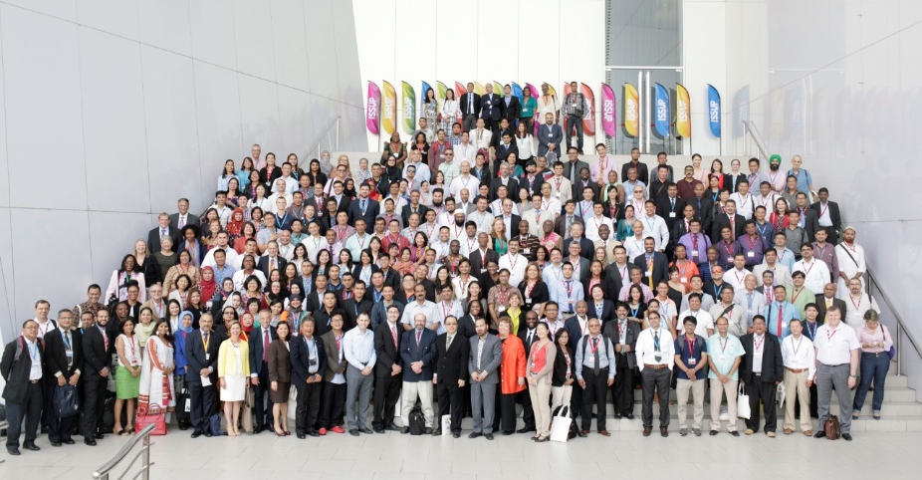

ISSUP Global Conference – Feb. 7-12, 2022
Abu Dhabi National Exhibition Centre, United Arab Emirates
Virtual Conference: 24/7

Slide 10
Thank you!
Brian Morales
Chief, Counternarcotics Branch
Bureau of International Narcotics and Law Enforcement Affairs
U.S. Department of State
DemandReduction@state.gov

