Slide 1
Alcohol consumption, burden and prevention policies in the Americas
Dr. Maristela G Monteiro
Senior Advisor on Alcohol and Substance Abuse
Pan American Health Organization/World Health Organization
monteirm@paho.org

Slide 2
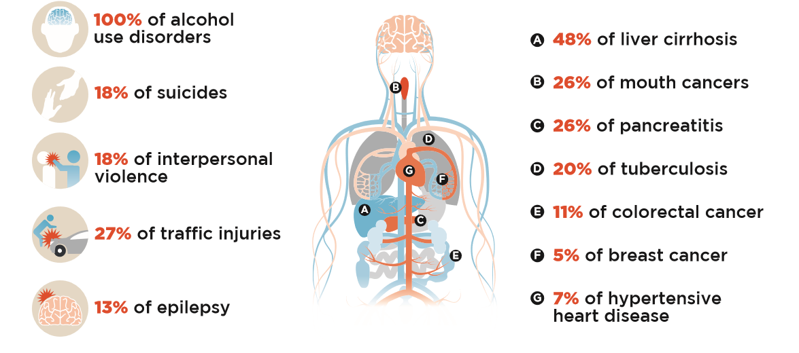
How alcohol contributes to various diseases
Alcohol also harms others than the drinker!

Slide 3
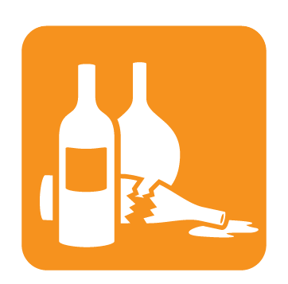

Alcohol Consumption – Population Level
Performance Indicators – Alcohol Target
APC - ALCOHOL PER CAPITA CONSUMPTION
At least 10% relative reduction in the harmful use of alcohol
Total (recorded and unrecorded) alcohol per capita (15+ y.o) consumption within a calendar year in liters of pure alcohol.
Data source: Administrative reporting and survey data
HED – HEAVY EPISODIC DRINKING
Age-standardized prevalence of heavy episodic drinking among adolescents and adults.
Data source: Population-based survey
AUD – ALCOHOL USE DISORDER
Adults (15+y.o) who suffer from disorders attributable to consumption of alcohol (ICD-10: F10.1 Harmful use of alcohol F10.2 Alcohol dependence), calendar year
Data source: Population-based survey using validated instruments

Slide 4


3.5 Strengthen the prevention and treatment of substance abuse, including narcotic drug abuse and harmful use of alcohol
  3.5.1 Coverage of treatment interventions (pharmacological, psychosocial and rehabilitation and aftercare services) for substance use disorders
  3.5.2 Harmful use of alcohol, defined according to the national context as alcohol per capita consumption (aged 15 years and older) within a calendar year in litres of pure alcohol

Slide 5
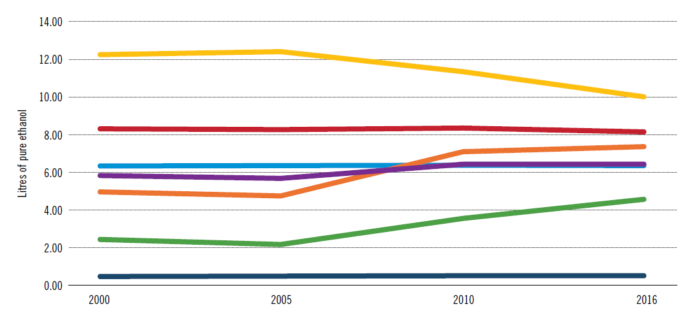
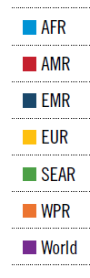
Trends in total alcohol per capita consumption (APC) (15+ anos) in liters of pure alcohol in WHO regions, 2000−2016

Slide 6
Changes in APC 1990 – 2017 in detail
Again, almost half of the countries increased, and half decreased the level of consumption
The overall effect was a decrease from 8.5 litres to 7.9 litres

Slide 7
Changes in APC 2010 – 2017 in detail
Almost half of the countries increased, and half decreased the level of consumption
The overall effect was a decrease from 8.2 litres to 7.9 litres

Slide 8
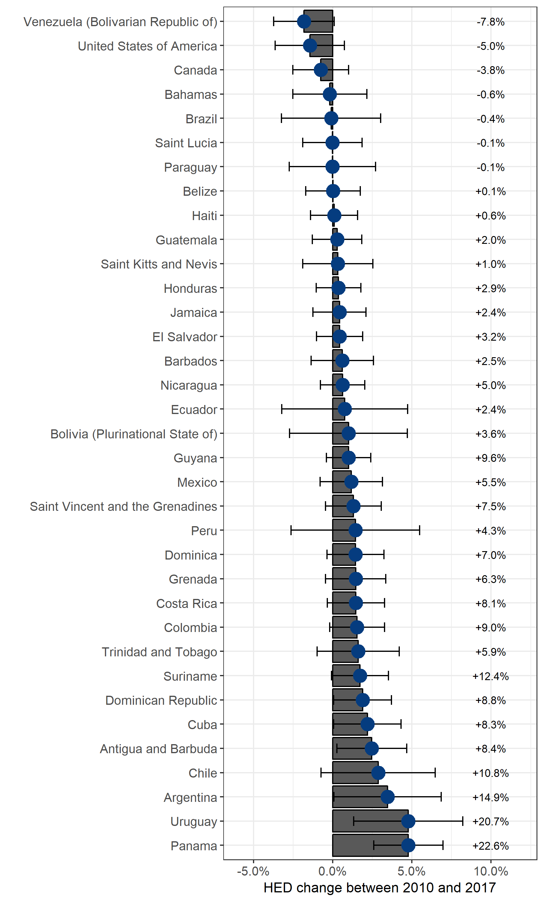
Details of heavy episodic drinking 2010-2017
Decreases in the large countries and increases in smaller countries almost cancelled out with HED overall stable at 25%

Slide 9
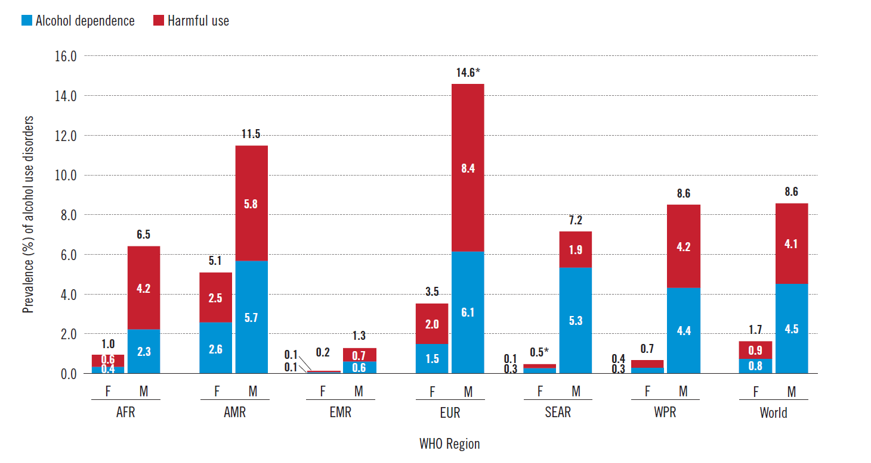
Prevalence (in %) of alcohol use disorders (AUDs), by sex, and by WHO region and the world, 2016

Slide 10
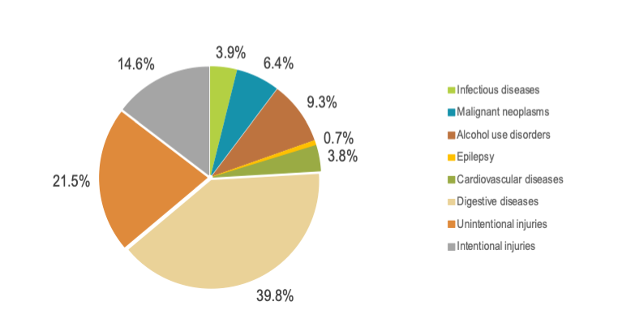
Deaths Attributable to Alcohol in 2016 in the Americas, by cause
% of all AA deaths
% of all deaths
3.1%
of all communicable, maternal,
perinatal, and nutritional condition
deaths
3.6%
of all NCD
deaths
23.6%
of all injury
deaths
Total DEATHS: 379,000; 5.4% of All DEATHS

Slide 11
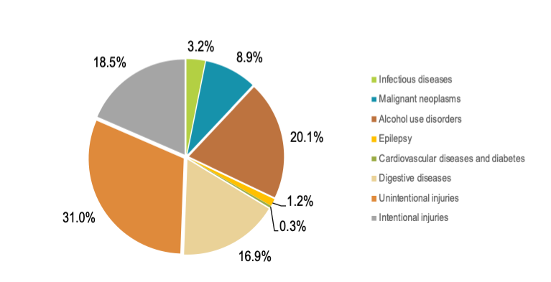
Alcohol-attributable DALYs - 2016
18,901,659 DALYs; 6.7% of all DALYs

Slide 12

What is alcohol prevention? What works at what cost and for how many?
Availability of
products
Consumption
Excessive
consumption
Acute and
Chronic
Problems
RETAIL
Education
Early interventions
Treatment and
Rehabilitation;
Separating harms (drink-driving e.g.)
Physical-Economic-Social
Public
Policies

Slide 13
BEST BUYS, ESPECIALLY FOR LOW AND MIDDLE INCOME COUNTRIES FOR MEN AND WOMEN
Harmful use of alcohol (> 50m DALYs; 4.5% global burden) | Restrict access to retailed alcohol * | Combined effect: 5-10 m DALYs averted (10-20% alcohol burden)
 | Enforce bans on alcohol advertising *
 | Raise taxes on alcohol *
very cost-effective ($ per DALY prevented < GDP per person)
very low cost in implementation and in principle feasible
Notes:
The combination of the 3 most cost effective interventions is the best alternative for LMICs.
13

Slide 14
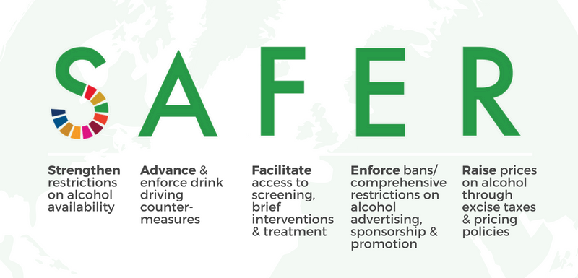
“We are proud to introduce SAFER – a package of proven interventions to reduce the harms caused by alcohol, and a new partnership to catalyze global action. We need governments to put in place effective alcohol control policy options and public policies to reduce the harmful use of alcohol.”
Dr Tedros Adhanom Ghebreyesus,
Director-General of WHO
Geneva, 28 September 2018

Slide 15
REGIONAL SITUATION: LIMITED COMMITMENT TO ALCOHOL POLICIES!
INDICATORS: Regional APC stable (reduced in 13 countries); HED high and increased since 2010 in all but 2 countries in LAC; AUD in women are the highest in the world; lowest abstinence rates of all regions
Current National Plan and/or Policy: 9
S Countries with some restriction on hours/days/places of alcohol sales: 5
A Countries with screening, brief interventions and treatment: ?
F Countries with drink driving countermeasures: 8
E Countries with marketing restrictions: 2
R Countries with excise taxes adjusted for inflation: 8

Slide 16

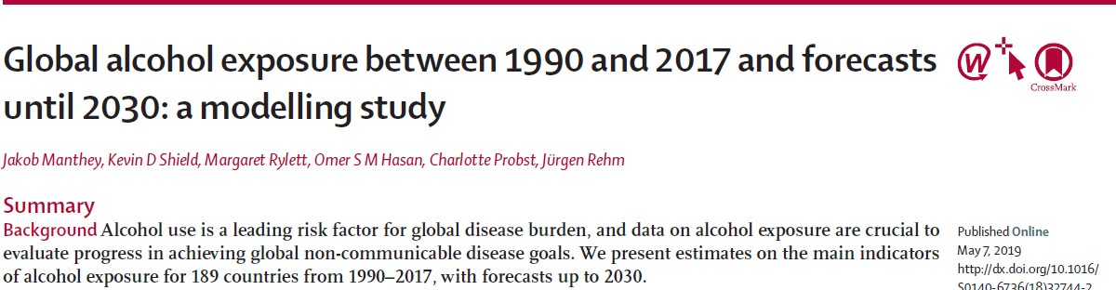
Are we on track for meeting the global target for harmful use of alcohol in the NCD Global Monitoring Framework and advancing
SDG health target 3.5?
NO!

Slide 17

Virtual courses
http://www.campusvirtualsp.org/
AUDIT-SBI (E,S)
ASSIST-SBI (E,S)
Alcohol policy and public health (E, S)
Drug policy and public health (E, S)
Advocacy for Alcohol Policy (P,E,S)
Alcohol and Pregnancy (P, E,S)

Slide 18
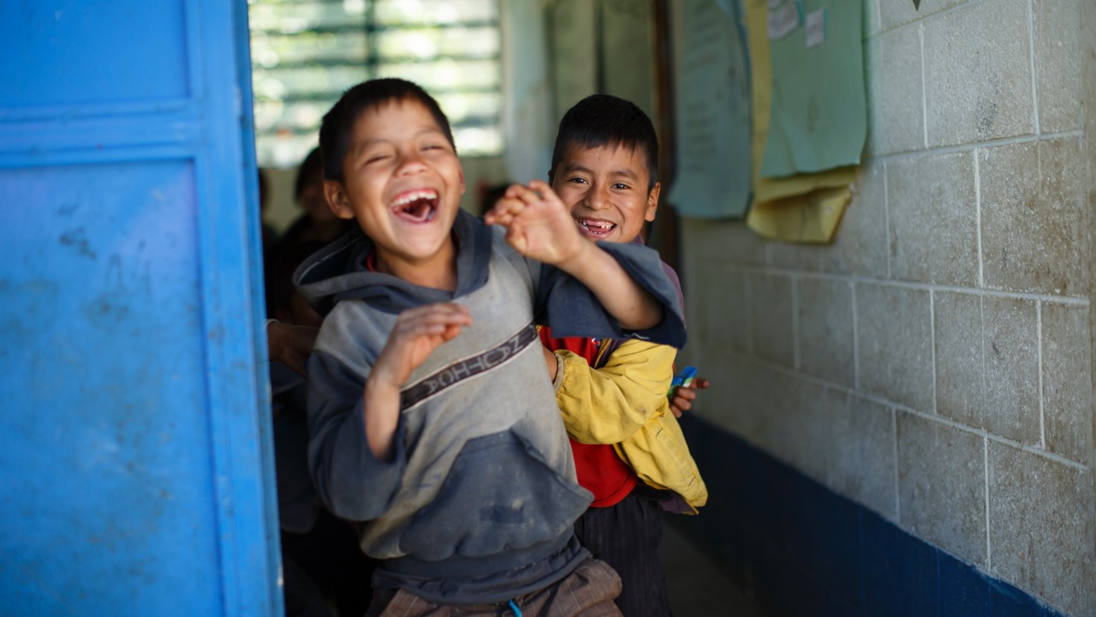
Questions?
Thank you!

