Slide 1

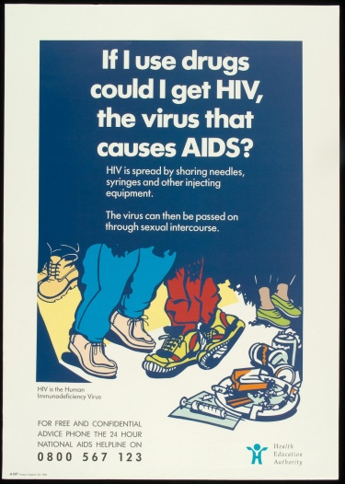
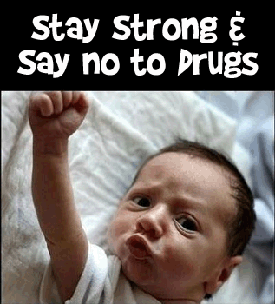
Persuasion:
A Crucial Feature of Successful Prevention
William D. Crano, PhD
Professor of Psychology & Director,
Health Psychology and Prevention Science Institute
Claremont Graduate University

Slide 2
History of for demand reduction campaigns in the US
Combined effects of supply and demand reduction efforts over the years, after many billions of dollars expended in the U.S.

Slide 3
The Issues
Mass Media have been irregularly successful in prevention of psychotropic substance use
Successful campaigns are good value (Reach, even in remote places)
Failed campaigns are intolerably expensive
Inevitably, failed campaigns have ignored evidence on persuasion, resulting in use of unpersuasive preventive communications
PREVENTION ALWAYS INVOLVES PERSUASION

Slide 4
Evidence indicates we are losing the race for public support
11 States in the US, + the District of Columbia, have legalized marijuana for adult recreational use
33 States + DC have legalized marijuana for medical purposes

Slide 5
Evidence indicates we are losing the race for public support
Yet, our National Academies Report
  Found little to no evidence of claimed positive effects of use,
  But, if the substance is used heavily and frequently before age 25, evidence indicates brain development may be retarded
Yet, two-thirds of Americans favor legalization
Does the evidence indicate any potential problems of “medicalizing” marijuana and by extension, making recreational use legal?
WHY

Slide 6
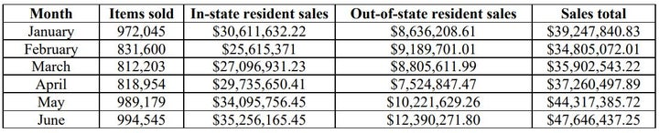
Monthly Cannabis Sales in First Six Months of Legalization
$52.5M in taxes collected in first 5 months
Obviously, $$ is one possible explanation

Slide 7
Percent Using Marijuana in Past Month,
Ages 12-17, by State (2013-2014)
States with Legalized Marijuana by 2014 (Medical or Recreational)
Source: National Survey on Drug Use and Health, 2013-2014.
http://www.samhsa.gov/data/sites/default/files/2/2/NSDUHsaeSpecificStatesTOC2014.htm

Slide 8

Another reason why we are losing the battle of public opinion. Consider a memorable ad from an early media campaign in the U.S.

Slide 9
Some questions the ad evoked
Yeah can I get a side of bacon with that?
Could you make that over easy?
Yes. Are you going to eat my brain? Because I’m really hungry...mostly from doing drugs.
No, that's a frying pan, and that's an egg. I think whoever wrote this ad is on drugs.
Responses to ad trivialized the problem
Etc. How about that S. Dakota campaign It only cost $.5 Mil

Slide 10
How should we respond?
SOME STEPS in Persuasion
DON’T TRIVIALIZE THE ISSUE
Induce audience to attend to your message, start to finish
Require them to think about your message
Present information in way that is difficult to counter
Get buy-in and if possible, commitment to act
A single presentation doesn’t do much – rinse & repeat
Boost initial effect with “booster shots”
Not that➔ ➔ ➔ ➔ ➔

Slide 11
Our solution: The EQUIP Model, which integrates critical media and persuasion requirements for effective prevention
EQUIP highlights the key design features for successful media-based persuasion
It is based on 60 years of strong, well-established evidence

Slide 12
The Central Action Components of the EQUIP Model
Engage: Attract and maintain attention of your audience
Question: Raise question in mind of receiver about their pro-drug attitude
Undermine: Destabilize the attitude
Inform: Provide plausible replacement of existing belief
Persuade: Provide incentives for agreement with your message

Slide 13
Evaluate the Brain on Drugs Ad in terms of the EQUIP model
  ENGAGE: Did it attract people’s attention? Yes, initially.
  QUESTION: Did it raise a question in viewers’ minds? No.
  UNDERMINE: Did it threaten existing beliefs & provide alternative? No.
  INFORM: Did it tell you how to avoid frying your brain? No.
  PERSUADE: Was it persuasive? No. It is telling me to avoid a drug, but not how to do it, or why I should… It will fail.
BUT, Americans remember the ‘this is your brain on drugs’ ad! There’s a difference between memorability and persuasion
Notes:
There is a difference between an ad’s memorability and its persuasiveness. This ad was memorable – but not persuasive.
This was a creative and memorable ad that satisfied only one of the EQUIP criteria - ENGAGE. As we might expect, evidence showed it had no preventive effect.

Slide 14
Important working assumptions
People do not always believe what they are told, especially when dealing with psychotropic substances.
We need to overcome their resistance to attain positive preventive effects
The first and major consideration: expect counter-arguments
The EQUIP can help overcome these defensive reactions
Notes:
There is considerable literature, built up over the past 6 decades that suggests what to do and how to do it
This literature fits perfectly with our EQUIP requirements, and facilitates our attempts to integrate preventive media with persuasion

Slide 15
Building on the EQUIP, when designing our persuasive message, we:
Make resistance difficult, impossible, or apparently unnecessary
Target or tailor the persuasive message to the susceptibilities of the audience – what do they care about?
Note – in some contexts, the audience may be your legislators, the press, school authorities, etc.
When dealing with young adult audiences: Use message sources they respect – don’t let them take the easy way out – “He doesn’t know what he’s talking about…”

Slide 16
More specifics… “Dos & Don’ts”
  Do not over-promise or over-threaten:
  Fear arousing ads usually fail – Avoid them
  Unbelievable ads usually fail – Avoid them
  Exaggerated ads usually fail – Avoid them
  Whimsical ads usually fail – Avoid them
  Disgusting ads usually fail – Avoid them
  Current failures result in future failures by reinforcing certainty and hence, resistance
  For young adults, involve opinion leaders as message sources, but choose carefully
  Try to create a norm of abstinence or avoidance – the norm will help guide future group behavior

Slide 17
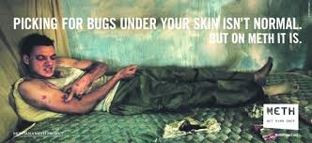
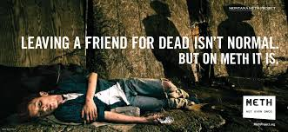
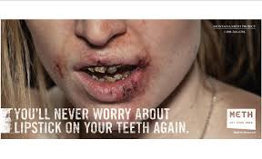
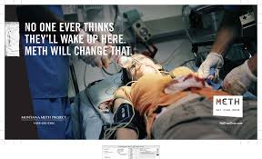
Fear arousing, exaggerated, unbelievable, disgusting ads

Slide 18

Thank you for your kind attention
Any Questions?
william.crano@cgu.edu

