Slide 1
BEST PRACTICES IN TRAINING ON TREATMENT -AFRICA
George Murimi
Project Manager for Africa
Colombo Plan Drug Advisory Programme
george.murimi@colombo-plan.org
Notes:
Appreciations/congratulations to the organizers and conveners of the 1st DDR Virtual conference in Africa
-One of the highlights of 2020

Slide 2
Background and Aims:
Formed in 1973 by the Colombo Plan
Operations in Africa from 2013
Prevention of substance use and treatment of related disorders continue to fall far short of needs ( WDR 2020)

Slide 3
Approaches:
3-pronged approach:
Rigorous development of evidence-based Drug Demand Reduction (DDR) curricula,
Dissemination through best-practices training
and credentialing of addictions prevention and treatment professionals.

Slide 4
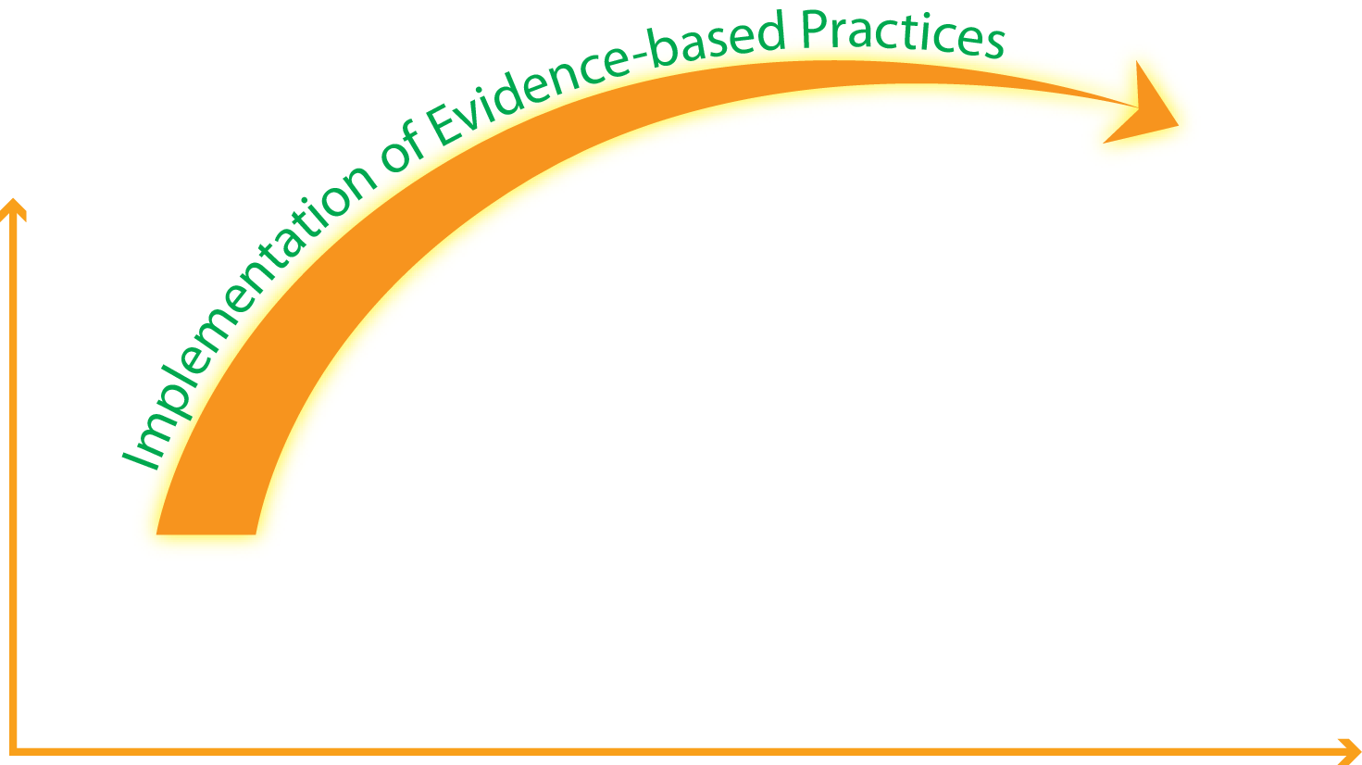
Process of professionalization
Credentialing
UC Training
Devt of Curriculum
ISSUP (issup.net)

Slide 5
Rigorous process of curriculum devt devt.
Notes:
Evidence-based, comprehensive, integrated, balanced, experiential and universally applicable and acceptable
- Treatment equally needs to be evident-based, comprehensive, holistic and balanced
-Aligned with the International Standards for Treatment and Principles for Effective Treatment of Drug Use Disorders, Guiding Principles for Recovery
- Curriculum is the bedrock, foundation of any training

Slide 6
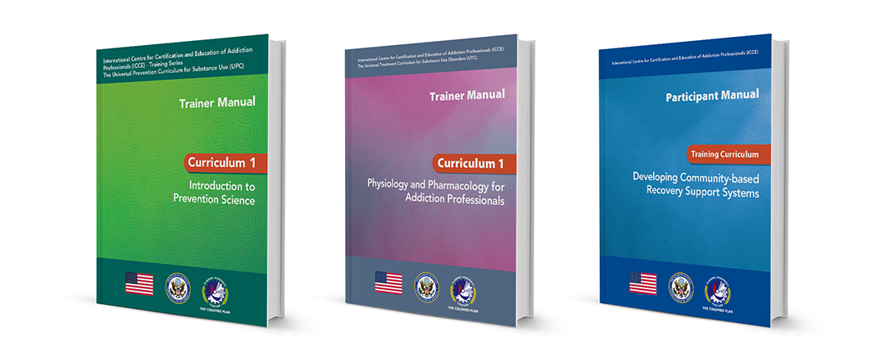

Curriculum Development
Specialised Curricula
  Recovery Support (-Peers & Allies)
  Womens Interventions for Substance Exposure (WISE)
  Treatment of Child Substance Use Disorders
  Rural Treatment & Prevention
  Community Outreach
Core Curricula
  Universal Prevention Curriculum (UPC)
  Universal Treatment Curriculum (UTC)

Slide 7

UPC Series 1- for Coordinators / Managers and Supervisors
UPC Series 2- for Practioners / Implementers / Specialists

Slide 8

Curriculum
1- Physiology & Pharmacology for Addiction
2-Treatment for Substance Use Disorders- The Continuum of Care
3-Common Co-occurring Mental and Medical Disorders
4-Basic Counseling for Addiction Professionals
5-Intake, Screening, Assessment, Treatment Planning and Documentation for Addiction Professionals
6- Case Management for Addiction Professionals
7 –Crisis Intervention for Addiction Professionals
8 –Ethics for Addiction Professionals

Slide 9
UTC ADVANCED Level
    C 9: Pharmacology and SUD (33 hours )
    C 10: Medication Assisted Treatment Programs (33 hourss)
    C 11: Enhancing Motivational Interviewing Skills (20 hours)
    C 12: Cognitive Behavioural Therapy (CBT) (20 hours)
    C 13: Contingency Management (20 hours)
    C 14: Working with Families (33 hours)
    C 21: Trauma and Informed Care (27 hours)
    C 22: Recovery Management and Continuing Care (27 hours)

Slide 10
What is Training?
Systematic process
human resources gain knowledge and develop skills & acquire attitudes
by instruction and practical activities …including coaching & mentoring that result in improved performance.

Slide 11
The ASK Concept
The GAP concept:
training is simply a means to use activities to fill the gaps of performance between the actual results and the expected results.
This GAP can be separated into 3 main themes
        Attitude
        Skills
        Knowledge
Notes:
GAP: Where we are, and where we wish to be

Slide 12
Rank ASK by difficulty to develop in people
Attitude
Skills
Knowledge
Easy
Moderately difficult
Most difficult

Slide 13
Importance of Quality Training
Maintains qualified products / services
Achieves high service standards
Achieves learning about new things; technology, products / service delivery
Improves communication & relationships - better teamwork

Slide 14
4 Best Practices For Training And Development
Identify Your Audience And Performance Challenges Before You Begin.
Create A Plan For Mobility, Flexibility, And Accessibility. ...
Leverage Rich Media, Interactive Activities, And An Engaging Script. ...
Incorporate Assessments To Test Your Trainees' Knowledge And Make Adjustments.

Slide 15
Nine Steps in the Training Process
Assessing training needs
Preparing training plan
Specifying training objectives
Designing the training program(s)
Selecting the instructional methods
Completing the training plan
Implementing the training program
Evaluating the training
Planning future training

Slide 16
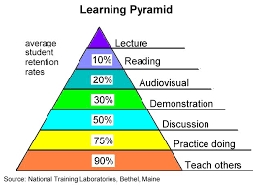
5%

Slide 17




Diversity of Learning….& training Styles
Visual | Remember best when they SEE (create) mental images of what they hear or read.
Auditory | Remember best when they LISTEN
Kinaesthetic | Remember best by DOING rather than sitting and listening, reading, or thinking about the information.
Verbal | Remember best when they DISCUSS .
Notes:
-Balancing act to cater for individual differences
- Verbalize….conceptualize, internalize and memorize
-The need to have 2 or 3 Trainers at any one time

Slide 18
Adult Learners . . .
Are autonomous and self-directed.
Have a foundation of life experiences and knowledge.
Are goal-oriented.
Are relevancy-oriented.
Are practical.
Need to be shown respect.
Notes:
Adult Learners . . .
Are autonomous and self-directed.
Have a foundation of life experiences and knowledge.
Are goal-oriented.
Are relevancy-oriented.
Are practical.
Need to be shown respect.

Slide 19

Notes:
56 countries…and still counting

Slide 20
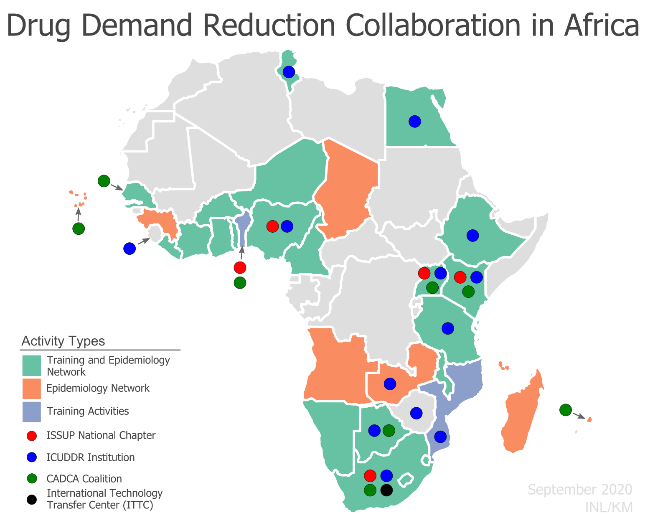

Slide 21
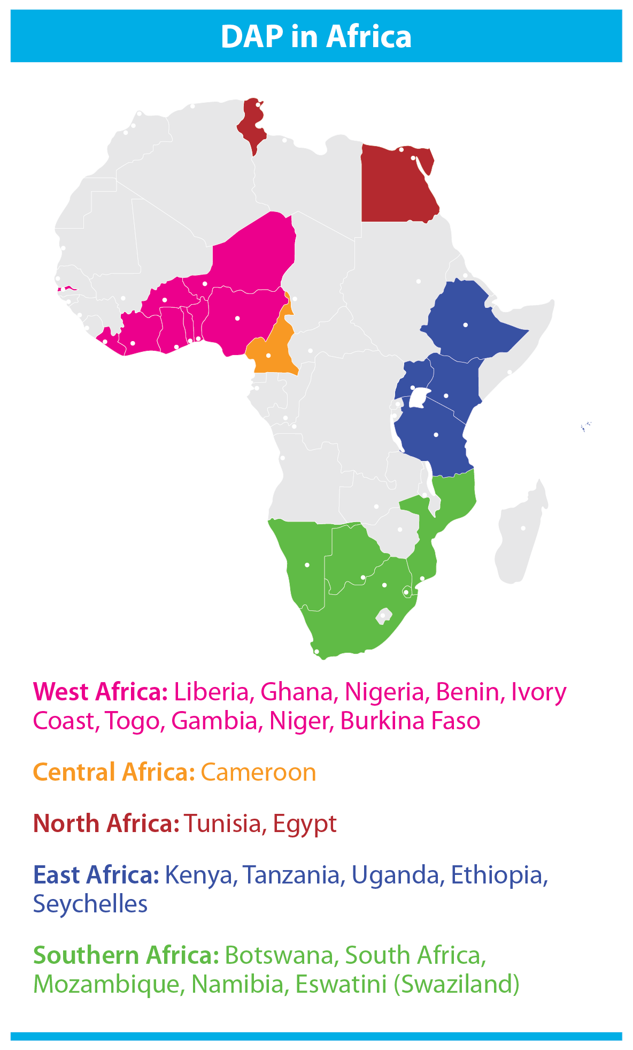

Slide 22
Close collaborations…& goodwill
INL, US Department of State
A.U, UNODC , ISSUP, ICUDDR
Governments
Regional organizations such as ECOWAS
People in Recovery , Civil Societies
Master and National Trainers
Notes:
Goodwill & buy-in, ownership

Slide 23
Training of Trainers (TOT) concept
Multiplier effect
20-25 per country, who in turn train others in-country, in a continuous process of dissemination and expansion
Total trained = 506
Total echo-trained=2084
% Increase= 312%

Slide 24
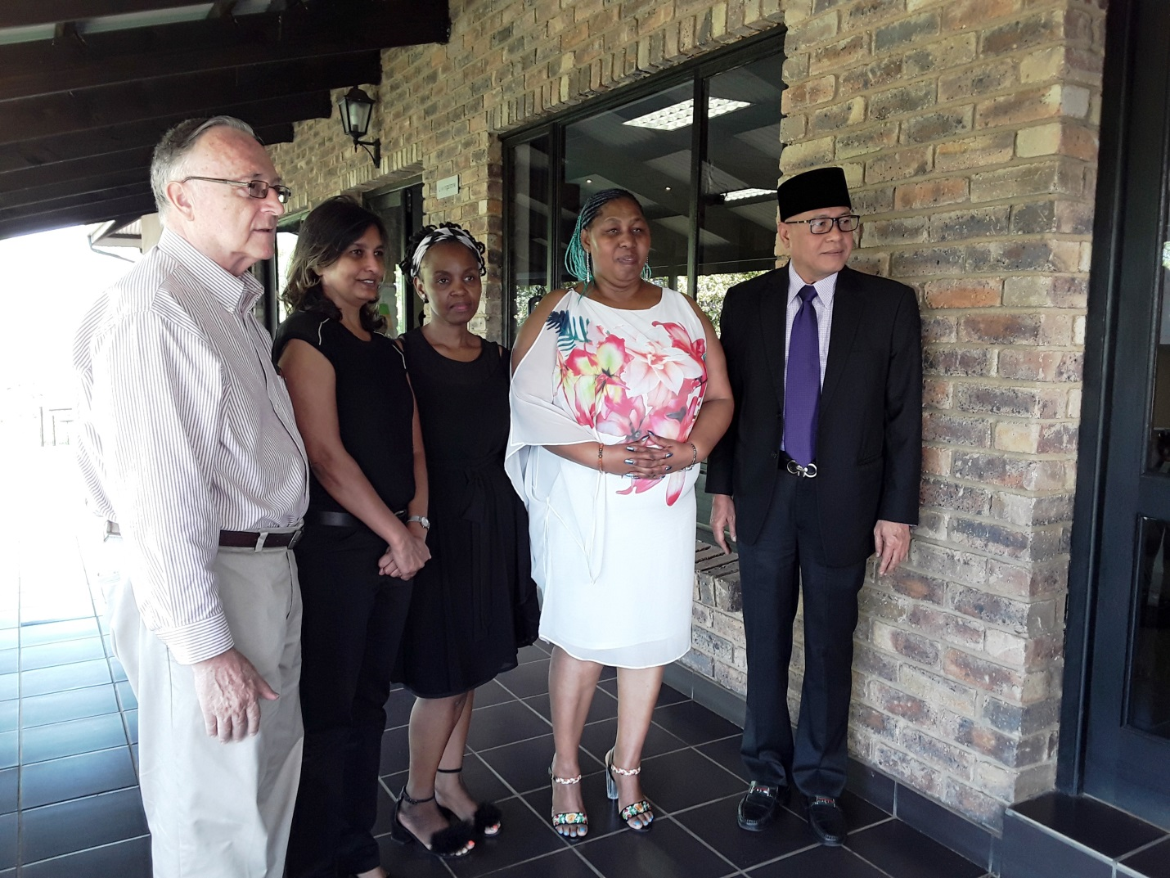
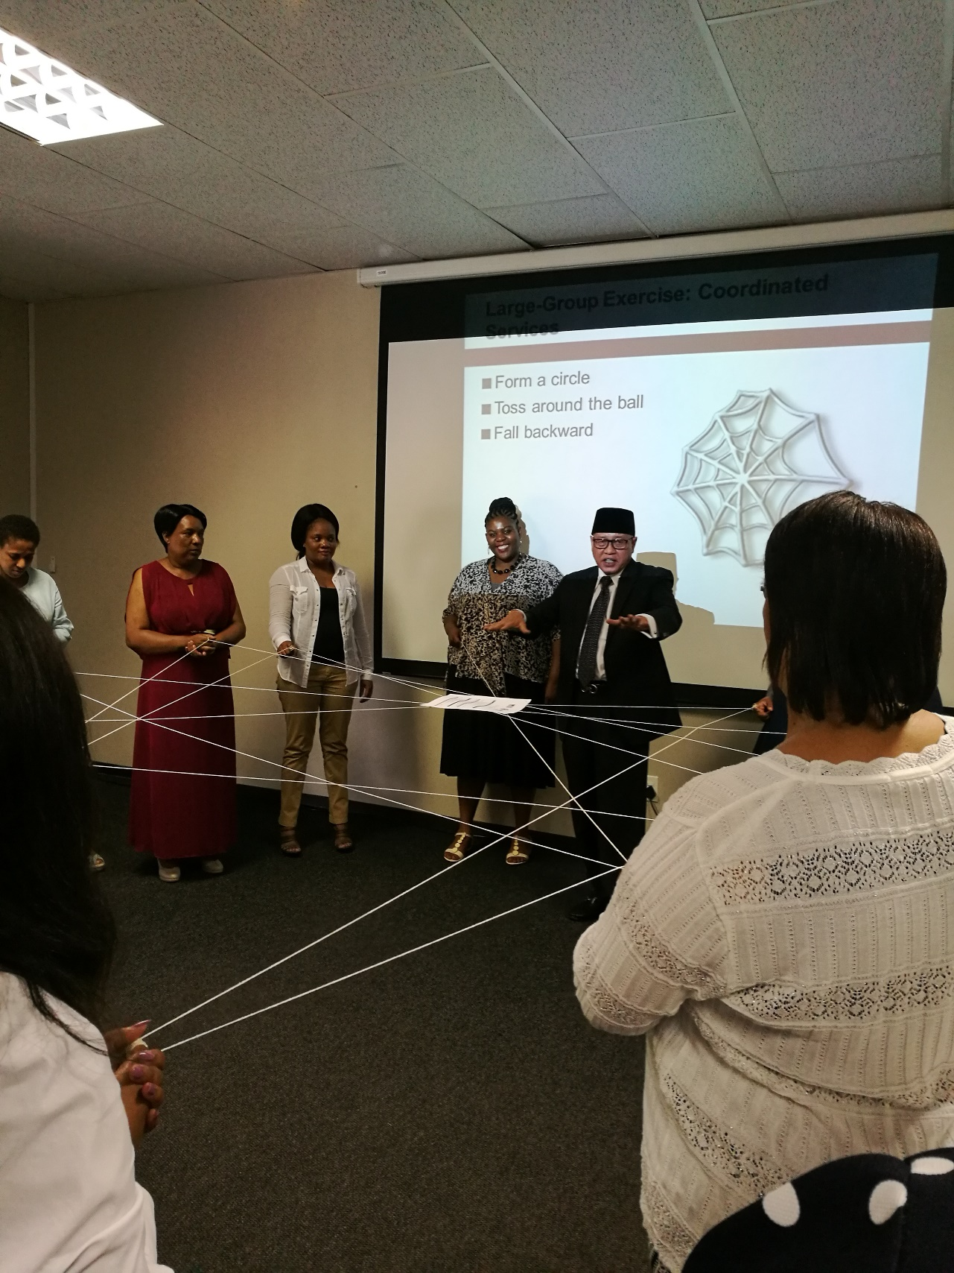
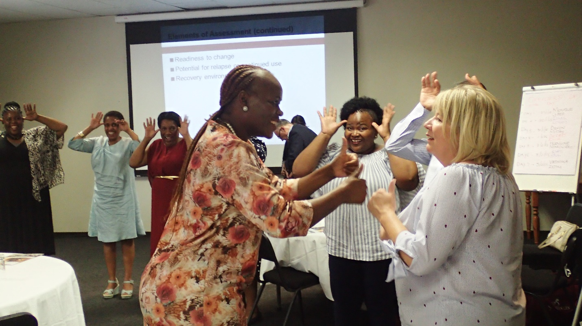
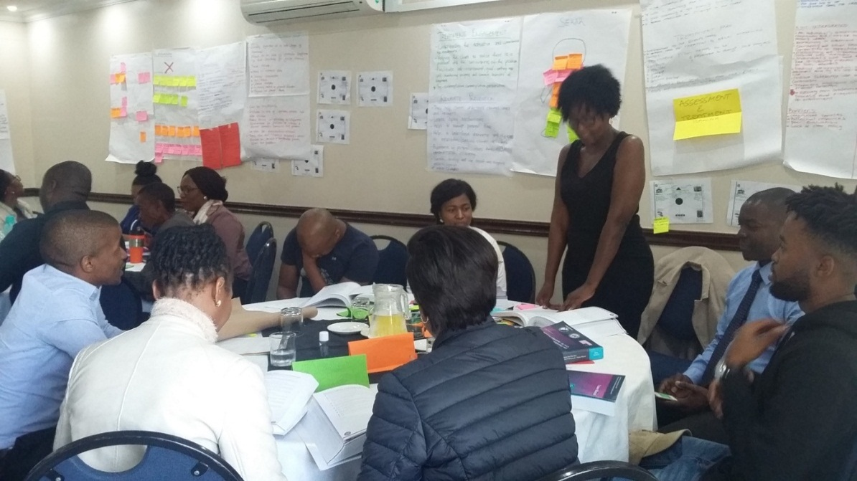

Slide 25
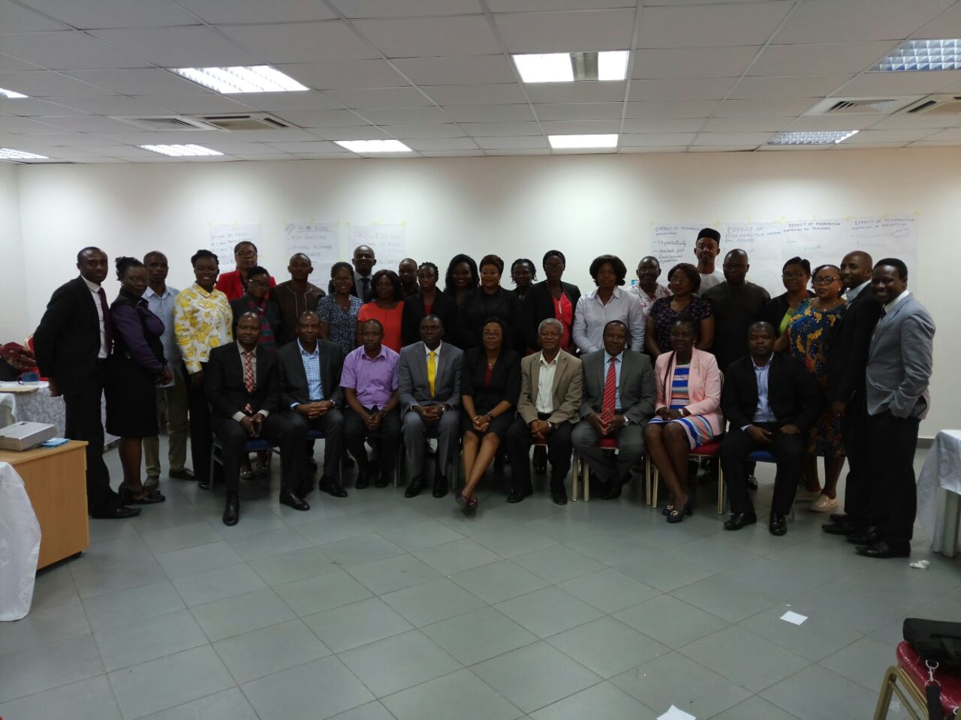
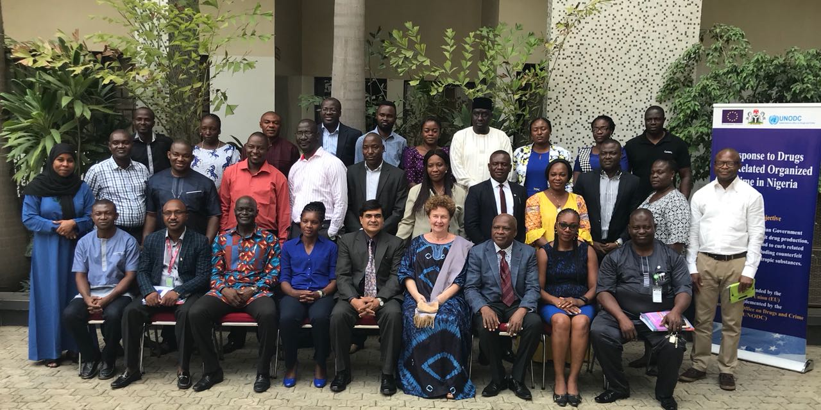

Slide 26
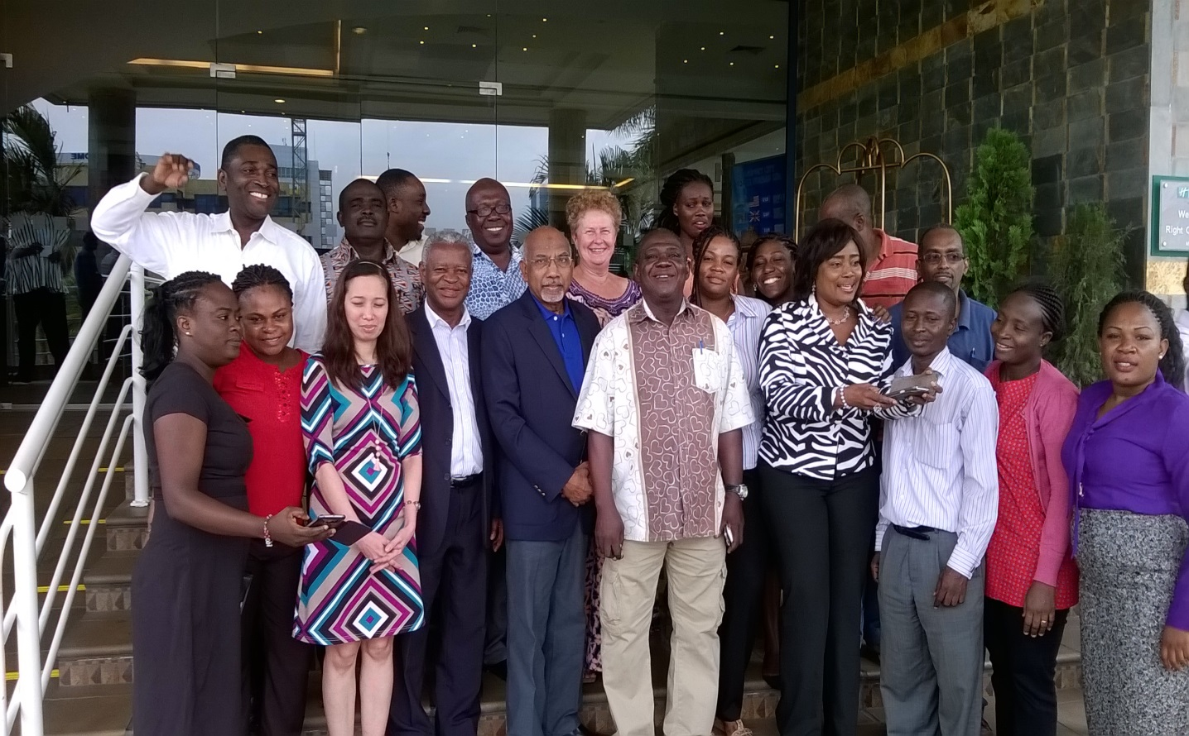
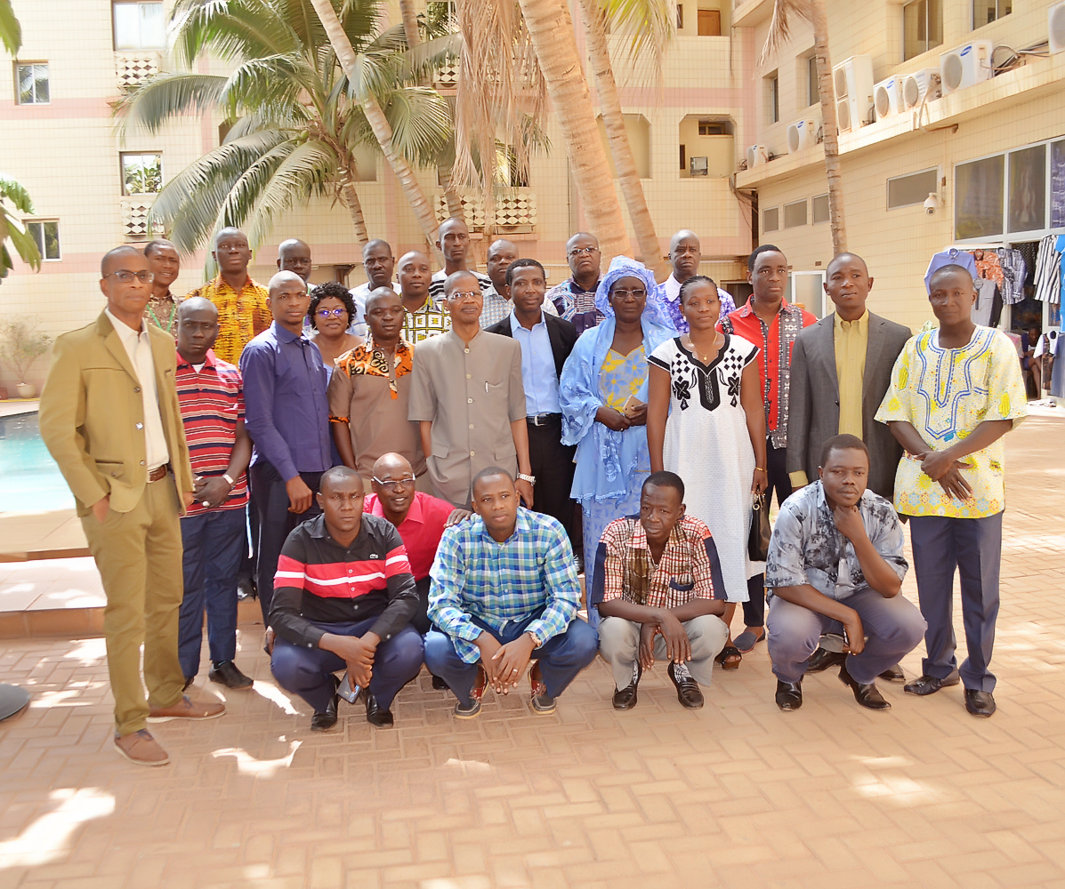
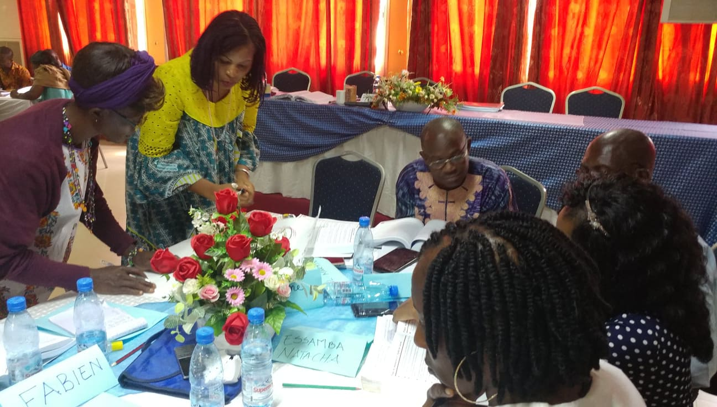
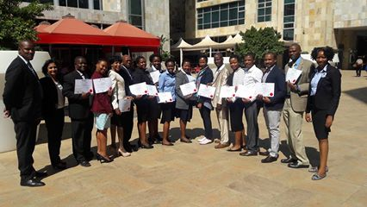

Slide 27
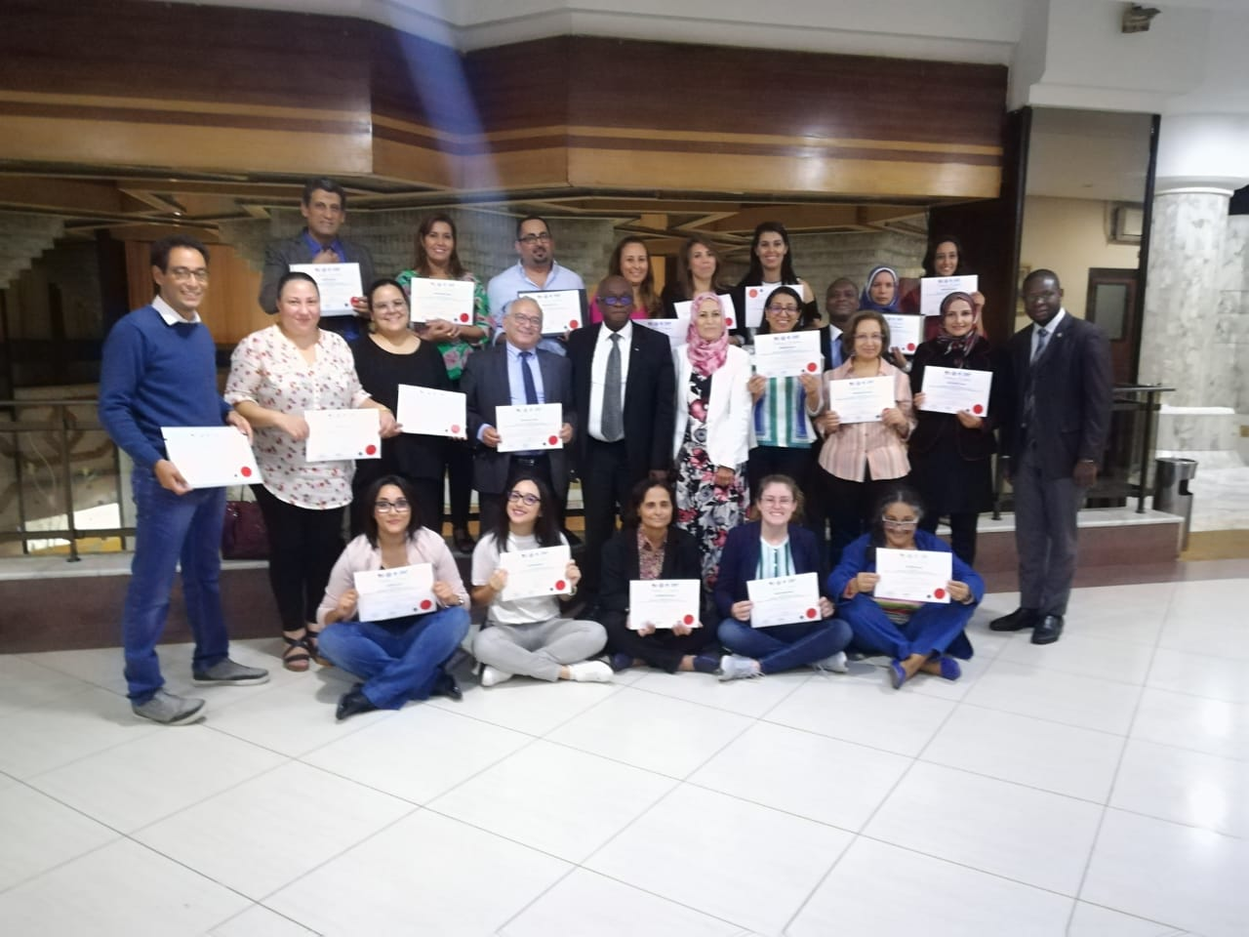
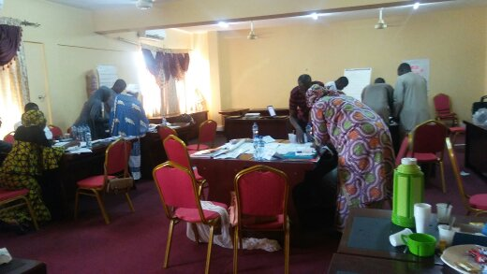
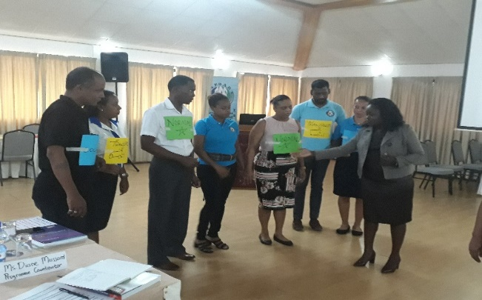
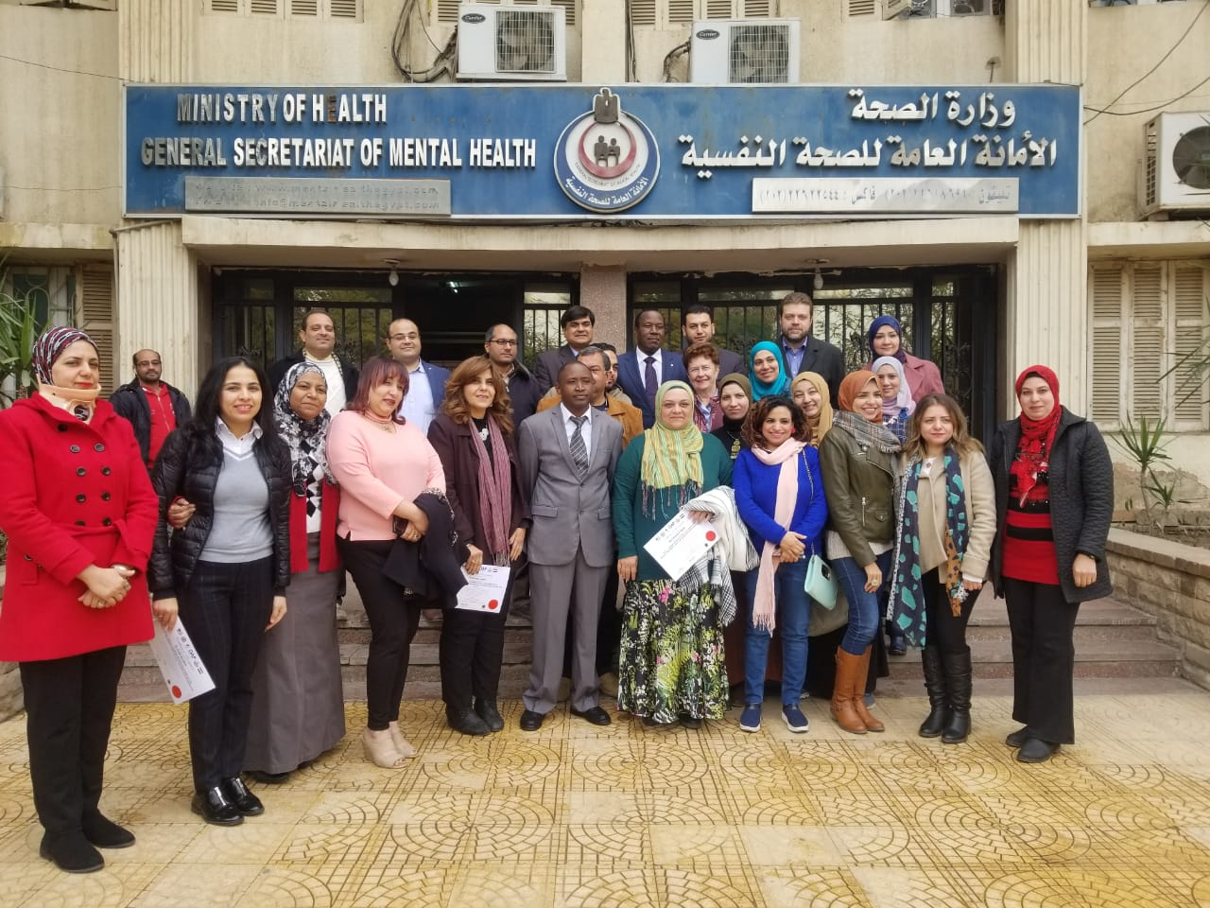

Slide 28
Conclusion and Recommendations
Cover over 50% of the Africa and Middle East by 2025 …by complementary efforts and capitalizing on each other’s strengths
Quantity and Quality
Continually review What Works……….

Slide 29
THANK
YOU!
george.murimi@colombo-plan.org

