Slide 1
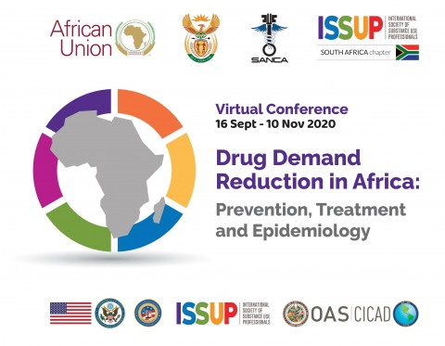
Case Study: EVIDENCE BASED Treatment ProgrammeS IN Nigeria
Dr. Bawo. O. James (MSc, FMCPsy, FWACP)
Consultant Psychiatrist & Head, Drug Abuse Treatment Education and Research (DATER) Unit, FNPH, Benin-City, Nigeria

Slide 2
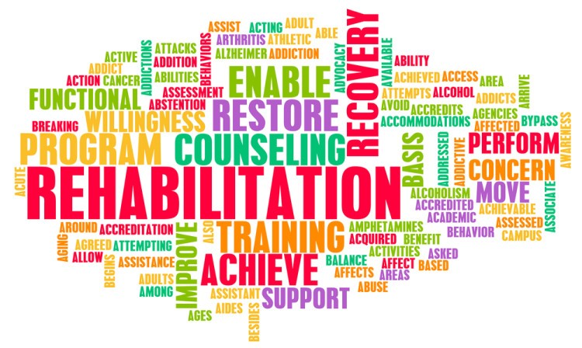
Outline
Background
Objectives
Activities
Results
Challenges
Lessons learned

Slide 3
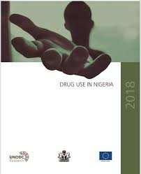
Background
Nigeria has a huge psychoactive substance use burden. Past year prevalence of 14.4% exceeded the 2016 global prevalence of 5.6%
Two-thirds of high risk users indicated a need for treatment. 40% of these were unable to access intervention.
Barriers include: poor awareness of available services, inadequate treatment centers, high cost of care, fewer evidence based services (Drug Use Survey, 2018)

Slide 4
background
An assessment in 2010/2011 of drug treatment services in Nigeria showed that centers were few, skewed as regards location, had limited funding, were poorly networked and did not fully employ best practices (Onifade et al, 2011)

Slide 5

background
Another assessment of drug treatment services in 2012/2013 as a component of the UNODC (Response to drugs and related organized crime) project showed
Lack of standardized tools for assessment and treatment planning
Low number of trained staff
Limited equipment

Slide 6
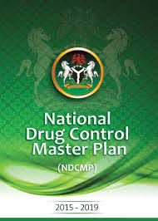
OBJECTIVE
The Federal Government of Nigeria (FGN)/Federal Ministry Of Health (FMOH)/National Drug Law Enforcement Agency (NDLEA) with support from the UNODC sought to improve the quality, availability and spread of evidence based treatment services across the country as one of the strategic pillars of the 2015 – 2019 Drug Control Master Plan.

Slide 7
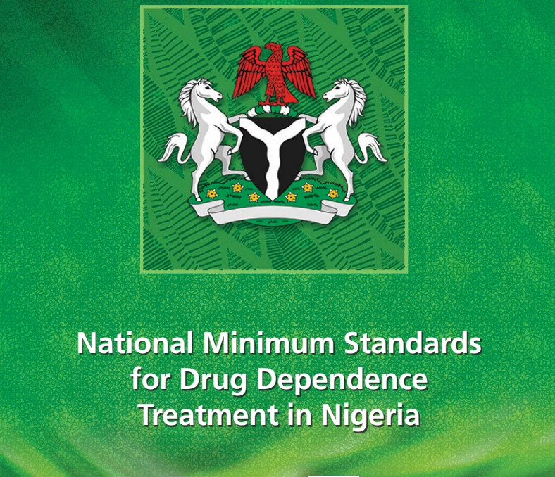
ACTIVITIES
Developing a country specific minimum standard for drug treatment services
Published in 2015
Standards facilitate a benchmark/guide for starting a new service, auditing an existing service and getting service user feedback

Slide 8
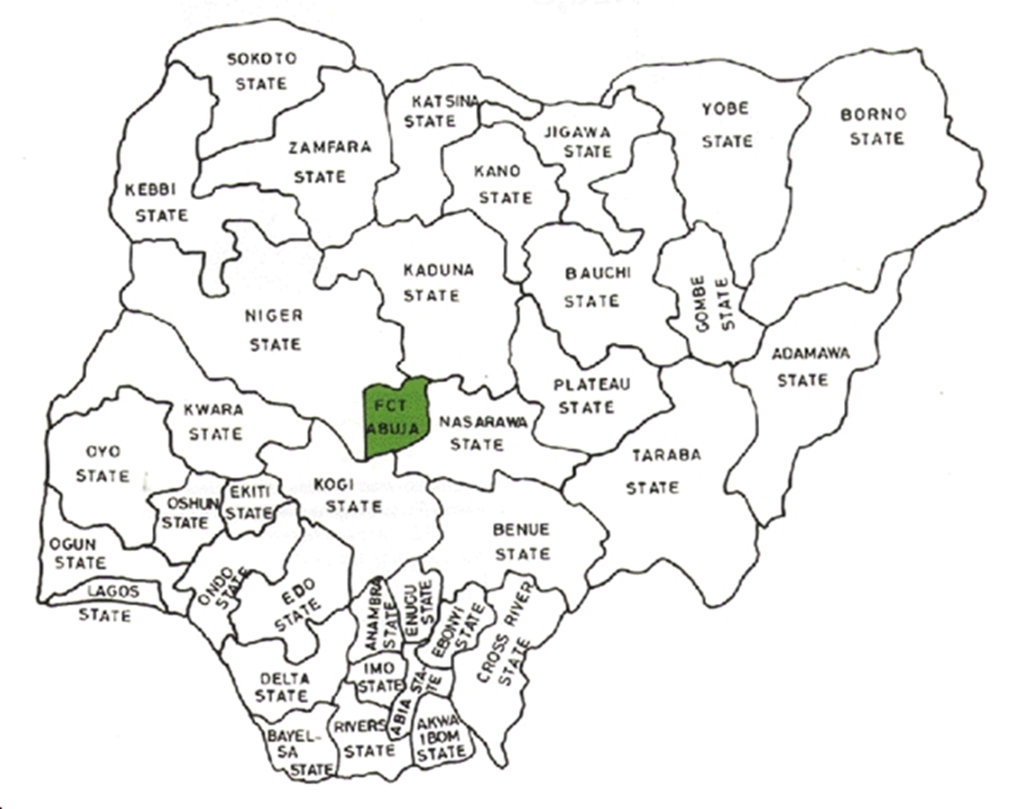


Activities
FG/FMOH/UNODC facilitated support and capacity building to 11 geographically spread treatment centers (10 publicly funded hospitals and 1 CSO)
Some centers designated ‘Model Treatment Centers’ and ‘Regional Training Hubs’ according to geopolitical spread
Similar capacity building for NDLEA counselling centres

Slide 9

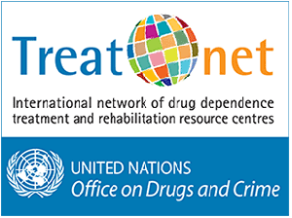
activities
Training
Over 1200 practitioners trained using TREATNET
Capacity for continuous training with 24 National Master Trainers and 90 Trainers
Over 50 National Trainers on the Universal Treatment Curriculum (UTC)
Over 400 practitioners trained on the UTC with a sizeable proportion credentialed or awaiting credentialing.

Slide 10
Evidence-Based Treatment Service
Minimum Standards
Management Buy-in
Network of providers
Staff Training and Retraining
Multi-disciplinary teamwork

Slide 11
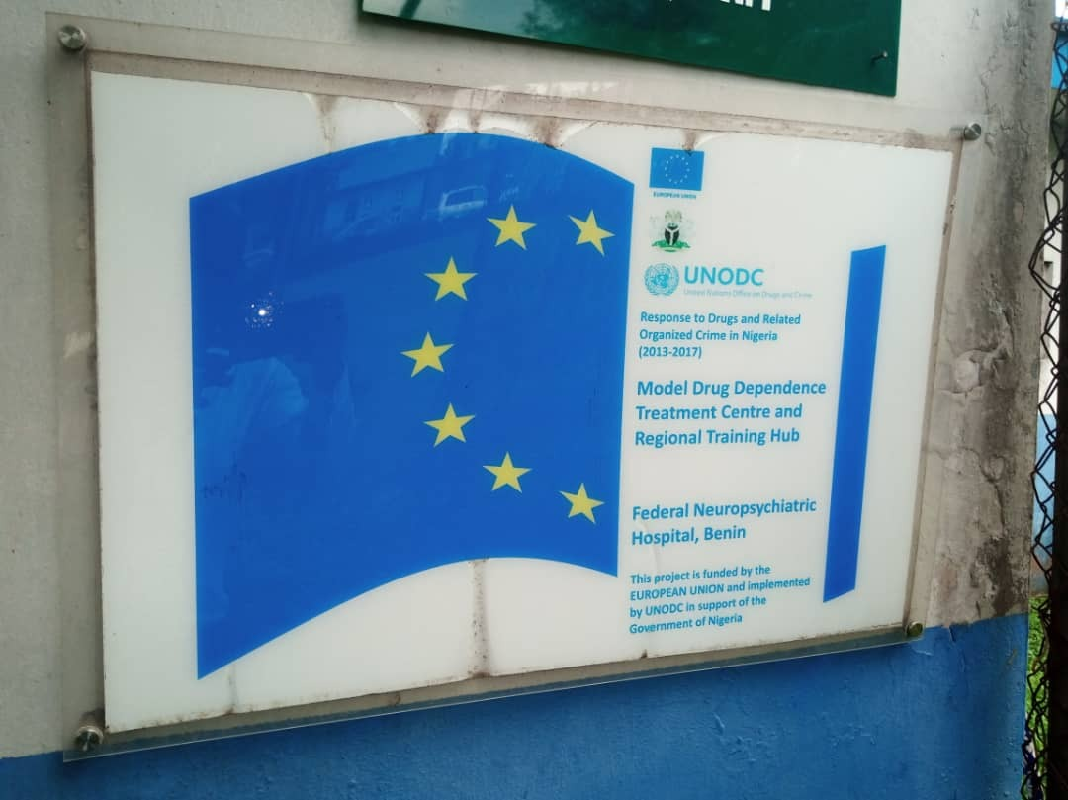

RESULTS
Treatment programme at FNPH Benin-City, Nigeria pre-2012
 | Before 2012/2013 | By 2020
Evidence based client centered treatment program | Absent | Present
Percentage of appropriately trained staff | 10% | 100%
Training and mentorship capacity | Absent | Present
Service user treatment satisfaction | 22% | 93%

Slide 12

Challenges
Staff adaptation to practice evidence-based treatment interventions
Multi-disciplinary collaboration and client-centred care planning
Availability and affordability of medications for managing addictions
Cost of care and impact on satisfactory duration of treatment
Institutional support/funding
Brain drain

Slide 13
Lessons learned
Stakeholder buy-in important for the success of evidence-treatment programs and would vary depending on the setting
Networks developed as a result of national and regional level trainings were invaluable in navigating program bottlenecks. Evidence-based practice vs. Practice-based evidence
Training and retraining are invaluable for successful programs. Because of staff attrition, it helps to train more than you think you may need at any time.
Teams make the difference, rather than excellent individual skills. Team work creates a sense of ownership, facilitates skill and knowledge transfer

Slide 14


