Slide 1

GANGS
Notes:
The trainer should introduce the module.

Slide 2
GANGS
Methodology:
Active discussion
Case Study
Role Play
Required Materials:
Easel Pad
Participant Manual
Notepad for each participant
Pens & Pencils
Duration: 3 hours
Notes:
The trainer will point out the methodology for this training. Active discussion refers to the trainer’s lecture but also participation from the audience in the form of questions, comments, suggestions that will enhance mutual learning.
The required materials for this module provide preparation for exercises.
The expected duration of this module is six hours.

Slide 3
GANGS
Learning Objectives
  To learn about gang culture.
  To learn about risk factors for gang involvement.
  To learn the reasons adolescents join gangs.
  Understand treatment models for gang involved adolescents.
  To understand community-based interventions.
Notes:
The trainer will introduce the learning objectives. But first, the trainer can ask the audience what their expectations are about this module.
Learning Objectives
To learn about gang culture.
To learn about risk factors for gang involvement.
To learn the reasons adolescents join gangs.
Understand treatment models for gang involved adolescents.
To understand community-based interventions.

Slide 4
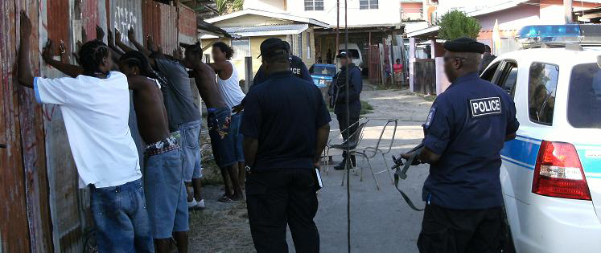
WHAT IS A GANG?
Notes:
The trainer should ask the group to brainstorm what makes a group a gang? S/he should note all responses on an easel pad, stressing that there is usually a criminal element in a gang’s activity.

Slide 5
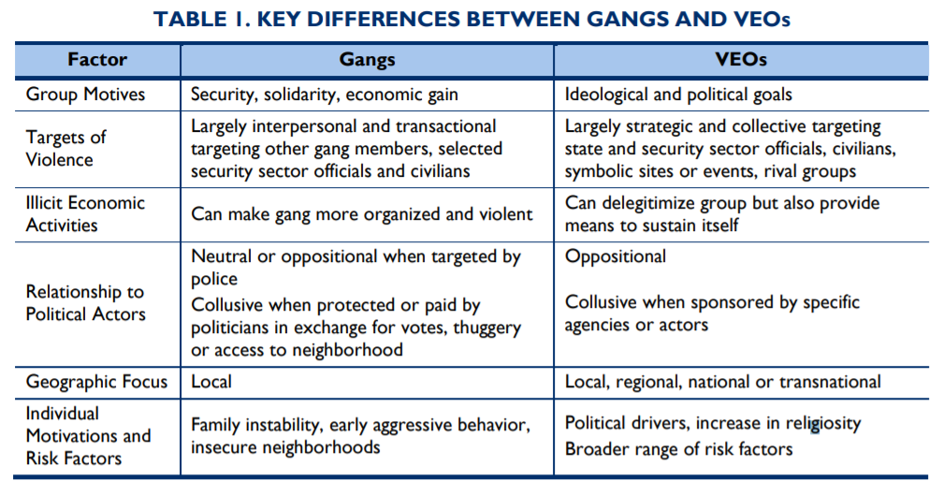
GANS VS. VIOLENT EXTREMIST ORGANIZATIONS
Notes:
The trainer will indicate the differences between gangs and violent extremist organizations (VEOs). The trainer will point out that although in some contexts they may co-exist, the main focus of this module will focus on gangs.

Slide 6
GANGS
Any durable street-oriented group whose involvement with criminal activity is part of their group identity.
  Street gangs/School-based gangs
  Organized crime
Notes:
Street gangs typically lack organization and have limited centralized leadership, whereas organized crime groups have clear lines of authority. Street gangs motivated by issues of status, while organized crime is more often economically motivated. Street gangs involved in neighborhood-level drug sales, organized crime involved in wider distribution and trafficking of drugs.

Slide 7
GANGS
An association of three or more individuals
Group with specific identity.
Purpose is to engage in criminal activity.
Gangs may:
  Employ rules for joining and operating within the association.
  Meet on a recurring basis.
  Provide physical protection of its members from others.
  Seek to exercise control over a particular geographic location or region, or it may simply defend its perceived interests against rivals.
  Have an identifiable structure.
(U.S. Department of Justice, 2011)
Notes:
The trainer should go on to explain that US government definition of gang as used by the Department of Justice and the Department of Homeland Security's Immigration and Customs Enforcement (ICE), is:
An association of three or more individuals;
Whose members collectively identify themselves by adopting a group identity, which they use to create an atmosphere of fear or intimidation, frequently by employing one or more of the following: a common name, slogan, identifying sign, symbol, tattoo or other physical marking, style or color of clothing, hairstyle, hand sign or graffiti;
Whose purpose in part is to engage in criminal activity and which uses violence or intimidation to further its criminal objectives. Whose members engage in criminal activity or acts of juvenile delinquency that if committed by an adult would be crimes with the intent to enhance or preserve the association's power, reputation or economic resources.
The association may also possess some of the following characteristics:
The members may employ rules for joining and operating within the association.
The members may meet on a recurring basis.
The association may provide physical protection of its members from others.
The association may seek to exercise control over a particular geographic location or region, or it may simply defend its perceived interests against rivals.
The association may have an identifiable structure.

Slide 8
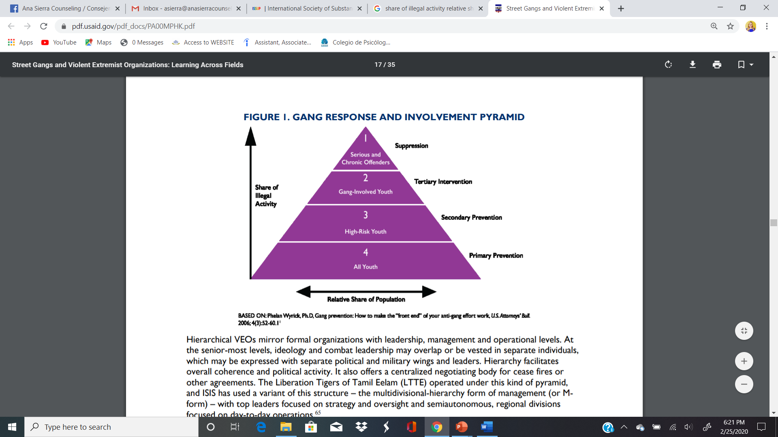
CRIME AND GANG INVOLVEMENT
(USAID, 2016)
Notes:
The trainer should discuss the fact that, while many adolescents are living in high risk areas, not all will become gang members. Adolescents may be attracted to, and influenced by, local gangs, but the large majority are not active gang members. Most crime is committed by relatively few gang members who are often perceived as gang leaders. It is important to differentiate at which level a young person finds him/herself before developing an appropriate intervention.

Slide 9
ADOLESCENT VIOLENCE
Adolescent violence has a gender dimension.
Violence among pre-adolescents is a growing concern.
School violence has escalated.
Adolescent violence is often a response to the threat and fear of victimization.
Adolescent violence is closely associated with community violence.
Adolescent victimization by peers and adults creates an environment for more violence.
(Gibson, 2016: UNDP, 2010)
Notes:
The trainer should discuss adolescent violence in general. The United Nations Development Program (UNDP) has identified six key patterns associated with the incidence of adolescent violence. These are:
Gender Dimension: The majority of aggressors and victims are young men who use violence for protection against threats – real or otherwise – or who have been socialized into a male-dominated tradition of conflict resolution through violence. Young women are victims of verbal and physical abuse, as well as sexual assault.
Pre-adolescents: Early manifestations of violence are often continued into adolescence.
School violence: Violence in schools has appeared to increase, and acts of violence have become more brutal, including student sexual violence.
Response to threat: Adolescents who perceive themselves to be at risk for victimization form delinquent groups and gangs to defend themselves from community violence that permeates the educational environment.
Community violence: The use of violence has often emerged from exposure to various forms of neighborhood or community violence, either as a victim or a witness. The UNDP reports that Caribbean adolescents worry about child abuse, rape, robbery, guns and shootouts, police abuse, unemployment, drugs and lack of road safety. Almost half the adolescents surveyed by UNDP expressed fearfulness about the possibility of becoming a victim of crime.
Victimization: In the same UNDP survey (2010), almost 20% of adolescents had been victims of a crime within the past ten years, and almost 30% of those had been victimized by acquaintances and friends.

Slide 10
WHO ARE GANG MEMEBRS?
Brainstorm in your group the characteristics you believe correspond to those individuals who join and participate in gangs.
Notes:
The trainer should break the participants into smaller groups of 5 – 6 people, asking them to brainstorm on characteristics that correspond to those individuals who are involved with gangs. Participants should note their responses on easel pad paper. The groups should have about 15 minutes to prepare their lists, then the trainer should ask each group to present. S/he should thank them for their efforts, noting similarities and differences in responses.

Slide 11
WHO JOINS GANGS?
Recruits generally range in age from 12 to 15 years
Most members are boys, but 10 percent of all gang members are girls
Certain risk factors increase the likelihood of gang involvement
(U.S. Department of Justice, 2010)
Notes:
The trainer should introduce some of the factors of who joins gangs. While there are specific risk factors related to gang involvement, in general most gang members are between the ages of 12 and 15, with many stating that 12 is the age to begin involvement. Certain risk factors include poverty, unmet basic living needs, the need for protection, and an unhealthy home life.

Slide 12
WHY JOIN A GANG?
Friendship
Protection or safety
Make money
Family member in gang
(Katz, Choate and Fox, 2010)
Notes:
The trainer should stress that, the study found that most adolescents joined for reasons of friendship and protection. To a smaller extent, in order, adolescents joined to make money, because a family member was already gang-involved or for other reasons.

Slide 13
RISK FACTORS
Individual and Personal Attributes
Family Demographics
Relational
Community
Society
(U.S. Department of Justice, 2010)
Notes:
The trainer should explain that, according to the literature there are many and multiple risk factors associated with gang membership and behavior. The six areas or domains are noted on this slide. Each of these domains offers opportunities for intervention:
- Individual and Personal Attributes
- Family Demographics
- Relational
- Community
Society
We’ll look at each of these domains in turn.

Slide 14

INDIVIDUAL AND FAMILY
(U.S. Department of Justice, 2010)
Notes:
The trainer should present that forms of delinquency and violence are strong predictors in the individual domain. Others include alcohol and drug use, early dating and precocious sexual activity. Some mental health problems are also predictors. Personal attributes to consider include impulsivity, risk taking behaviors, low commitment to school, less communication with and lower levels of attachment to parents. The UN Development Program identifies poor health status, early sexual initiation, drug misuse and mental health problems, as well as the inherent youthful desire to take risks with personal security and safety. Risk-taking among adolescents appears to be more about survival and fitting in than about achievement. Reasons for negative risk taking include:
Adolescence: during adolescence, children and parents become more physically and psychologically distant. Increases in family strain and pressures cause adolescents to seek out peers for information and acknowledgement. During this period, parent/adolescent conflict increases. Some research has shown that 10 - 20 percent of families have parents and children in distressed relationships. Today, formal dating patterns have been replaced with informal mixed-sex outings. There is also an increase in part-time employment, and adolescents tend to covet and protect time spent with friends rather than with family.
Desire to belong to a group and to be popular, a trendsetter or an admired rebel.
Yielding to peer pressure
As a means to obtain money from older people who influence them
Mere survival or to better themselves
Create new space for self-expression and distinguish themselves from others
Add excitement to their lives.
Looking specifically at the Caribbean, one study from Trinidad and Tobago reported that gang involvement is associated with adolescents who:
Have parents with attitudes that favor antisocial behavior
Live in neighborhoods that are characterized by high mobility
Live in neighborhoods in which handguns are widely available
Have been involved in antisocial behavior from an early age
Have the intention to use drugs
Has antisocial peers
Have peers who use drugs
The trainer should review the remaining associated risk factors, noting the following:
Lack of alternative activities, such as community youth programs
Lack of positive role models
Low self-esteem and/or a sense of hopelessness about the future
Poor decision-making and communication skills
Too much unsupervised free time
Additionally, the two principal concerns in relation to adolescent violence have been related to early sexual initiation and substance misuse.
In the Family Domain, poverty, structural deficiency (not living with both biological parents), many transitions between caretakers, and low levels of parental education need to be considered. Other issues within the family domain that require consideration and afford opportunities for intervention include poor family management, low parental supervision, attachment to and involvement with the child, and child maltreatment.

Slide 15
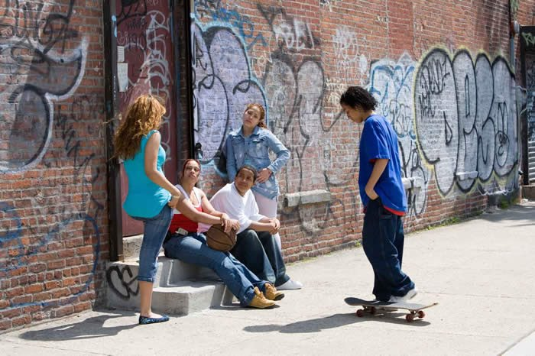
RELATIONAL
(U.S. Department of Justice, 2010)
Notes:
The trainer should note that association with delinquent peers is a persistent and consistent predictor of gang behavior. Adolescents who are less committed to school are also at higher risk for gang involvement. Peer delinquency is one of the strongest predictors of individual delinquency and, in certain analyses, of gang membership. Association with aggressive peers during early adolescence is critically important to consider and offers some opportunity for intervention strategies.
Marginal economic conditions, and sexual discrimination/victimization are key considerations for girls. Structural and institutional forms of racism and sexism must also be considered as they contribute to the ability to live in certain communities and to achieve success equally with other groups.
Low achievement in school and having learning problems are among the strongest school-related predictors of gang membership. Related risk factors include low academic aspirations, low school attachment, low attachment to teachers, low parental expectations, and negative labeling by teachers and others. The UN Development Program identifies exploitation and abuse by adults in the home and at school, including corporal punishment, as risk factors, as well.
Family members who are or were gang members
Problematic child-parent relationship
Lack of respect for authority (parents, teachers, law enforcement officers)

Slide 16
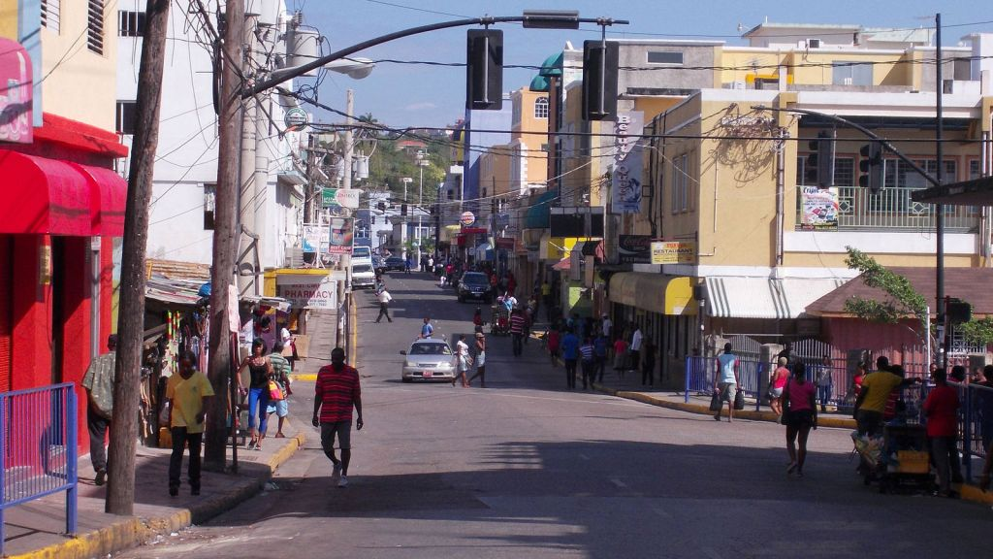
COMMUNITY & NEIGHBORHOOD
(U.S. Department of Justice, 2010)
Notes:
The trainer should note that youth who are victims of violence outside the home are more likely to join gangs (1).
Gangs typically appear in disorganized and disadvantaged neighborhoods, where many adolescents are in trouble, feel unsafe, and are less attached to others in the community, and where firearms are readily available. Analysis of data by UNDP found that community cohesion, social cohesion and informal social control are lacking in communities with street gangs. Community volatility also has a negative impact on youth development, with respect to incidence of local crime. Any programmatic approach to this domain should include a component that encourages the reduction of access to and presence of guns in the community.

Slide 17

SOCIETY
(U.S. Department of Justice, 2010)
Notes:
The trainer should continue by stating, on the societal level, the UNDP cites limited socio-economic opportunities, increased criminal activity and access to drugs and firearms and tolerance to violence as additional risk factors. Specifically, on a societal level, UNDP identified unemployment, violent crime, cost of food and cost of living as the push factors for adolescents violence. Additional factors include low levels of educational achievement, access to drugs and firearms, tolerance and acceptance of violent crime, exploitation and abuse by adults and loss of social cohesion.

Slide 18
RESPONDING TO A GAND PROBLEM
Prevention
  Primary and secondary
Intervention
Suppression
Reentry
(National Gang Center, 2020)
Notes:
The trainer should explain that the gang issue has been approached from many levels, and at many points in the involvement cycle. S/he should review each level of intervention.
Primary Prevention: Targets all adolescents or all youth in high-risk areas. Examples: Prenatal and early infancy home visits by health professionals, GREAT (Gang Resistance, Education and Training), Boys & Girls Clubs, Big Brothers Big Sisters, mentoring, Police Athletic League
Secondary Prevention: Targets high-risk children, based on prior record of delinquency, drug/alcohol abuse, child abuse, or poor school achievement
Intervention: Targets active gang members and close associates; requires coordinated services from family services, probation, social services, law enforcement, and community-based organizations
Suppression: Targets gang leaders for aggressive supervision, enforcement, prosecution, removal of leaders from the community; requires coordination by law enforcement, prosecutors, courts, corrections; relies heavily on gang-related intelligence.
Reentry: Targets gang members returning from confinement; requires close supervision by corrections with support of law enforcement. Coordination of services (employment, housing, transportation, employment training, life skills training) to support ex-offender is required.

Slide 19
PREVENTION, INTERVENTION, SUPPRESSION, & COMPREHENSIVE PROGRAMS
Notes:
The trainer should explain that this is a schematic from the U.S. Department of Justice Office of Community Oriented Policing Services entitled “Street Gangs and Interventions: Innovative Problem Solving with Network Analysis.” It is necessary to analyze where the problem is along the continuum of early formation to entrenchment and apply appropriate programmatic responses all along the continuum. The best strategies rely on multiple approaches and programs.

Slide 20
COMPREHENSIVE GANG STRATEGY
Community mobilization
Provision of academic, economic & social opportunities
Social intervention
Gang suppression
Organizational change & development
(National Gang Center, 2020)
Notes:
The trainer should go into more depth with respect to comprehensive gang strategies. One gang intervention strategy that takes a comprehensive approach comes from the US Office of Juvenile Justice and Delinquency Prevention. The premise of this strategy is that the effective use of social controls inherent in various social institutions can have an impact on the development and proliferation of youth gangs. Using this process, individuals, families, and community, both formal and informal, are reminded that they have a stake in supporting positive behaviors and taking a firm stance against illegal activities. All have a stake in this and a role to play. The key components of the strategy are:
Community Mobilization: Involvement of local citizens, including former gang-involved adolescents, community groups and agencies; and coordination of programs and staff functions within and across agencies.
Provision of Opportunities: Development of a variety of specific education, training and employment programs targeting gang-involved adolescents.
Social Intervention: Involving youth-serving agencies, schools, grassroots groups, faith-based organizations, police and other juvenile/criminal justice organizations in “reaching out” to gang-involved adolescents and their families and linking them with the conventional world and needed services.
Suppression: Formal and informal social control procedures, including close supervision and monitoring of gang-involved adolescents by agencies of the juvenile/criminal justice system and also by community-based agencies, schools and grassroots groups.
Organizational Change and Development: Development and implementation of policies and procedures that result in the most effective use of available and potential resources, within and across agencies, to better address the gang problem.

Slide 21
RESILIENCY
In the context of exposure to significant adversity, resilience is both the capacity of individuals to navigate their way to the psychological, social, cultural, and physical resources that sustain their well-being, and their capacity individually and collectively to negotiate for these resources to be provided in culturally meaningful ways.
(Resilience Research Centre, 2020)
Notes:
The trainer should reintroduce the concept of resiliency, and ask the group what they feel that resiliency means and looks like in a young person. What are some of the skills associated with increased resilience? Responses should include life skills, communication and feelings management, psychological health, etc. The trainer should then read the definition by the Resilience Research Center, which is:
In the context of exposure to significant adversity, resilience is both the capacity of individuals to navigate their way to the psychological, social, cultural, and physical resources that sustain their well-being, and their capacity individually and collectively to negotiate for these resources to be provided in culturally meaningful ways.
The trainer should ask participants what resilience might look like in an adolescent, based on that definition.

Slide 22
REDUCING RISK = ENHANCING RESILIENCY
Two-pronged approach
  Address structural issues that predispose adolescents to act violently and make them susceptible to victimization
  Equip adolescents with enhanced skills and abilities to prevent and reverse trends towards crime and violence
(UNDP, 2014)
Notes:
The trainer should stress that gang interventions must be multi-level, and cannot be achieved using an individualistic approach. A two-pronged approach is recommended. One area is to address structural issues that predispose adolescents to act violently and make them susceptible to victimization. The trainer should ask the participants to brainstorm on some of the structural issues which impact on adolescents violence, noting responses on an easel pad. Responses should include sexism, racism, existing legislation, adolescent marginalization, educational system which supports violence, unemployment, etc.
Additionally, it is necessary to equip adolescents with enhanced skills and abilities to prevent and reverse trends towards crime and violence. The trainer should ask participants how this prong is related to resiliency. S/he should ask for examples of programs that exist that build resiliency in adolescents.

Slide 23
REDUCING RISK = ENHANCING RESILIENCY
Violence prevention as part of social development
Principle of inclusivity
Integrated planning and programs
Coordination and partnerships
Strengthened police-adolescent relationships
Provision of specific alternatives for offenders and school drop-outs
(UNDP, 2014)
Notes:
The trainer should review the six themes identified by UNDP as the foundations of good practice.
Violence prevention as part of social development – Programs must address community risk factors by contextualizing them as aspects of a broader project of societal development.
Principle of inclusivity – Initiatives need to be tailored to different stages of the life cycle by integrating and involving all categories of youth, including at risk youth, “good” youth, offenders and school drop outs. It also addresses gender-related issues and patterns of youth violence and takes into account gender differences.
Integrated planning and programs – For example, drug treatment programs that also address issues such as anger management and school success are essential.
Coordination and partnerships – Relationships which support adolescent-adult partnerships among intergovernmental, governmental and civil society stakeholders need to be developed and strengthened.
Strengthened police-adolescent relationships – These type of relationships have been shown to provide a good foundation for social violence prevention.
Provision of specific alternatives for offenders and school drop-outs – This type of program helps lower adolescent risk and reduce the funneling of adolescents unnecessarily into the criminal justice system.

Slide 24
REDUCING RISK = ENHANCING RESILIENCY
Develop programs to promote “pro-social” behavior
  Structured voluntary community service
  Support family stability
  Adolescent-friendly spaces
(UNDP, 2014)
Notes:
The trainer should note that recommendations have been made in the Caribbean through CARICOM (2010) regarding prevention programs and policy development at the national level. The goal is to mitigate the risks through the creation of supportive programming.
Particular to the need for programming is the development of what is termed “pro-social” behaviors, including such programs as National Youth Service. As part of this effort, programs should include:
Structured voluntary community service – Volunteerism among adolescents should be recognized and encouraged.
Support family stability – An effort needs to be made to keep families intact rather than shifting care to relatives and family friends.
Adolescent-friendly spaces – These spaces facilitate access of adolescents to services, strengthen their ties to the community build their relationships with and access to critical state institutions and empower adolescents to make contributions to violence prevention in their communities. Example: citizen security

Slide 25
REDUCING RISK = ENHANCING RESILIENCY
Institutionalization of adolescents should be last resort
  Adolescent diversion programs
  Review legislation
  Systematic evaluation of mental health needs among institutionalized adolescents
(UNDP, 2014)
Notes:
The trainer should stress that the institutionalization of adolescents should be viewed only as a last resort. Adolescent diversion programs, which will be discussed in greater length in the next module, need to be created, strengthened and provided with more resources. Legislation which institutionalizes high risk adolescents, such as those who run away from home, needs to be reviewed and addressed. Lastly, the mental health status of children and adolescents in jails and prisons, or in the care of the state, need to be addressed so as to provide necessary services.

Slide 26
REDUCING RISK = ENHANCING RESILIENCY
Develop system to monitor youth development indicators, for the design and implementation of programs
  Creation of youth development index
  Longitudinal study on youth development
(UNDP, 2014)
Notes:
The trainer notes here that the situation among adolescents is a moving target, and there is a definitive need for systems to develop youth development. It is necessary to identify the necessary indicators, based on regional and national realities, which monitor where a country or region stands with respect to its adolescents. Youth development indicators need to be identified and followed in order to adapt to changing needs, simultaneous to the initiation or continuation of longitudinal studies on youth development. The trainer should ask for some potential youth development indicators, such as educational achievement, employment status, criminal involvement, community connectedness, etc.

Slide 27
REDUCING GANG VIOLENCE
Establish surveillance systems
Improve training of law enforcement
Monitor impact of existing gang legislation
Adopt a balanced approach
Develop plans to help gang members to exit from gangs
Establish a rigorous research agenda on the causes of street gangs
(UNDP, 2014)
Notes:
The trainer should reflect that violence reduction is directly tied to gang reduction. Towards that end, UNDP makes the following recommendations.
Establish surveillance systems – A system needs to be in place to accurately gauge the scope and nature of problems related to gangs for the purpose of planning and allocating resources to address these issues. The system should be integrated into existing systems used by law enforcement and gang and violence prevention programs.
Improve training of law enforcement – Training must be provided to ensure that suppression and intelligence activities are carried out effectively, fairly and with respect for human rights. Greater police accountability in these areas will enhance the rule of law and increase the effectiveness of the police in their response to gangs.
Monitor impact of existing gang legislation – New legislation may need to be proposed and evaluated, considering any negative consequences with respect to misuse of legislation or inequities.
Adopt a balanced approach – All adolescents should be exposed to primary prevention programs that have been demonstrated to be effective. Secondary prevention programs should be provided for those individuals most at risk for gang involvement. Intervention programs need to be administered with adolescents already actively involved in gangs.
Develop plans to help gang members to exit from gangs – Research has shown that many of the victims of gang violence are gang members and that the act of leaving a gang is often preceded by an incident involving violent victimization. However, few programs exist to assist gang members who are interested in leaving gangs.
Establish a rigorous research agenda on the causes of street gangs – Such a research agenda is essential for the development of efficient and effective public policy in the region. It should examine the impact of social structural factors, the community, the family, the school, peers and individuals.

Slide 28
EXTRACTION & EXITING ISSUES
Very serious and can be dangerous
Must be done by trained and talented people
Requires a process and extensive networking
Must include family, faith and community based resources as well as law enforcement
Highly individualized and confidential strategies
(UNDP, 2014)
Notes:
The trainer should note that there are a few programs and organizations with individuals who have experience and expertise in helping adolescents who want to leave the gang. This can be a very dangerous time for the adolescents and their family. If done correctly, it can provide the adolescents and family with options and opportunities for a gang-free life. A collaboration of community, law enforcement, school and potential employers will be necessary to identify viable alternatives to what the gang professes to offer.
Issues to be considered:
- Extraction/exiting is very serious and can be dangerous
- Must be done by trained and talented people
- Requires a process and extensive networking
- Must include family, faith and community-based resources as well as law enforcement
- Highly individualized and confidential strategies

Slide 29
WHAT YOU NEED TO KNOW
Know the current recruitment methods.
Know current initiation rituals.
Identify areas where gangs could gain an appearance of power and control.
Differentiate various levels of affiliation and involvement.
Notes:
The trainer should stress that it’s important to try to stay on top of trends and current indicators of what gangs are doing in addition to knowing the colors, signs and graffiti. An approach that recognizes that not all adolescents are involved in or affiliated with gangs to the same degree and for the same reasons will allow you to bring appropriate resources and assistance to address the problem.

Slide 30
CLOSING THOUGHTS
There is no single clear solution to preventing or reducing gang activity.
Adolescents do not join gangs for life.
More girls are joining gangs and engaging in violent delinquent behavior.
Adolescent gang members come from a variety of backgrounds.
A comprehensive approach, using prevention, suppression and intervention strategies will be most effective.
Notes:
The trainer should present these closing thoughts on this dynamic and evolving issue.
There is no single clear solution to preventing or reducing gang activity.
Adolescent do not join gangs for life.
More girls are joining gangs and engaging in violent delinquent behavior.
Adolescent gang members come from a variety of backgrounds.
A comprehensive approach, using prevention, suppression and intervention strategies will be most effective.

