Slide 1


Preventive Education & Training Unit
National Dangerous Drugs Control Board

Slide 2

Our Vision and Mission
Empowering Sri Lankans towards a drug free life
Enable people to create a safer environment towards prevention and reduction of substance abuse through quality education and training.

Slide 3
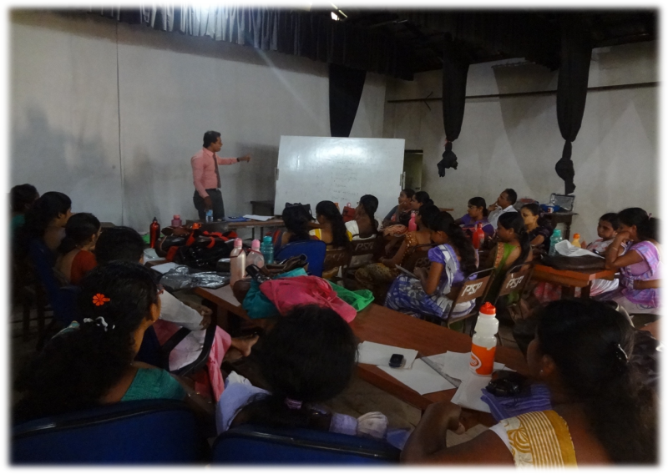
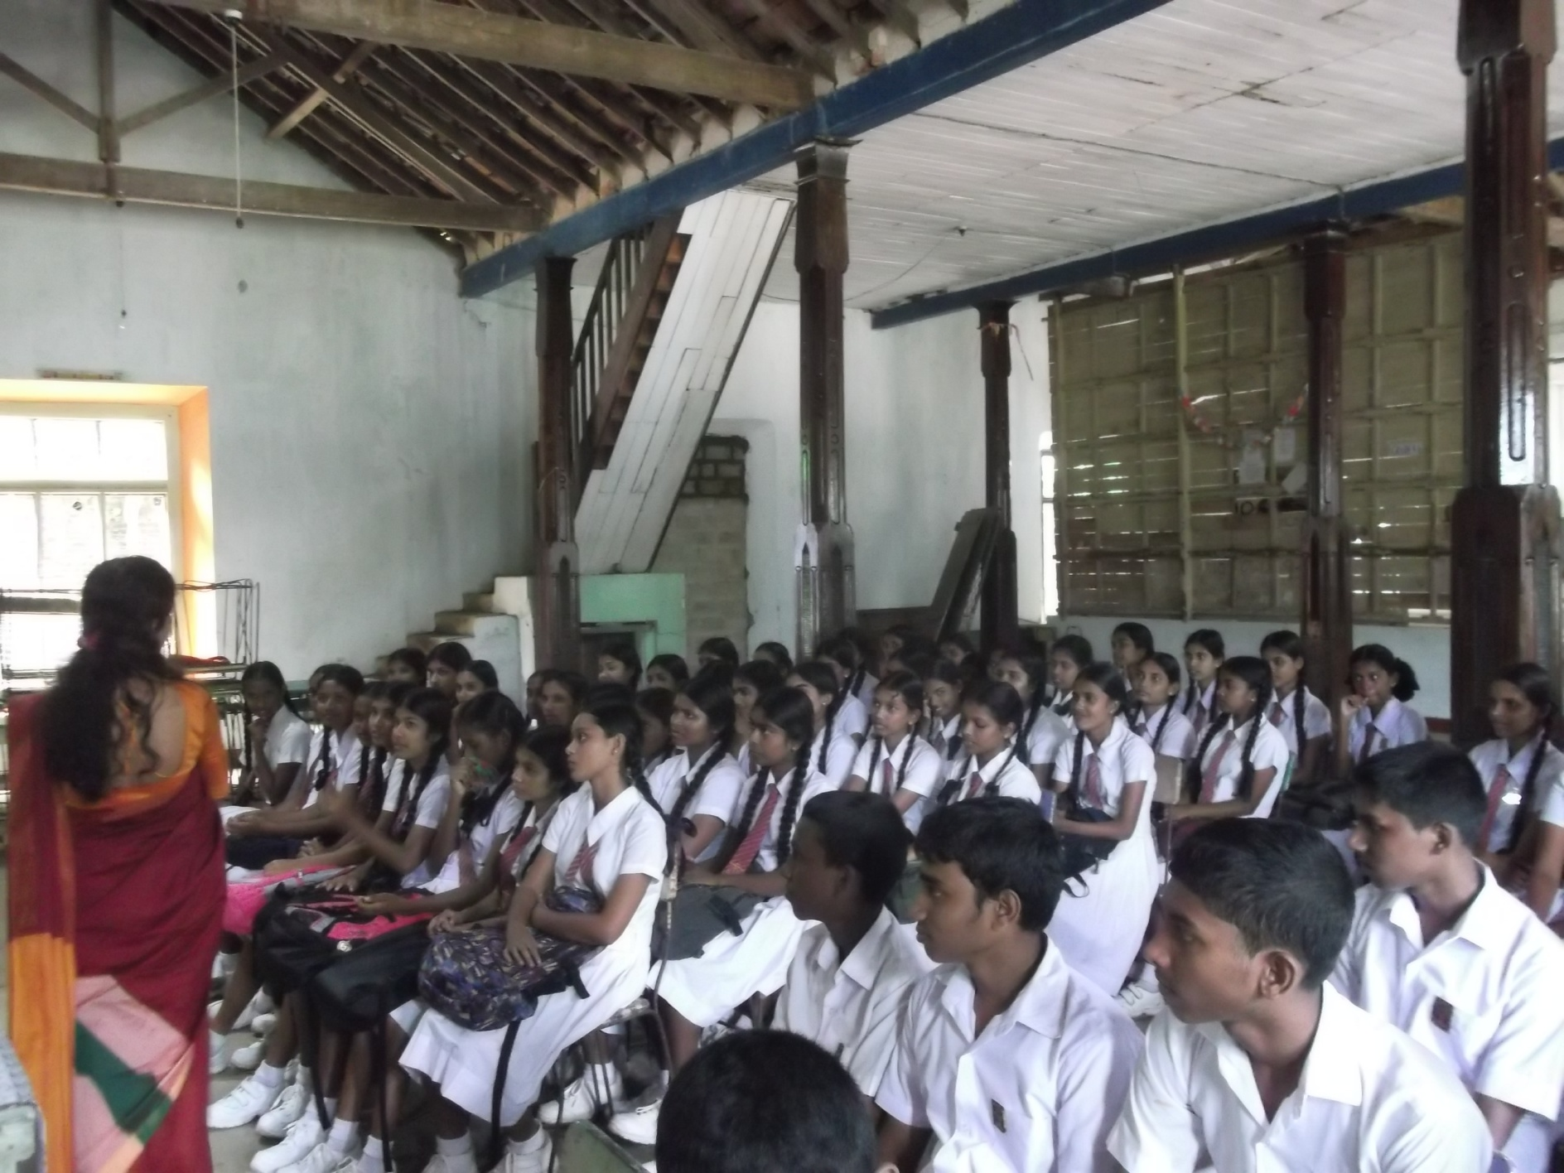
We Provide Our Services through
Awareness Programmes in
  Government Schools
  International Schools
  Vocational Training Centers
  Universities
  Sunday Schools and
  Exhibitions on Drug Prevention
  Early Childhood Development for
  Parents

Slide 4
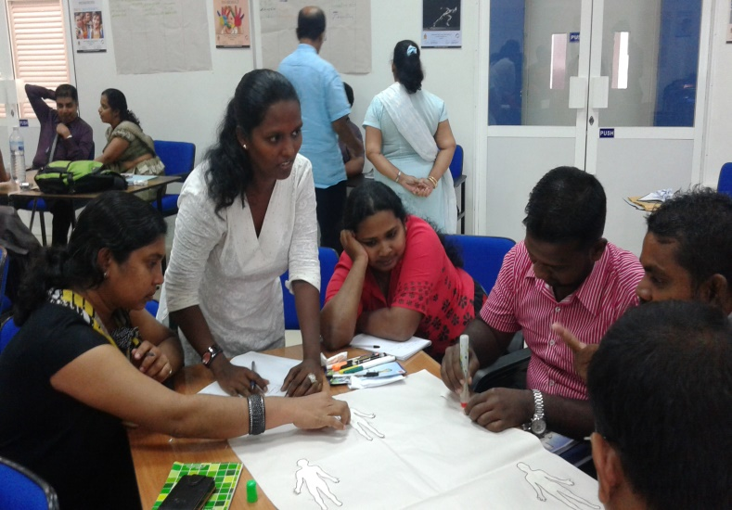
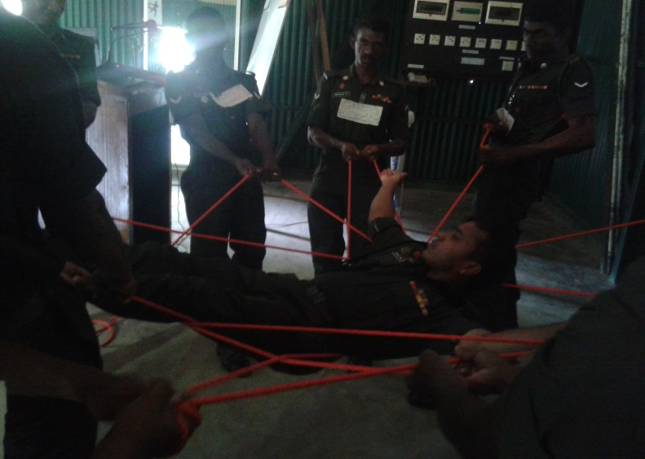
Awareness Programmes in
  Plantation Sector
  Larger Work Places
  Government Sector
  Law Enforcement Agencies
  Education Sector
  Health Sector
Training Programmes for
  Teachers (TOT)
  Government Officers (TOT)
  Youth Leaders (TOT)

Slide 5
Preventive Education and Training Unit-Programme Schedule
National Dangerous Drugs Control Board
Cumulative Summary of the End of Month of September 2018

