Slide 1

Introducing issup.net
Joanna Travis-Roberts
Project Manager - ISSUP

Slide 2
Ideas, Society and Website
Notes:
Ideas
ISSUP was established in order to strengthen our global network of individuals working in the field of substance use prevention and treatment. It provides a platform to brings us all together in our commitment to protect individuals and communities from the ill effects of substance use.
Society
Through ISSUP – treatment professionals, demand reduction practitioners, academics, advocates and policy makers have access to the latest news, scientific research, training and credentialing prospects to further their professional development in the field.
Together, ISSUP has the potential to significantly contribute to curbing the risk that drug use poses on individuals, communities and nations around the world.
Website
We do this through the new ISSUP Website that will provide the platform for the interaction between treatment and prevention practitioners and professionals. ISSUP is an important initative for the Colombo Plan and we hope that it provides help to us all in our combined efforts in drug demand reduction. The impact of our work is stronger when we work together and we hope that ISSUP is helpful and an important resource in your work.
My colleague Joanna will go through the website with you in more details now.

Slide 3
Role of the website
The five C’s…
Communicate
Connect
Convey
Clarify
Consult
Notes:
Comms– Keeping you up to date with the latest research and news. Contributed to from a range of ISSUP stakeholders, as well as the ISSUP community. Latest events including trainings and meetings/conferences from the field
Connections – putting you in touch with other professionals in your field
Conveying – Using the website as a tool to show the outside world that this is a profession
Clarify – clarifying for the lay person the issue of SUD, promoting best practice, describing BP, and talking of SUD within the knowledge
Consult– allowing you, our members to tell us what you need, to solicit your advice and consult re your needs

Slide 4
The website
issup.net
Notes:
GO TO WEBSITE
Homepage:
Sliding banner
Intro to ISSUP
Latest content additions
A selection of events
Languages
Member login/join boxes
About ISSUP
An introductory section to tell everyone who we are, and allow you to get in touch directly
Training:
An essential role of ISSUP is to promote the continued development of it’s professionals.
The website introduces you to the variety of trainings available to undertake under the titles of the Universal Prevention Curriculum and Universal Treatment Curriculum
A calendar of upcoming trainings allows you to see what’s happening and where, and register directly for elements you’d like to undertake
Credentialling
Substance Use:
Introducing the field
Emphasising best practice, and science behind approaches taken by professionals
Explaining the terms we use… addiction, substance use disorders, prevention etc.
Develop as our learning increases
Forum:
Where we talk to each other around the world
There are 6 Forums, 1 is open to the public and any users of the site, and the rest are for ISSUP members only.
Members – to ask another member a question, or start a discussion with a group of members
Prevention and treatment – for all matters specific to prevention or treatment
Research and eval – for scientists
Admin – for more practical matters that may relate to training, credentialling, further studies, or any areas that users wish to discuss such as fundraising, the operation of research or project.
Open – to put allow non members to connect with the knowledge and know-how of ISSUP members, and hear what they want to learn and know about
Information Centre:
central exchange point of information. It is fed by ISSUP, but also by the members
Content is organised into 4 sections:
Online Publications
News
Latest Research
Events
Filter everything by category/country
Exciting – you can shape the content, based on research from your area of work or country
Member area:
GO TO REGISTRATION
Complete a quick and easy registration process. ISSUP staff will approve your membership within 3 days
You can update your profile
See profiles of other members
Benefits to re-iterate
Please go to a computer here to register yourself – we urge you!
Profile page:
GO TO MY PROFILE PAGE
You can choose what information you allow mother members to see. Only members can access your profile, and only the elements you decide.
Promote the work you’re doing here by uploading your presentations, research, latest work.

Slide 5
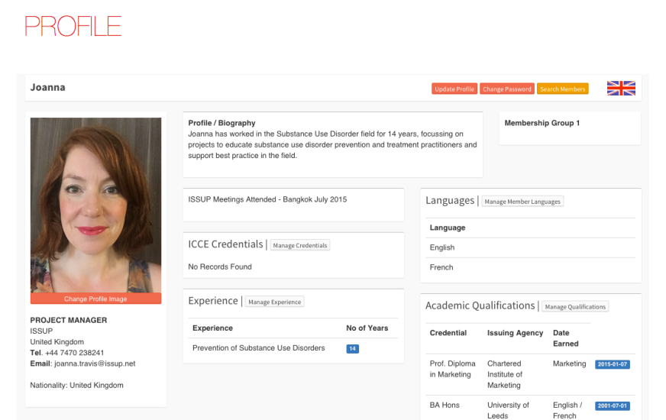

Slide 6
Future developments
Member section with direct interaction
Country profiles
Taking the trainings online
Translation
Collaboration with other knowledge exchanges
What else would you like to see?
issup.net
Notes:
New and developing site – not a complete product – ever changing with you
We want this ISSUP website resource to develop according to your needs, so please join, contribute and shape the ISSUP website to fit your needs.
User surveys
We have fantastic vision! – Future developments

Slide 7
Thank you!
Please come and talk to me, or get in touch!
Joanna Travis-Roberts
Project Manager
joanna.travis@issup.net
Notes:
I’m here all week
Tell me what you think & what you’d like to see
Share with me what you you know we can post online to share

