Slide 1

Translating
Scientific Research
into
Practice and Policy
Gilberto Gerra
Chief
Drug Prevention and Health Branch

Slide 2

Drug use disorders
A non-recognized,
discriminated,
complex disease
A non recognized disease
A huge gap between
science and practice

Slide 3
Addiction
Genetic and environmental influences on cannabis use initiation and problematic use:
a meta-analysis of twin studies.
Verweij et al., 2010
A systematic literature search
28 twin studies on cannabis use initiation
24 studies on problematic cannabis use
genes (A) shared environment (C) unshared environment (E)
cannabis use initiation:
A 48%, C 25%, E 27% in males
A 40%, C 39%, E 21% in females
problematic cannabis use:
A 51%, C 20%, E 29% for males
A 59%, C 15% , E26% for females.

Slide 4
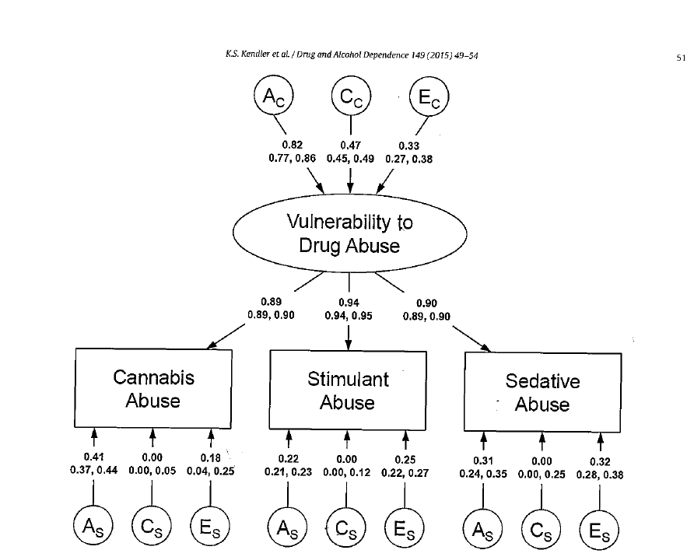

Slide 5
Genes are influencing:
- Temperaments (sensation seeking, harm avoidance)
- Motivational/reward system tone
- Inhibitory control mechanism(prefrontal cortex)
- Psychobiological response to emotions
- Ability to cope with stress
- Sociability and emotional stability
Direct
vulnerability
for drug use
Parent-child
attachment/
relationships

Slide 6
Serotonin transporter Gene variant SS associated
with temperament among adolescents
LL
SL
SS
NOVELTY SEEKING
15,72
19,41
21,75*
BDHI DIRECT AGGRESSION
51,03
55,70
59,58*
J. Neural Transmission
Gerra et al. , 2005

Slide 7
Infant Behav Dev.
Temperamental precursors
of infant attachment with mothers and fathers.
parent sensitivity
infant temperament
infant-mother
and infant-father
attachment relationship
Planalp and Braungart-Rieker, 2013

Slide 8
Addiction
Candidate genes for cannabis use disorders: findings, challenges and directions.
Agrawal and Lynskey, 2009
Genes with specific influences
on cannabis use disorders:
Cannabinoid receptor gene (CNR1)
Cannabinoid receptor type 2 (CB2)
Fatty acid amide hydrolase (FAAH)
Monoglyceride lipase (MGLL),
Transient Receptor Potential Vanilloid 1 (TRPV1)
Orphan cannabinoid receptor (GPR55)
Genes with a non-specific influence
on risk of cannabis use disorders:
GABA Receptors 2 (GABRA 2)
Dopamine Receptors D2 (DRD2)
Opioid Receptors Mu 1 (OPRM1)

Slide 9
Am J Med Genet B Neuropsychiatr Genet.
Relevance of perceived childhood neglect, 5-HTT gene variants
and hypothalamus-pituitary-adrenal axis dysregulation to substance abuse susceptibility.
Gerra et al., 2010
Drug
initiation
HPA Axis
dysfunction
Mother Father
Neglect
CECA-Q
Serotonin
Transporter
Gene
S- allele

Slide 10
Addict Biol.
Gene-environment interaction in problematic substance use:
interaction between DRD4 and insecure attachments.
Olsson et al., 2013
Cannabis
heavy
use
Anxious
avoidant
parent -child
attachment
Reward
deficit
7R+ allele
Dopamine
Receptor
gene
DRD4

Slide 11

American Journal of Medical Genetics Part B (Neuropsychiatric Genetics) 141B:1–7
Perceived Parenting Behaviour in the Childhood of Cocaine Users: Relationship With Genotype and Personality Traits
Gerra et al., 2007
J Consult Clin Psychol. 77(1):1-11.
Parenting moderates a genetic vulnerability factor in longitudinal increases in youths' substance use.
Brody et al., 2009
5-HTTLPR status SS
linked with increases
in substance use
over time
the association was greatly
reduced by involved-supportive parenting

Slide 12
short version (S) of the 5-HTTLPR
secure
attachment
agreeable
autonomy
insecure
attachment
hostile
autonomy
Zimmermann et al., 2009

Slide 13
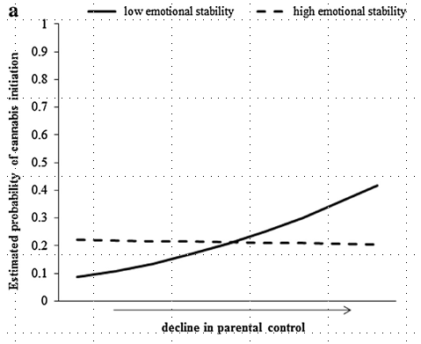
Creemers et al., 2015

Slide 14
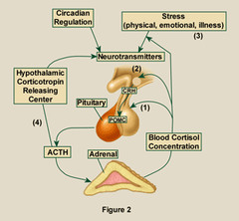
Hypothalamus-Pituitary-Adrenal-axis
Gene
variants
Adverse
childhood
experiences
Drug use disorders vulnerability

Slide 15
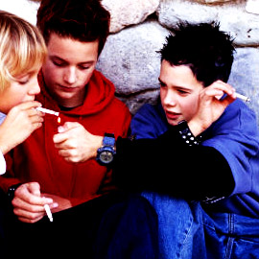
Addiction
Hypothalamic-pituitary-adrenal axis and smoking and drinking onset among adolescents:
the longitudinal cohort
TRacking Adolescents' Individual Lives Survey (TRAILS).
Huizink et al., 2009
higher cortisol levels
were related
to current smoking
and future frequency
of smoking
higher, instead of lower,
hypothalamic-pituitary-adrenal
axis activity, as a predictor
of smoking in early adolescence

Slide 16
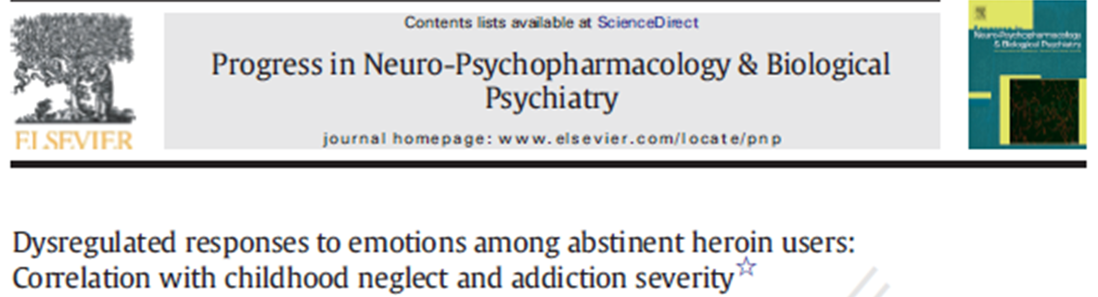
Childhood neglect
Altered response to emotions
HPA axis dysfunction
Addiction Severity
Gerra et al., 2013

Slide 17
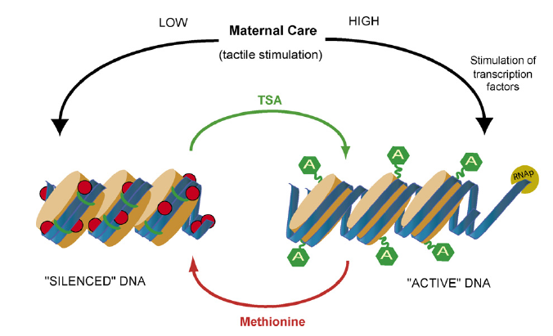

Slide 18
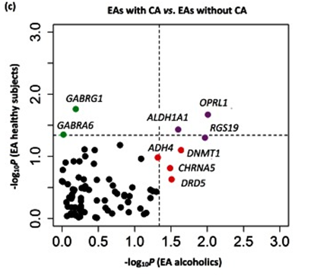
Epigenetic mechanisms in vulnerability
Profiling of childhood adversity-associated DNA methylation changes
in alcoholic patients and healthy controls.
Childhood adversities could induce
methylation alterations
in the promoter regions
of specific genes and
changes in gene transcription
with increased
risk for substance use disorders
(Zhang et al., 2013)

Slide 19
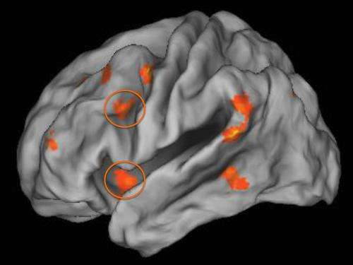
Poverty and stress
during childhood:
- hyperactive amygdala (emotions store)
- hypoactive prefrontal cortex (emotions regulation)
Luan Phan et al., 2013

Slide 20

Pathogenesis of substance use disorders
Candidate genes temperaments
Parent child insecure attachment
Early adverse experiences (neglect / abuse)
Impaired coping with stress
Impulsiveness / low inhibitory control
Frustration
Impaired sociability and social isolation
Lack of bonding to family
Lack od school engagement
Vulnerability to peer pressure

Slide 21
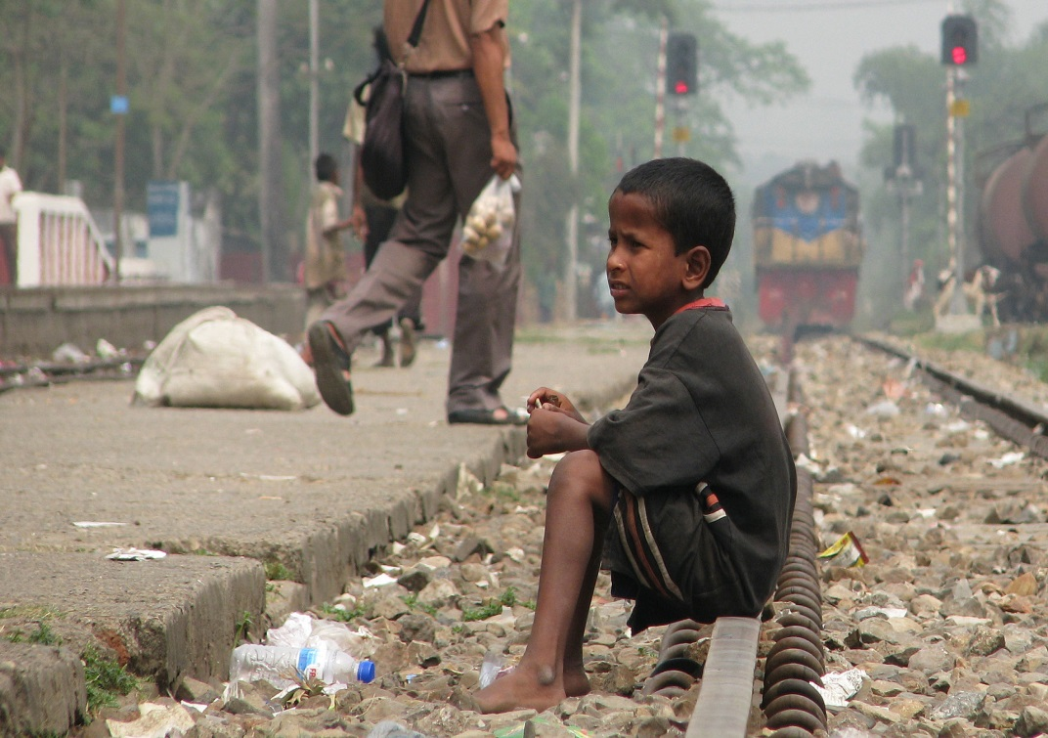
Pathogenesis of substance use disorders
Extreme poverty
Exposure to domestic violence
Exposure to degraded environment
Displacement
Hunger
Work overload
Being trafficked
Living in the street
Child sex-work
Child-soldiers

Slide 22
Drug use disorders: a complex chronic disease
Not a self acquired disease: a multifactoral pathogenesis
Vulnerability for initiation
Vulnerability for drug use disorders
Interaction gene/environment concurring to the disease
Stable changes in the brain pre-existing to drugs
Not a moral or criminal issue

Slide 23
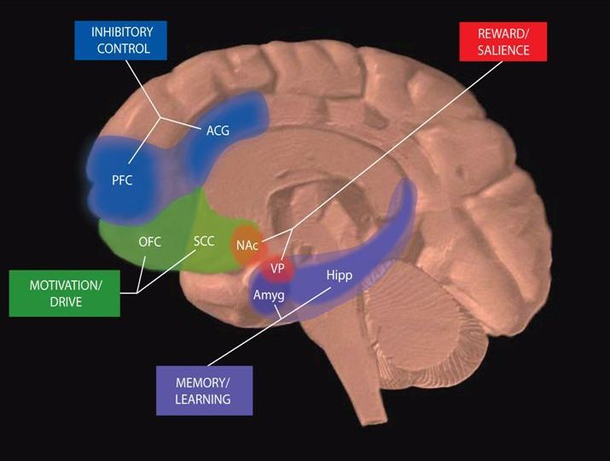
Circuits Involved In Drug Abuse and Addiction
Uncontrollable compulsive behaviour

Slide 24

The motivational
system and
the emotional memory
are hijacked by drugs
The system
that should respond
to salient stimuli
is focusing only on drugs
and drug-related stimuli

Slide 25
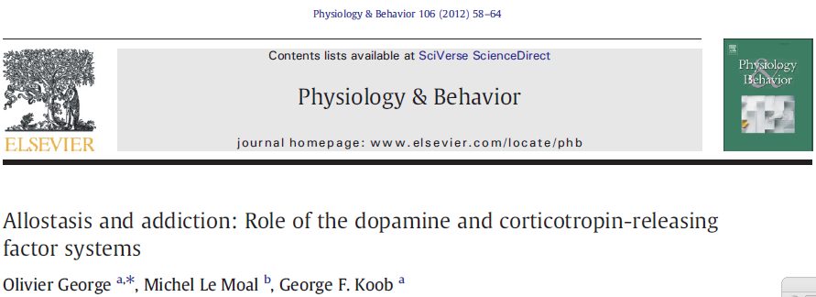
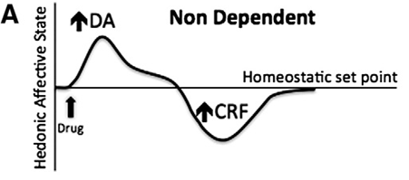
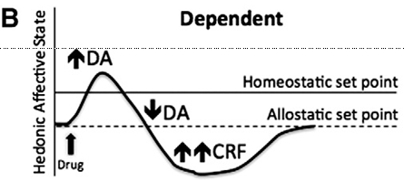

Slide 26
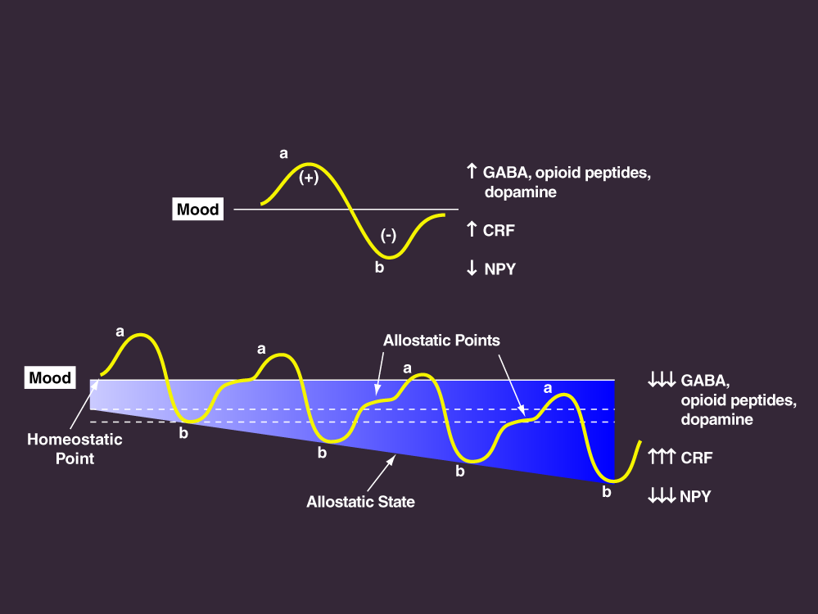
Allostatic View of Neurotransmitter Adaptation During the Transition from Drug Use to Addiction
Koob, 2012

Slide 27
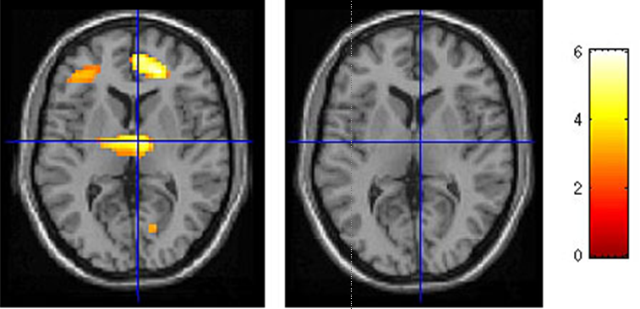
Usurpation of emotional memory
Cocaine addicts brain is not activated
anymore by monetary reward
Milton and Everitt, 2012

Slide 28
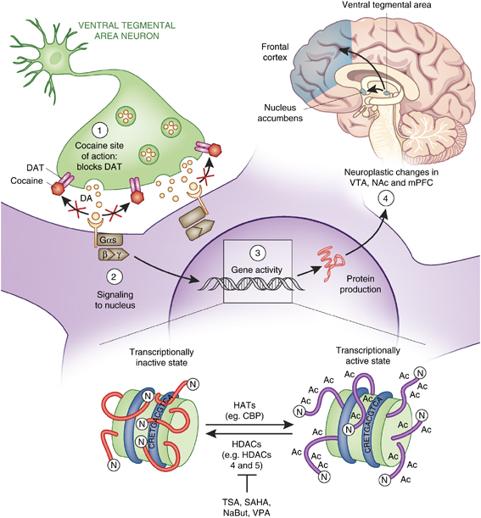
Epigenetic
effects of
drugs

Slide 29
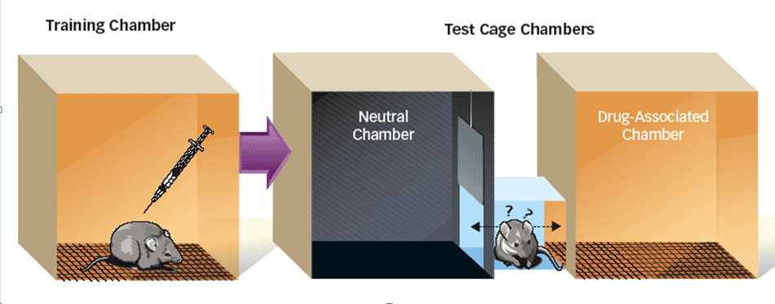
Altered histone acetylation affects behavioural sensitivity to cocaine
In the conditioned place preference test the inhibition of histone de-acetylase
potentiates the rewarding effects of cocaine
Histone acetylation control the saliency of a variety of environmental stimuli
Elevated histone acetylation appears to potentiate the behavioural responses

Slide 30
J Cell Physiol.
Epigenetic control
Recent studies challenge the idea that DNA methylation
is irreversible.
Delcuve et al., 2009

Slide 31
Stable changes in the brain – long lasting
Not curable
Treatable
Willpower impaired or non-existent
Compulsive behaviour extinction needed

Slide 32


Psychiatric
comorbidity
43% - 47%

Slide 33
Arch Gen Psychiatry. 64(5):566-76.
Prevalence, correlates, disability, and comorbidity of DSM-IV drug abuse and
dependence in the United States: results from the national epidemiologic survey
on alcohol and related conditions.
Compton et al., 2007
Comorbidity of drug use disorders
- other substance use disorders
- antisocial personality disorder
- mood disorders
- generalized anxiety disorder
appears to be due in part to unique
factors underlying the disorders studied.

Slide 34
J Clin Psychiatry. 67 Suppl 7:18-23.
Adolescent substance abuse and psychiatric comorbidities.
Deas, 2006
Psychiatric disorders in adolescents
often predate the substance use disorder.
Once the substance use disorder develops,
the psychiatric disorder may be further exacerbated.

Slide 35
J Clin Psychiatry
Adolescent substance abuse and psychiatric comorbidities.
Deas and Brown, 2006
Concomitant psychiatric disorders
depression
anxiety
bipolar disorder
conduct disorder
attention-deficit/hyperactivity disorder
PTSD

Slide 36
Biol Psychiatry.
Moderation of the effect of adolescent-onset cannabis use on adult psychosis
by a functional polymorphism in the catechol-O-methyltransferase gene:
longitudinal evidence of a gene X environment interaction.
Caspi et al., 2005
A functional polymorphism
in the catechol-O-methyltransferase (COMT) gene
moderated the influence of adolescent cannabis use
on developing adult psychosis
COMT valine158 allele
psychotic symptoms
if they used cannabis
COMT methionine allele
no such adverse influence

Slide 37
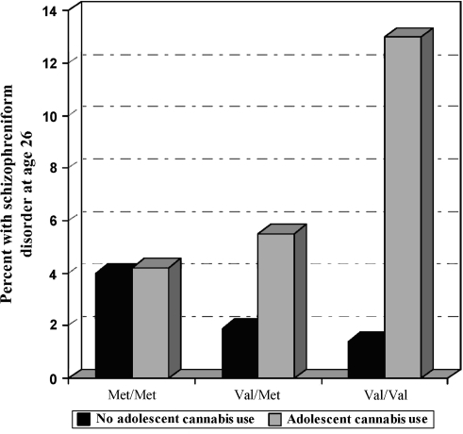
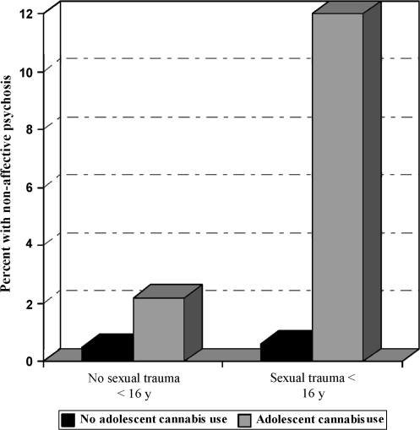
Schizophr Bull.
Gene-environment interplay between cannabis and psychosis.
Henquet et al., 2008

Slide 38
Concomitant mental health disorders cannot be ignored
Pre-existing, parallel, consequent
Pharmaco-genetics causes / traumatic causes
Large rate, not a minority
They influence negatively treatment outcome
Integrated therapy
Psychiatrist in the team
A component of relapse prevention

Slide 39
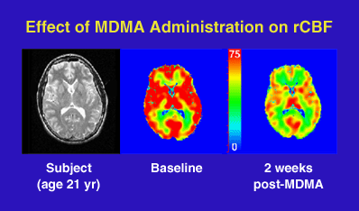

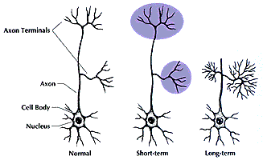
Ecstasy (MDMA)
effects
on synapsis
terminations

Slide 40
Methylphenidate
Narcolepsy
ADHD
Obesity
Methylphenidate?
Energy for dancing
Stay awake all the night
Being rewarded/excited
Methylphenidate
Agitation/anxiety
Insomnia
Weight lost
Arrhythmias
Hypertension
Criminals (illicit market)
Pharmaceutical companies (licit market)

Slide 41


Mephedrone, 4-methylmethcathinone(4-MMC)
or 4-methylephedrone:
Mephedrone induces dopamine/norepinephrine release
Stimulant effects
Teeth grinding, cardiovascular problems, behavioural undercontrol
Bath salts containing substituted cathinones
White crystals often resemble legal bathing products
cathinone
mephedrone

Slide 42
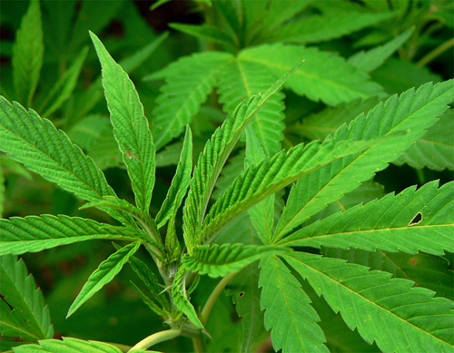
Lancet
Adverse health effects of non-medical cannabis use.
The health effects most likely to occur
and to affect a large number of cannabis users:
a dependence syndrome
increased risk of
motor vehicle crashes
impaired respiratory function
cardiovascular disease
adverse effects on
adolescent psychosocial development
and mental health disorders
Hall and Degenhardt, 2009

Slide 43
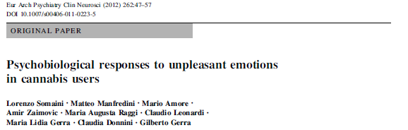
association between active cannabis use, subjective
reduced sensitivity to negative emotions and threat and
HPA axis dysfunction

Slide 44
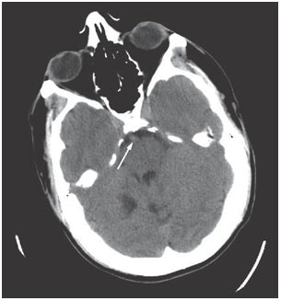

Brain CT scan in a patient with
cocaine-induced basilar artery thrombosis
MacEwen C et al. (2008) A case of cocaine-induced basilar artery thrombosis
Nat Clin Pract Neurol doi:10.1038/ncpneuro0879

Slide 45
Opioid prescription drugs death

Slide 46
Not permitted for non-medical purposes
because they are dangerous
Dangerous also in an unrestricted market
Prescribed by qualified health professionals
Following the rules applied
to any psychoactive medication
for approval and registration for medical use

Slide 47
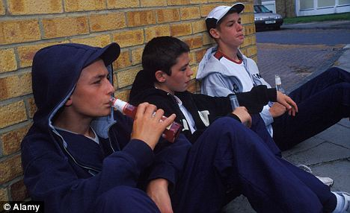
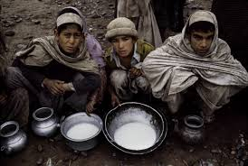
Is substance use
prevention
effective?

Slide 48
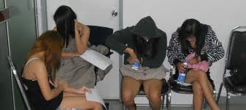
Is substance use
prevention effective?

Slide 49
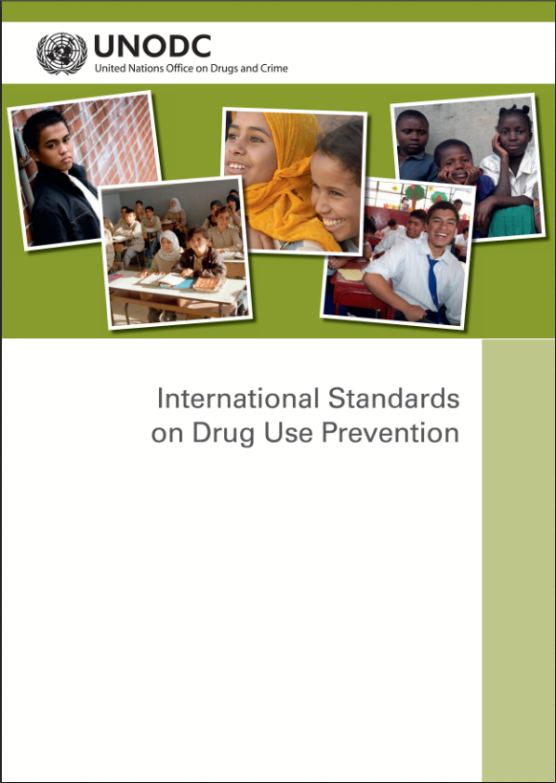

Slide 50
- International Standards of Drug Use Prevention:
Science based methods:
Life skill / social skills education
Family skills programs
Reliable information /interactive approach
Brief intervention
- Children social protection and support
to families with problems
Fighting inequality, reduce social exclusion
and change the trajectory
Early screening of children at risk and
specific educational work.

Slide 51
Piloting E B programme Life Skills Education Programme (UNPLUGGED) in Brazil
Relative difference (∆%) of last year use of different substances
Adolescents (13-15 years old)
Experiment vs. Controls
(16 schools, 5000 students)
Source: Avaliação de processo e de resultados do Programa Unplugged/ #tamojunto, 2014

Slide 52
Meth Initiation Results at
4½ Years Past Baseline
Source: Spoth, R., Clair, S., Shin, C., & Redmond , C. (2006). Long-term effects of universal preventive interventions on methamphetamine use among adolescents. Archives of Pediatrics and Adolescent Medicine, 160, 876-882.

Slide 53
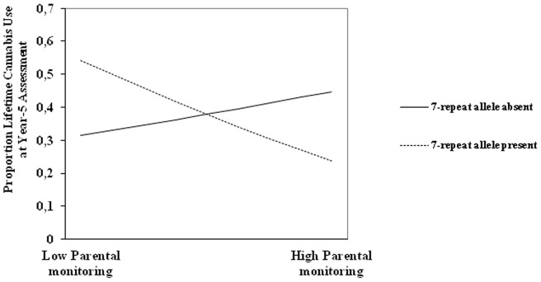
The interplay between parental monitoring
and the dopamine D4 receptor gene
in adolescent cannabis use.
7-repeat allele were more likely to show lifetime cannabis use
Otten et al., 2012

Slide 54
Male participants of a classroom management programme in grade 1 have a decreased probability to have developed a drug-related disorder at age 21, especially if they were rated aggressive by their teachers at that time

Slide 55

Prevention of drug use disorders
Parental
monitoring
Undivided time
for children
Warm/supportive
style
Clear rules
in family life

Slide 56
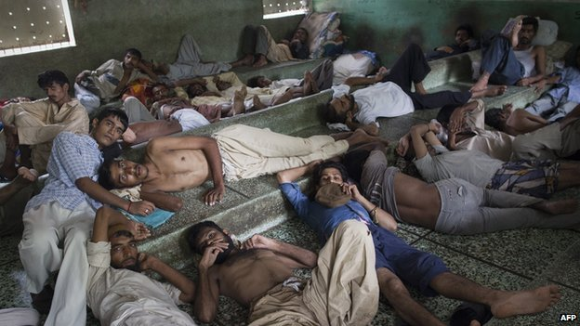
Are drug use disorders treatable?

Slide 57

Addiction Medicine: Closing the Gap between Science and Practice
Published: June 2012
Most medical professionals who should be providing
addiction treatment are not sufficiently trained
to diagnose or treat the disease.
Most of those providing addiction care
are not medical professionals
Misunderstandings about the nature of addiction
among professionals
Disconnection of addiction medicine
from mainstream medical practice

Slide 58
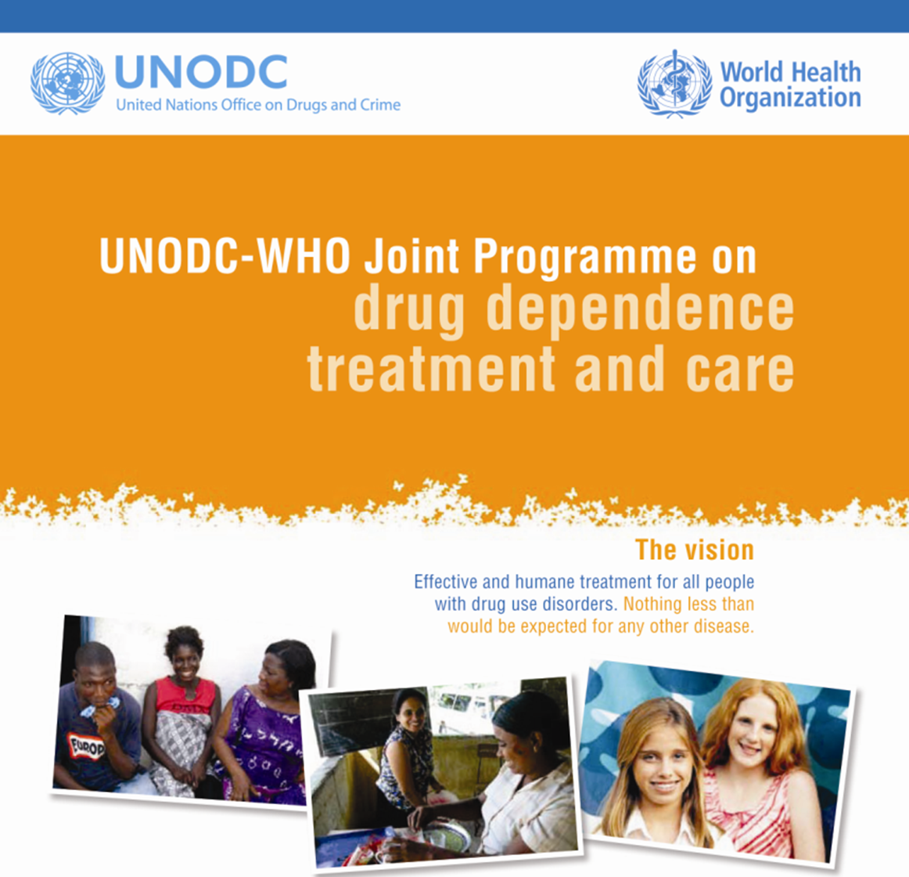
Psychosocial science based interventions
Pharmacological science based interventions
Integrated comprehensive multidisciplinary approach
Accessible
Appealing
One stop shop

Slide 59
Psychosocial science based interventions:
Brief intervention
Cognitive behavioural therapy
Self-help group therapy
Motivational interviewing
Contingency management
Job skills education
Pharmacological science based interventions
Opioid agonists
Opioid antagonists
Clonidine/lofexidine
Antidepressant
Neuroleptics
Disulfiram
Integrated comprehensive multidisciplinary services
Accessible
Appealing
One stop shop

Slide 60

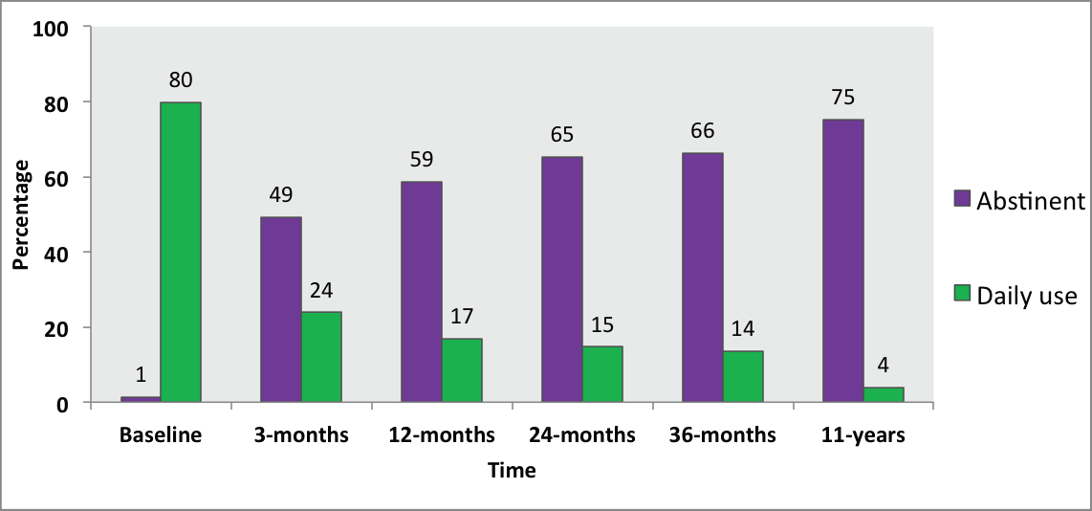
Heroin use in preceding month
pharmacological maintenance therapy –
MT; detoxification - DTX; residential rehabilitation - RR
Nov.2014

Slide 61
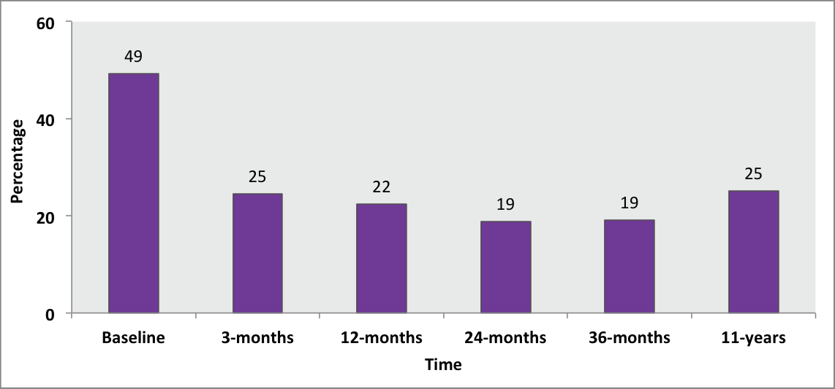
Mental health severe disability

Slide 62
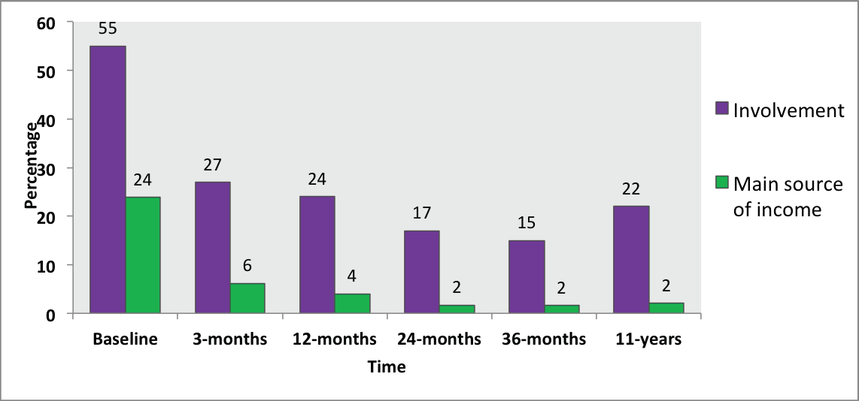
Proportions committing crime

Slide 63
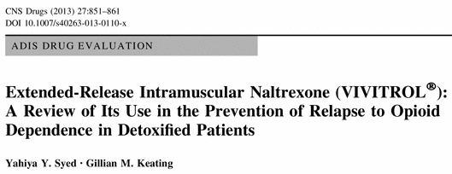
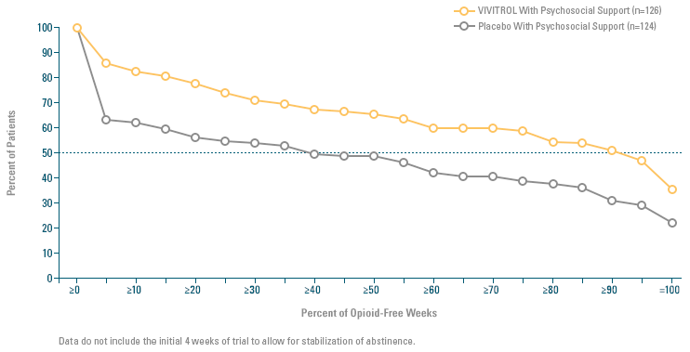

Slide 64

No differences in
socio-demographic
conditions between
heroin addicts and
patients in treatment
Paola Sacerdote,
Silvia Franchi
Gilberto Gerra
Vincenzo Leccese
Alberto E. Panerai
Lorenzo Somaini

Slide 65
Contingency management
reduces cocaine use in methadone patients
65%
45%
Usual care
Contingency
Petry et al., 2014

Slide 66
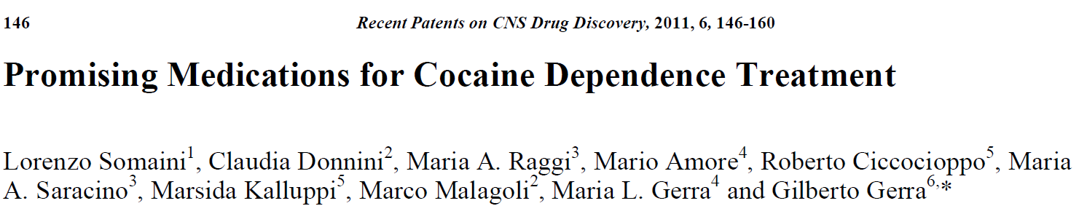
Methilphenidate
Adderal
Topiramate
Baclofen
Modafinil
MAO inhibitors
SNRI
Neuroleptics
Buprenorphine ?
Subtypes
of
stimulants
users

Slide 67
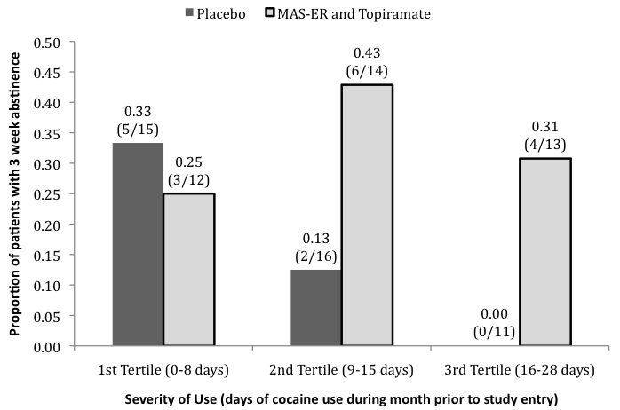
ER amphetamine + topiramate
for Cocaine Dependence
Significantly more patients achieved 3-week of continuous abstinence in medication (33%) vs. placebo (17%) group, effect most pronounced in patients with frequent
use at baseline.
(Mariani et al., 2013)

Slide 68
Genes Brain Behav.
Epigenetics and memory: causes, consequences and treatments
for post-traumatic stress disorder and addiction.
Pizzimenti and Lattal, 2015
Both stress and exposure to drugs of abuse induce
epigenetic changes that result in persistent behavioural changes
How modulating these epigenetic
targets may induce persistent
Extinction of drug-seeking
behaviour
Extinction of fear

Slide 69
Prevention and treatment should be based
on science
Prevention and treatment should be implemented
by qualified professionals
Scientific/Academics Associations/Health Authorities
should take decisions and reach consensus
on the nature of the interventions
Prevention and treatment are cost-effective
Always new research frontiers open new perspectives

Slide 70
Addiction, 2012
Compulsory detention, forced detoxification and enforced labour
are not ethically acceptable or effective ways to treat addiction.
Hall W, Babor T, Edwards G, Laranjeira R, Marsden J., Miller P., Obot I.,
Petry N., Thamarangsi T., West R
Consent of the patient
Negotiation concerning the treatment program
Therapeutic alliance
Flexibility

Slide 71
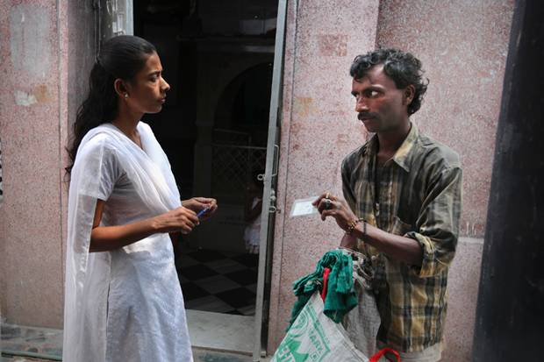
Low threshold, outreach, harm reduction
interventions are essential
Respond to patients needs
in all the stages of their disease
O'Rourke et al., 2015

Slide 72
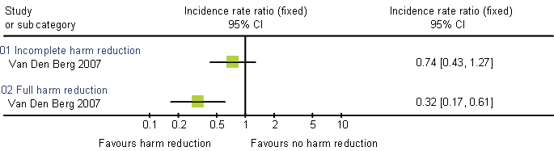
Importance of combining priority harm reduction interventions to achieve impact
Empirical evidence: NSP + OST at scale: Amsterdam cohort study -57% HIV incidence reduction, 64% HCV incidence reduction (incidence reductions low if service uptake partial)
Van Den Berg et al, 2008

Slide 73
Harm reduction:
Outreach activities:
not waiting for the patients in the office.
Low threshold interventions, no rules, easy access,
Unconditioned services to protect health
accompanying the patient through reiterated failures.
Relapse management.
Non-responders to harm reduction?
Continuum of care including
harm reduction and treatment/recovery, without any conflict
Nine elements package for HIV
Naloxone for overdose prevention

Slide 74
Addiction treatment appealing /retention in treatment
Non confrontational/
low threshold
Therapist-patient
engagement
Fight against
empty services
Food and
social protection
One stop shop:
one team
Medications
Family
therapy

Slide 75
World mobilization
for prevention and treatment
of substance use disorders
A public health and human rights approach
Nothing less than what is provided
for any other chronic disease

Slide 76
e-mail
gilberto.gerra@unodc.org
twitter
@gilbertogerra

