Slide 1
The International society for substance use prevention and treatment professionals (ISSUP)
No Borders – Unifying the Global Workforce

Slide 2
The Impact of drug use…
Communicable Diseases & Mental Health
Drug Cultivation, Production, Trafficking
Public Security: Violence and Crime
Organized Crime, Corruption, Money Laundering
Terrorism & Isurgency
Economic Development & Productivity
Social Development of Children
Governance

Slide 3
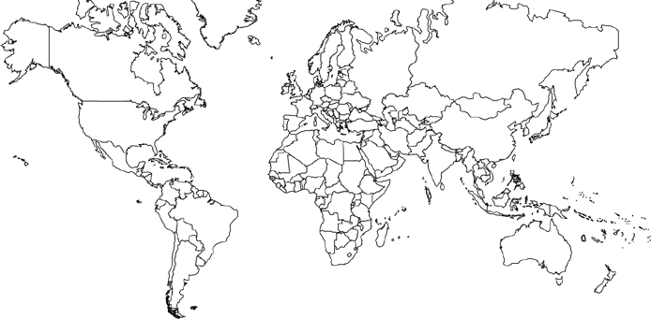
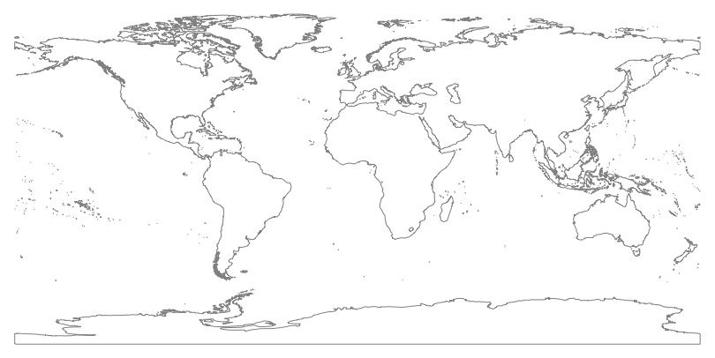
No Borders
Q. What do all of these threats share in common?
A. They do not respect borders, sovereignty, and affect all nations.

Slide 4
No Borders
Transnational threats require transnational solutions.
Today we launch the International Society of Substance Use Prevention and Treatment Professionals (ISSUP) to harness the global expertise in the fields of prevention and treatment, promote evidence-based research, and improve service delivery.

Slide 5
The good news
70 years of scientific research in the field, with significant advances since 1990s.
  Innovations in behavioral and medical research
Drug addiction is a chronic and relapsing disease (e.g. like diabetes, heart disease, hypertension) and its success rate is on par with these other conditions.
U.S. Government (NIDA) conducts 85% of the world’s research in the field of substance abuse treatment and prevention, spending billions of U.S. dollars over the past decades.

Slide 6


The good news
Science demonstrates that drug treatment and drug prevention work and have an impact beyond only drug use.
Some results of INL outcome evaluations
Afghanistan Evaluation Results:
31% decrease in opium overall
45% decrease for women (past 30-day use)
40% reduction in serious crime
48% reduction in non-serious crime
73% reduction in self-reported arrests (past month)
64% decrease in suicide attempts among women
El Salvador Evaluation Results
70% reduction in drug use by gang members and non-gang members (gang members had higher use before treatment)
83% reduction in past-month felonies
75% reduction in arrests and incarcerations by gang members
66% reduction in arrests and incarcerations by non-gang members

Slide 7
The BAD news
The scientific research is not being translated to the field.
Addiction remains misunderstood by many and non-evidence-based practices continue to be used in some treatment programs.
  Non-evidence-based practices
  Only detox, no psychosocial treatment
  Religious education and work in isolation, no therapeutic interventions
  Cold showers, physical restraints, beatings, starvation, and other techniques
As a result of these practices, treatment fails; then clients, families, and communities lose hope for recovery and confidence in treatment.

Slide 8
ISSUP: GOALS, MiSSION, and VISION
ISSUP is created with the purposes of:
  Better translating research into practice
  Recognizing substance use prevention and substance use treatment as independent and multidisciplinary fields of study and practice, requiring specialized academic and practical training.
  To serve as a professional association supported and guided by international organizations, donor partners, and organizing partners.
ISSUP is not a policy forum to debate the merits of drug control policies. ISSUP members share a common aim to prevent and treat substance use.
ISSUP does not aim to endorse one modality of treatment or a specific intervention above others. Simply, evidence-based interventions and research is shared and promoted. It is up to national authorities and prevention and treatment professionals to have a dialogue on how to strengthen their national treatment and prevention systems.

Slide 9
COMPONENTS OF ISSUP
Promoting Evidence-Based Practices
Connecting Researchers to Practitioners
Research
Scientific Sessions where researchers, university faculty, curriculum developers share knowledge about the field.
Regular communication between researchers and practitioners via the ISSUP website.
Greater dialogue between international associations of researcher and ISSUP members (e.g. NIDA, SPR, etc.).

Slide 10
COMPONENTS OF ISSUP
Capacity Buiding
Training of the Workforce
Core Curricula
Universal Treatment Curriculum (UTC)
Universal Prevention Curriculum (UPC)
Specialized Curricula
Recovery
Guiding the Recovery of Women (GROW)
Child Substance Use Disorders
Rural Treatment & Prevention
Outreach Drop in Centers

Slide 11
COMPONENTS OF ISSUP
Capacity Buiding
Training of the Workforce
40+ countries will receive UTC, UPC, and specialized curriculum training in 2015.
ISSUP promotes these training packages
Other training packages by organizing partners are welcome.
Other training packages shared by researchers/practitioners are welcomed.
Expert Advisory Group will review and evaluate curricula before dissemination.

Slide 12
COMPONENTS OF ISSUP
Examination and Credentialing
Capacity Buiding
Examination and Credentialing is a necessary process for the professionalization of the treatment and prevention field.
ISSUP promotes the credentialing process.
ICCE Credential
  ICCE Commission Meeting taking place during ISSUP.
  ICCE Credentialing Exam on Saturday
Other international and national credentialing agencies are also welcome to join ISSUP and participate in ISSUP.
  Precondition: have reciprocity with the ICCE international credential

Slide 13
DIFFERENCE BETWEEN
CERTIFICATION AND CREDENTIALING
CERTIFICATION
Undertake academic program
Successful completion of coursework
Earn an academic degree
CREDENTIALING
Demonstrate completion of a recognized academic program
Demonstrate clinical/practical hours of experience
Continuing education
Take and pass a single exam
Renew credential periodically

Slide 14
COMPONENTS OF ISSUP
Website for Regular Communication
Registry of Professionals and Available Services
Communication
www.ISSUP.net is a professional networking site
Mapping of treatment and prevention services
Directory of professionals in the field
  Documenting personal training history, credit hours received
  ISSUP registration numbers are generated for anyone trained in these curricula
Ability for those professionals to communicate with one another:
  Through the Forum
  By sharing research and news articles
Announce upcoming and documenting past training events

Slide 15
SUMMARY: COMPONENTS OF ISSUP
Promoting Evidence-Based Practices
Connecting Researchers to Practitioners
Research
Training of the Workforce
Examination and Credentialing
Capacity Buiding
Website for Regular Communication
Registry of Professionals and Available Services
Communication

Slide 16
ISSUP Groups
ISSUP MEMBER Titles
Non-credentialed trainees and meeting participants
Trainees credentialed at:
2. Basic level
3. Intermediate level
4. Advanced level
5. ISSUP volunteers
(e.g. website moderators)
PARTICIPANT
TRAINER
6. National Trainer
7. Master Trainer (Regional and Global)

Slide 17
ISSUP Groups
ISSUP MEMBER Titles
BOARD MEMBER
Executive Management Board
DEVELOPER
9. Curriculum Developers
RESEARCHER
9. Researcher / Investigator
9. Representative to the Credentialing Agency
COMMISSIONER

Slide 18
ISSUP Groups
ISSUP MEMBER Titles
EXPERT
10. Treatment Expert Advisory Group (TEAG)
10. Prevention Expert Advisory Group (PEAG)
10. Organizing Committee Members
International Organizations
Donor Governments
Local Partners (Govt & civil society)
COMMITTEE

Slide 19
ISSUP’s Governing Body
BOARD MEMBER
Executive Management Board
Election will take place at ISSUP-III (2017) to establish an independent governing board comprised of ISSUP members.
Board will be geographically representative
Board will meet between ISSUP conferences
In the interim (2015-2017), a Pro Tem Committee comprised of the organizing partners and select members will take responsibility for the development of ISSUP.
Group will meet to form this Committee on Wednesday evening

Slide 20
ISSUP ANNUAL MEETINGS
The primary interaction between members is the website.
The primary opportunity for training and credentialing are trainings and exams conducted in your countries.
Long term vision: Online trainings
Annual ISSUP workshops are designed for:
  Current and prospective members to meet.
  Organizers to share future activities and opportunities (Plenary Day)
  Researchers/developers to share the latest research (Scientific Session)
  Training and Credentialing Examination Opportunities (Day 2-6)
  Expert Advisory Group Meetings and Commission Meetings (Day 2-4)
  Other special meetings (Afghanistan Stakeholders, Central Asia Curriculum Expert Working Group)

Slide 21
ISSUP Annual Meetings
Primary Geographic Regions
North America
Including Central America & the Caribbean
South America
Europe
Africa
Asia
Including the Middle East
Australia/Oceania
Annual meetings occur in a different region of the world to allow for more participants from those regions to attend.
Additional criteria is the opportunity to partner with a related event that is aligned with ISSUP’s vision, mission and goals.

Slide 22
Questions & Answers
Q. How do I join ISSUP?
A. Register on the website and set up a profile. Having an account on the website will constitute membership for now.
Q. What are the membership dues? Is there a fee to join?
A. Not yet. The Pro Tem Committee will discuss this question on Wednesday.
Q. Can I join ISSUP without registering on the website?
A. No. Registration is required.

Slide 23
Questions & Answers
Q. Can I receive the UTC/UPC training or ICCE credential without joining ISSUP?
Yes, but your training history needs to be documented by the trainers on the ISSUP website (visible only to ICCE) for the purpose of determining eligibility for the exam.
Q. Do I need to earn a credential to remain part of ISSUP?
A. No, but credentialing is encouraged and we are trying to encourage governments to recognize and require credentialing in the fields of treatment and prevention.
Q. Can I get a copy of this brilliant presentation?
A. Yes, all plenary presentations will be posted on the ISSUP website
…so register today!
Brian Morales
Bureau of International Narcotics and Law Enforcement Affairs
U.S. Department of State
Washington, D.C.
MoralesBA@state.gov

